Slide 1







Quantum Simulation of Far-From-Equilibrium Gauge-Theory Dynamics
@JCHalimeh
Jad C. Halimeh
QMUL workshop, 05.03.2024
Jad C. Halimeh

Slide 2
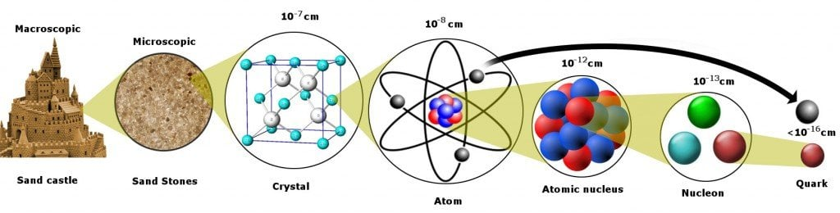
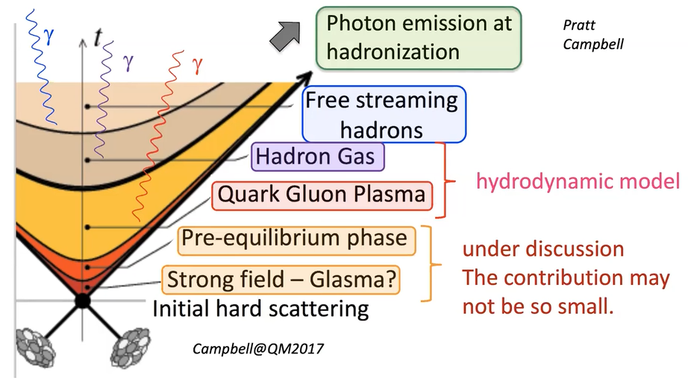
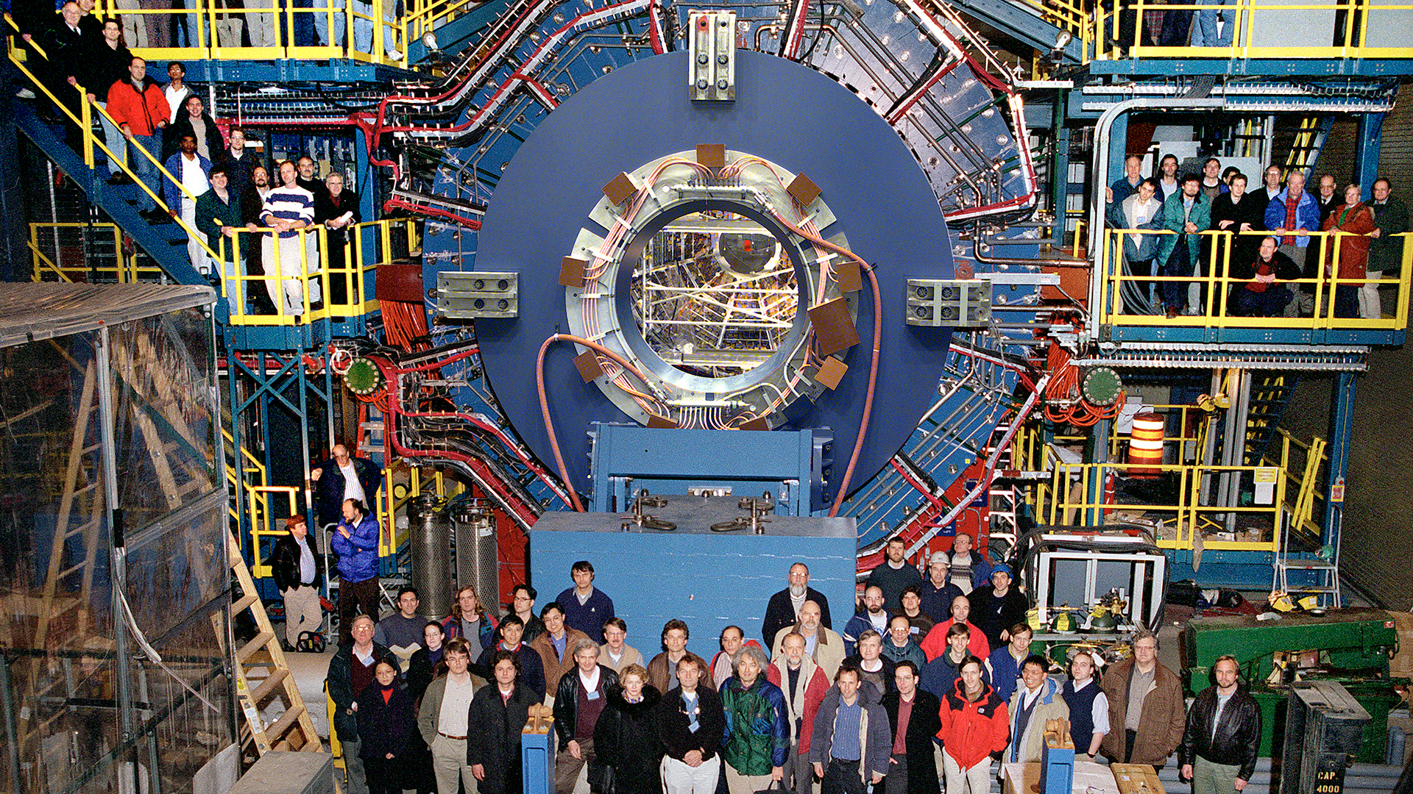

Major Goal: Probing Far-From-Equilibrium Gauge-Theory Dynamics
RELEVANCE TO HIGH-ENERGY PHYSICS
Modern framework for description of fundamental constituents of nature
Phenomenological models on classical computers
QUANTUM ADVANTAGE
TUNABILITY
TEMPORAL SNAPSHOTS
Can we find a complementary venue?

Slide 3
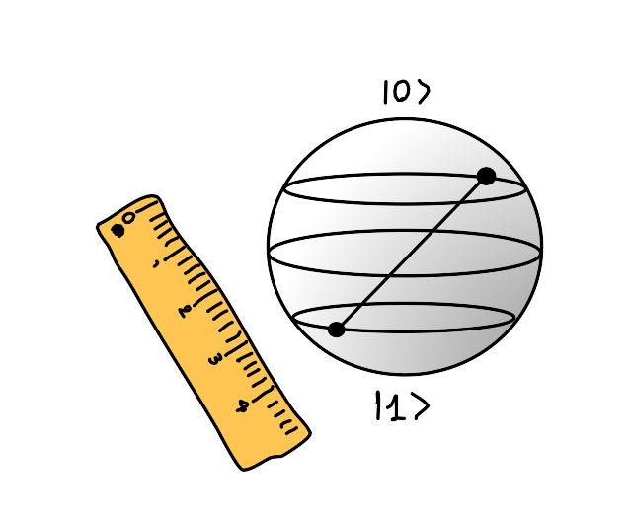
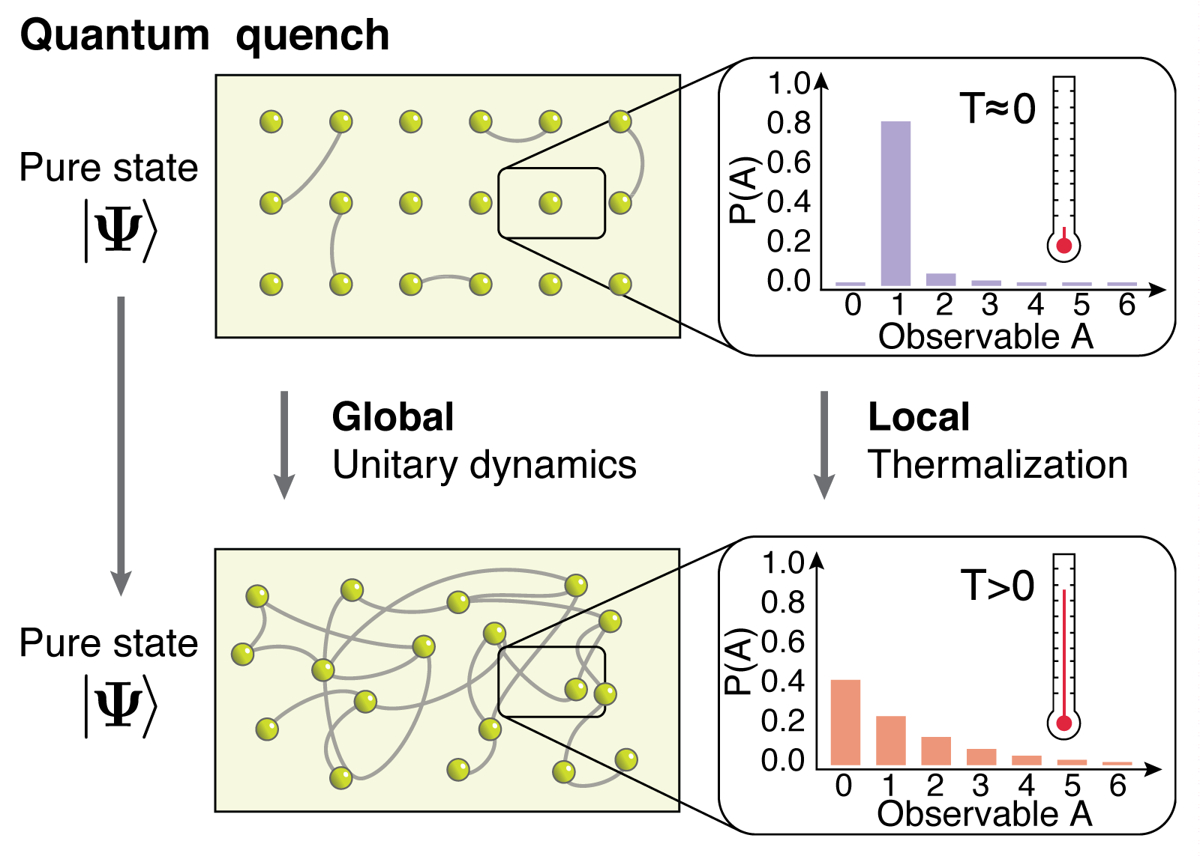
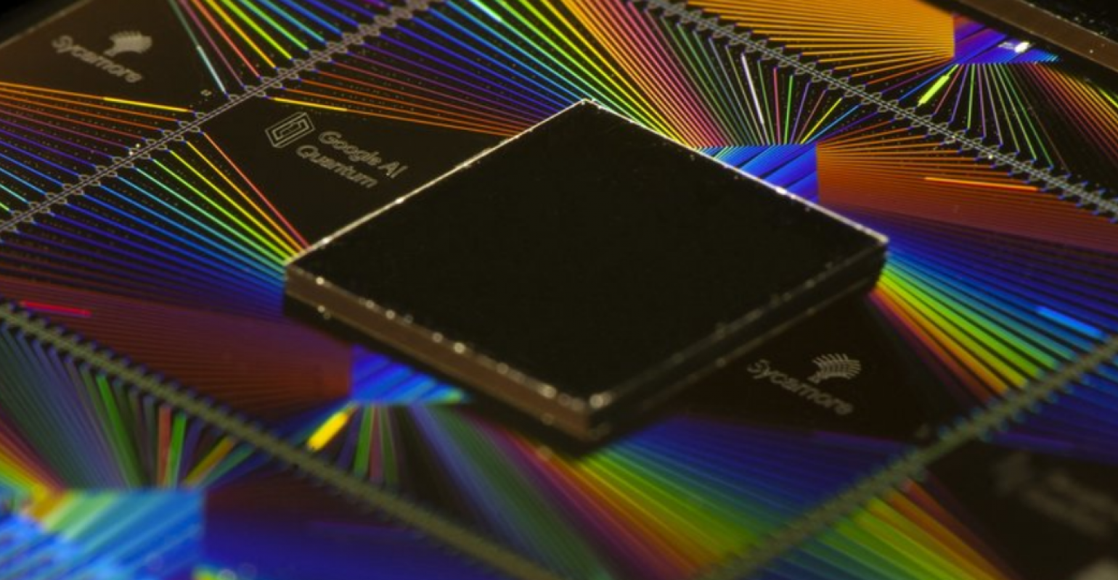
Major Goal: Probing Far-From-Equilibrium Gauge-Theory Dynamics
RELEVANCE TO QUANTUM MANY-BODY PHYSICS
FUNDAMENTAL
TECHNOLOGICAL
E.g., tensor networks
Limited mostly to 1D and
short evolution times due to entanglement buildup
Can we find a complementary venue?
Quantum advantage
Higher dimensions
Longer evolution times
How do isolated quantum many-body systems equilibrate?
Can we leverage exotic (nonthermalizing) dynamics for quantum technology?

Slide 4
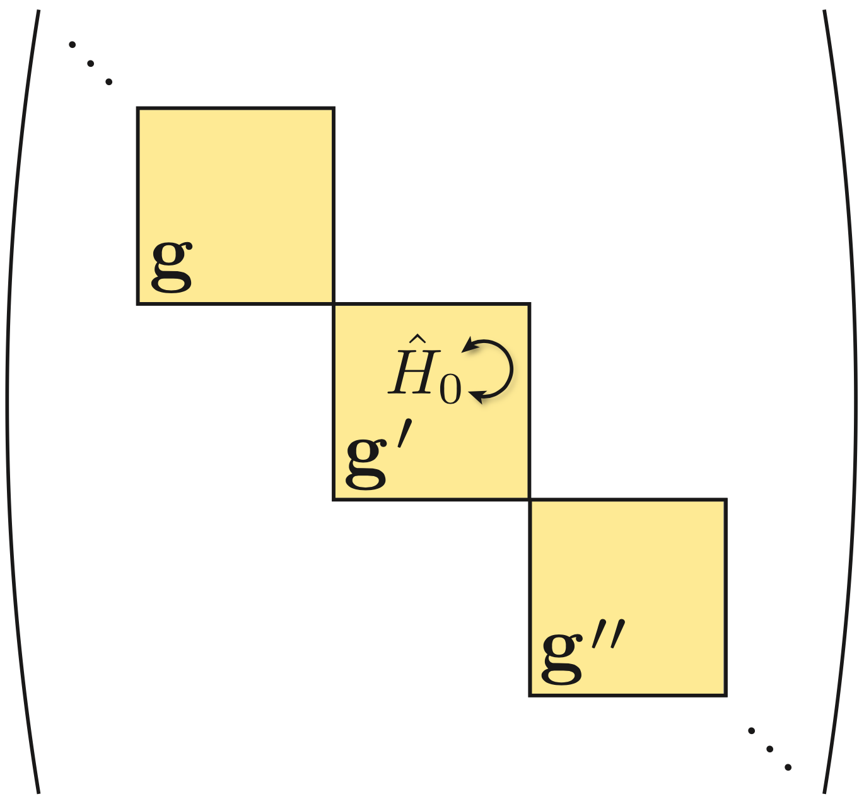
Paradigmatic gauge theory: 1+1D QED (Schwinger model)
Generator of Gauss’s law
U(1) gauge symmetry
Gauge-invariant states
Gauge superselection sectors

Slide 5
Quantum link formulation
Infinite-dimensional local Hilbert space
Quantum link model (QLM) formulation
Jordan-Wigner transformation
(2S+1)-dimensional operators
Spin-S U(1) QLM
Chandrasekharan and Wiese, Nuc. Phys. B 492, 455 (1997)
Wiese, Ann. Phys. 525, 777 (2013)

Slide 6
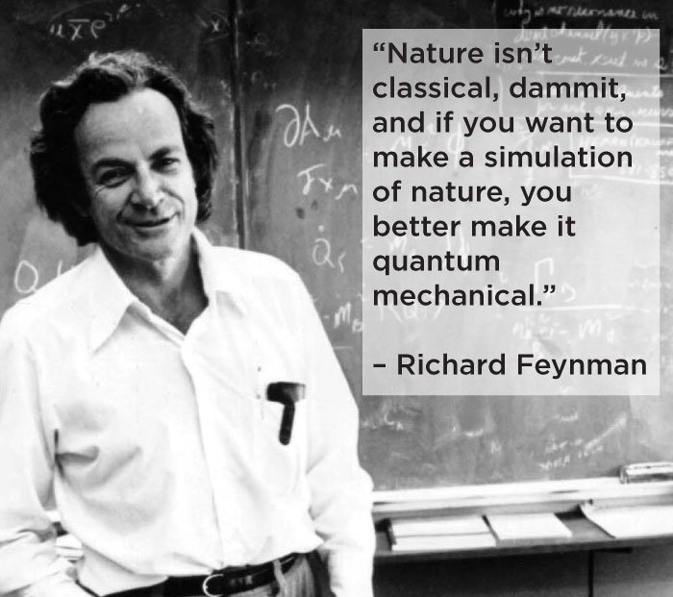
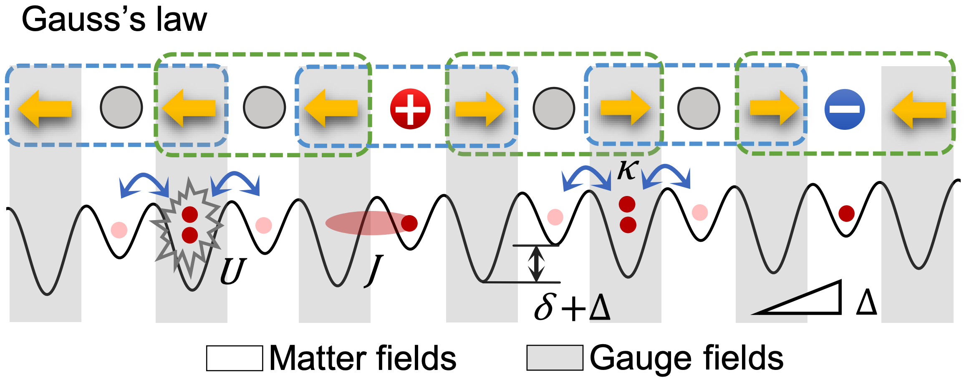
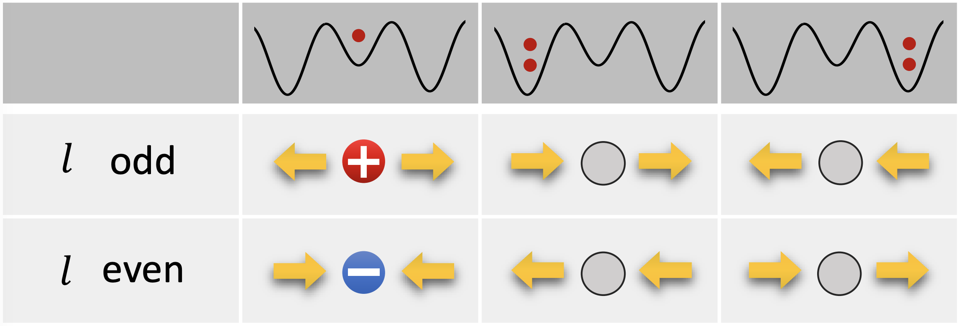
Large-Scale Quantum Simulators of Gauge Theories
Yang et al. (JCH), Nature 587, 392 (2020)

Slide 7
Large-Scale Quantum Simulators of Gauge Theories
Yang et al. (JCH), Nature 587, 392 (2020)

Slide 8
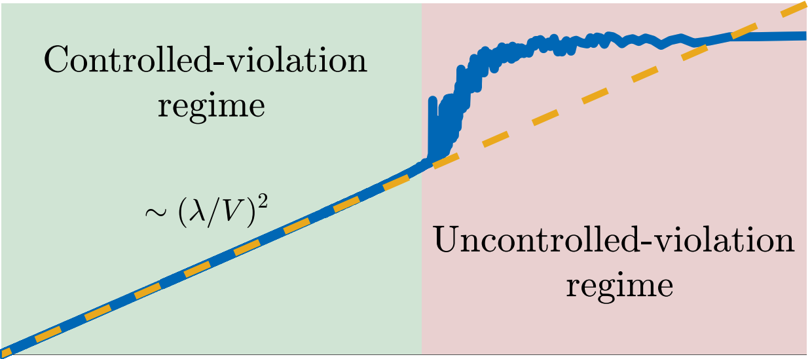
Our Solution: Linear Gauge Protection
Energy
Target model
Unavoidable errors
Gauge protection
Choose coefficients properly to energetically isolate physical sector
Target model subspace
“Infinite”-time gauge violation
Facchi and Pascazio, Phys. Rev. Lett. 89, 080401 (2002)
Facchi et al., Phys. Rev. A 69, 032314 (2004)
Burgarth et al., Quantum 3, 152 (2019)
JCH and Hauke, Phys. Rev. Lett. 125, 030503 (2020)
JCH et al., PRX Quantum 2, 040311 (2021)

Slide 9
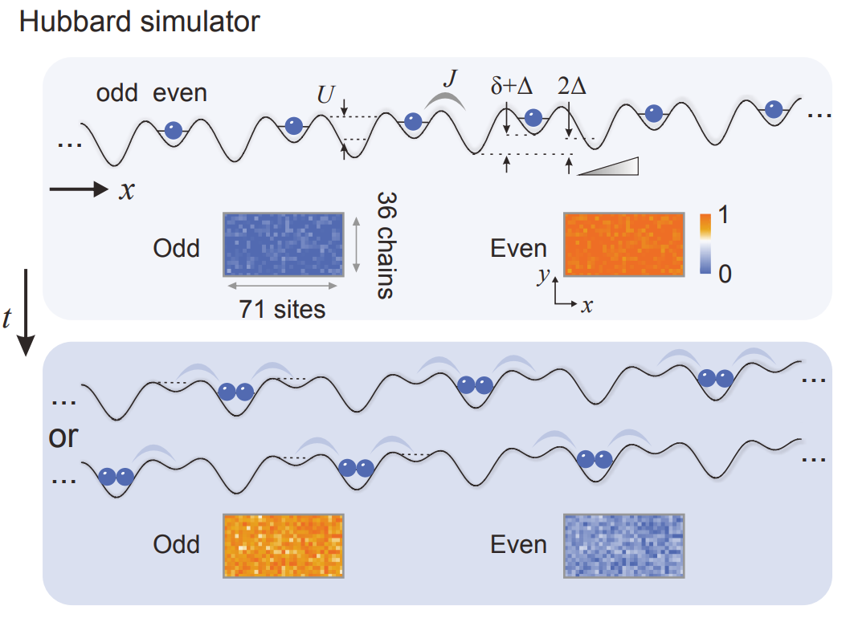
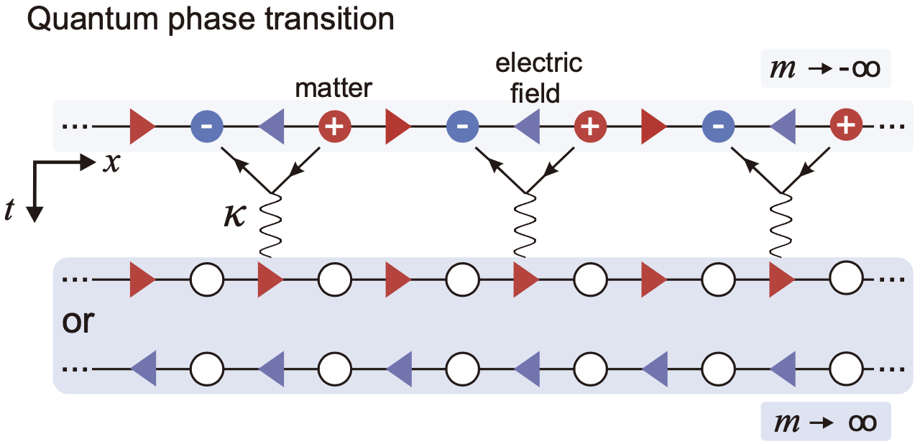
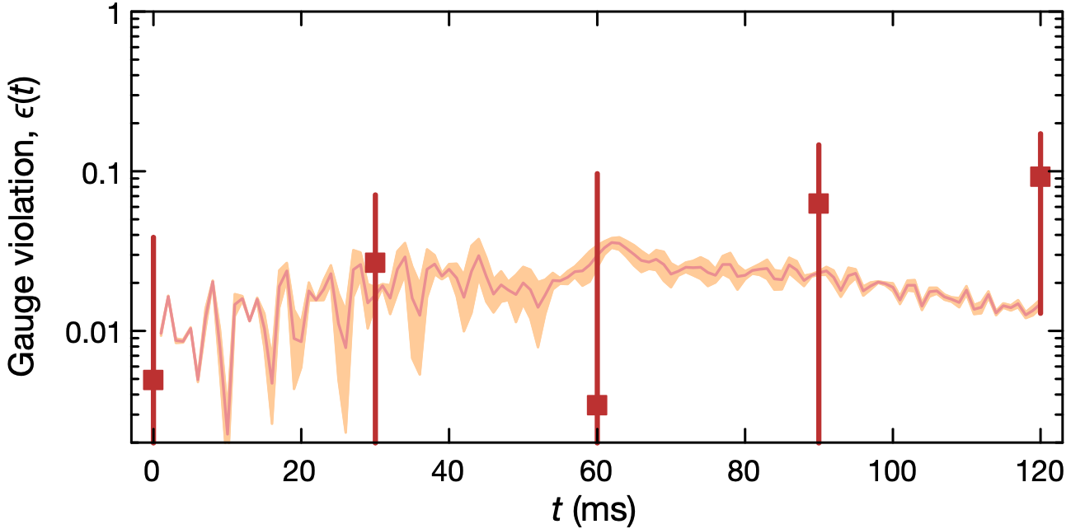
First Large-Scale Quantum Simulator of Gauge Theories
71 SITES
Controlled violation
Gauge protection term
Yang et al. (JCH), Nature 587, 392 (2020)

Slide 10
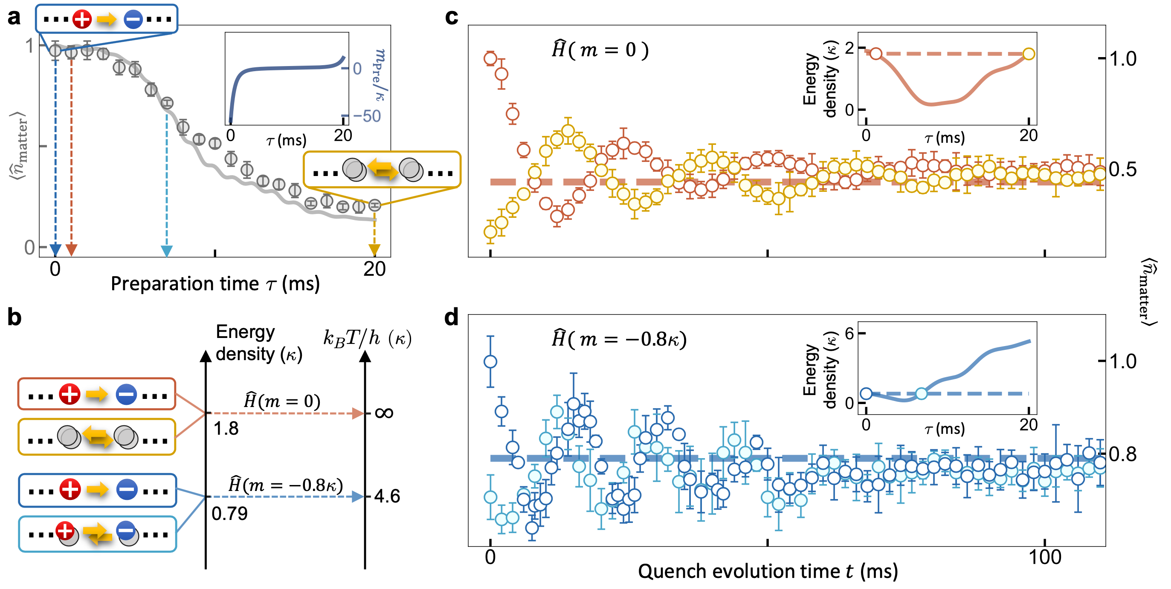
Thermalization of Gauge Theories
Zhou et al. (JCH), Science 377, 311 (2022)

Slide 11
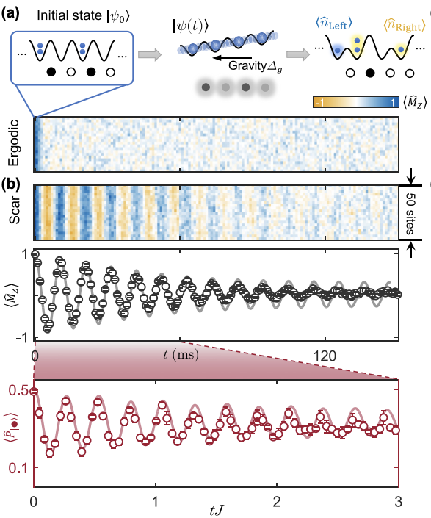
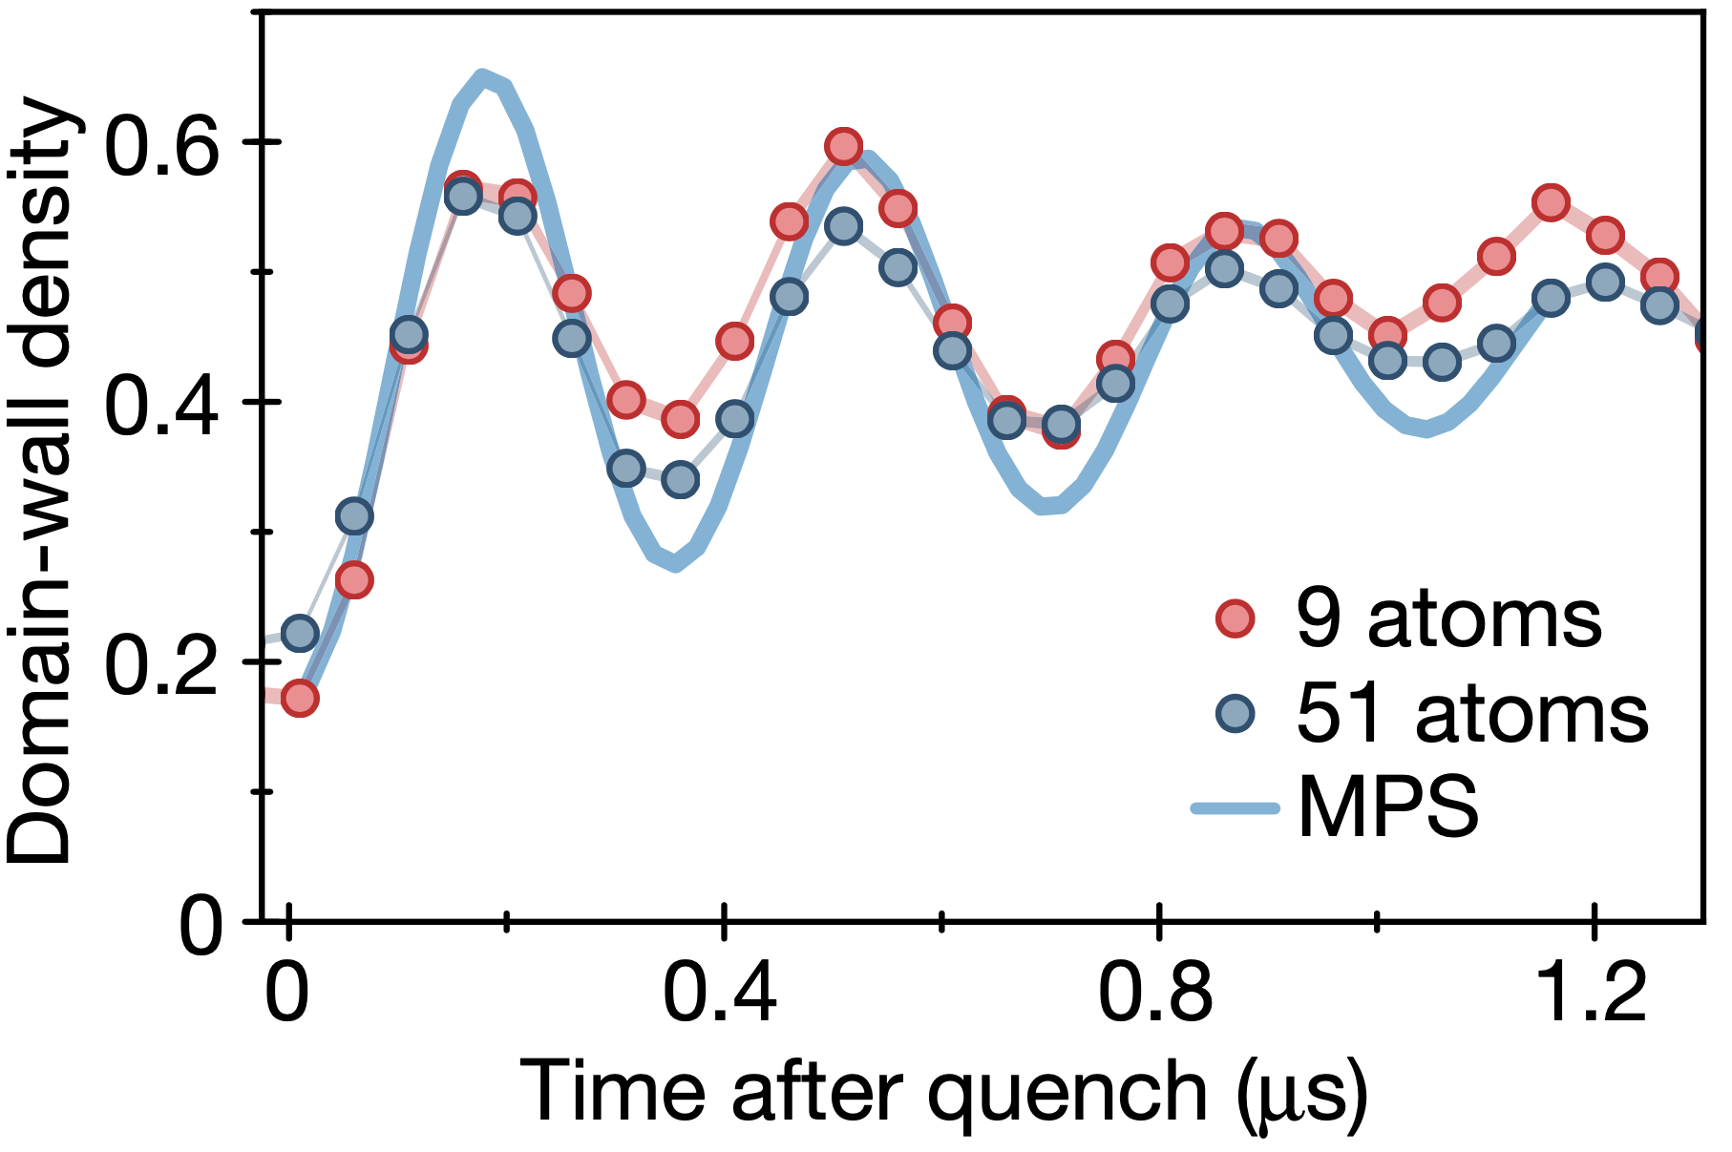
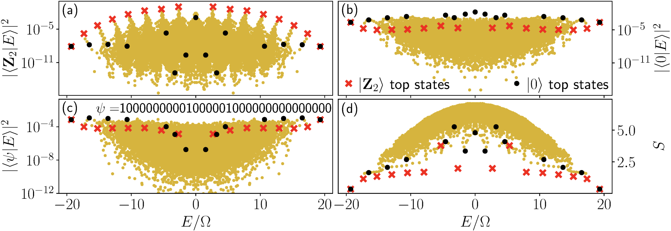
Exotic Gauge-Theory Dynamics: Quantum Many-Body Scarring
Bernien et al., Nature 551, 579 (2017)
Surace et al., Phys. Rev. X 10, 021041 (2020)
Su et al. (JCH), Phys. Rev. Research 5, 023010 (2023)

Slide 12
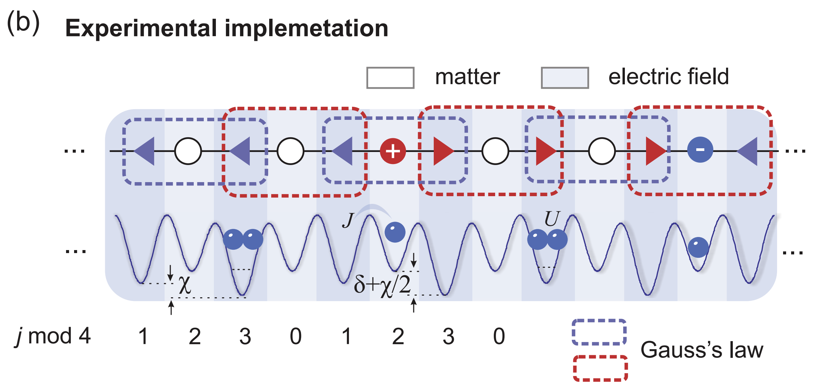
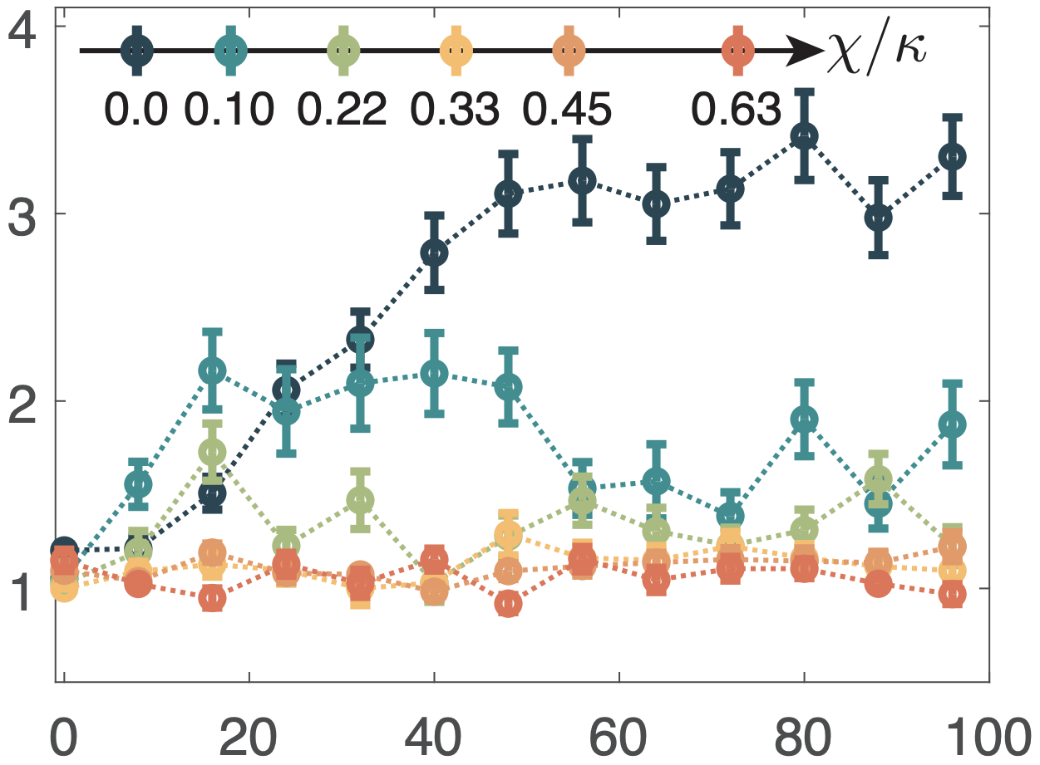
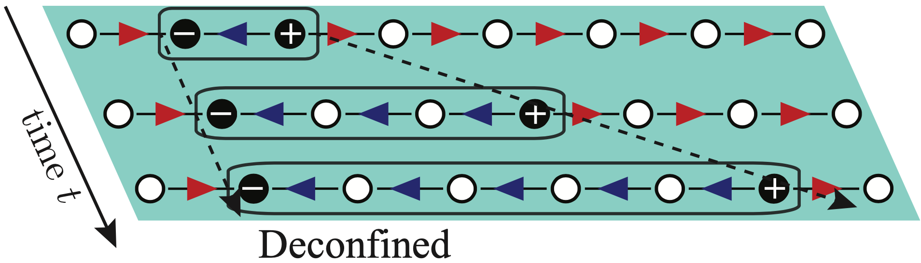
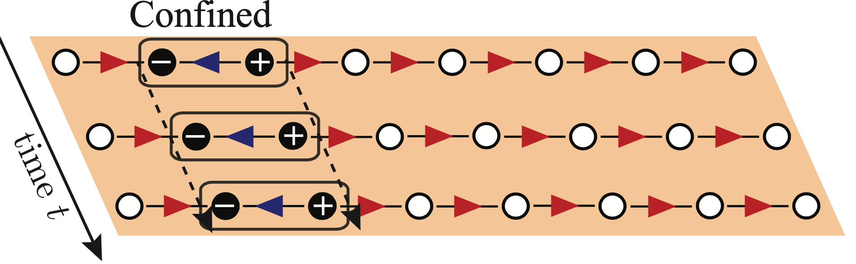
Exotic Gauge-Theory Dynamics: Confinement
Experimental results
string length
time (ms)
JCH et al., PRX Quantum 3, 040316 (2022)
Zhang et al. (JCH), arXiv2306.11794

Slide 13
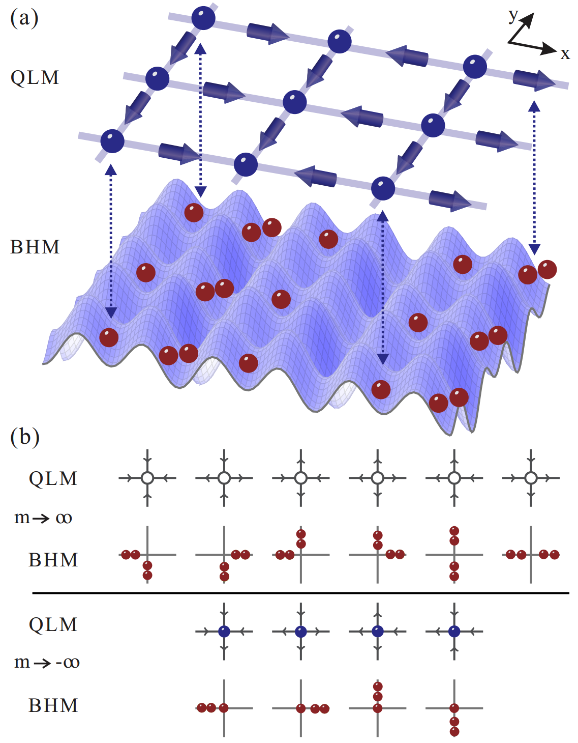
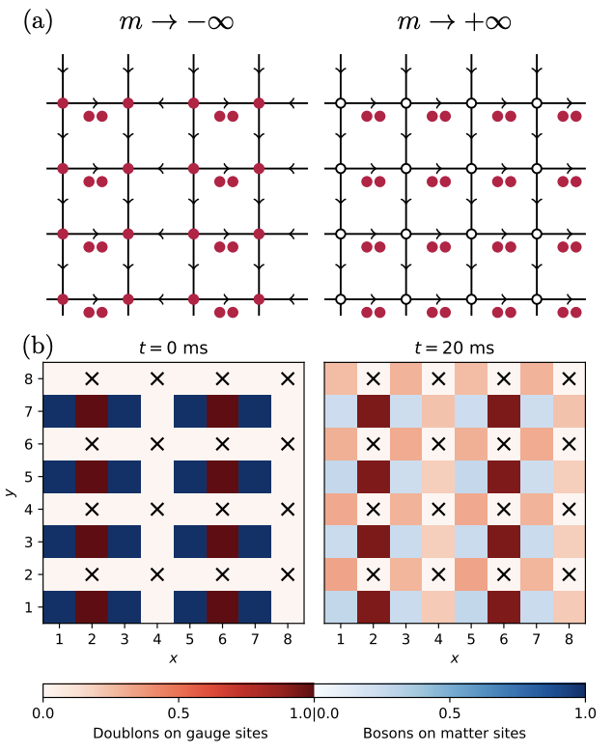
Going to Higher Spatial Dimensions
Osborne et al., JCH, arXiv:2211.01380

Slide 14
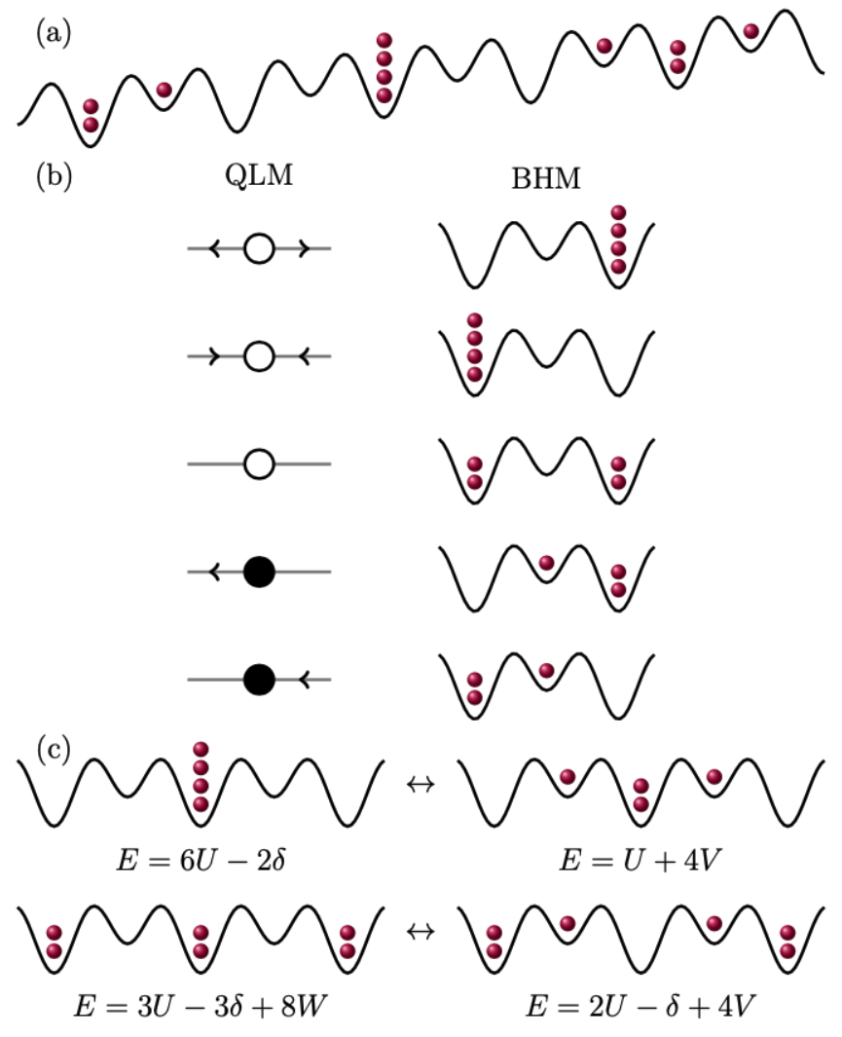
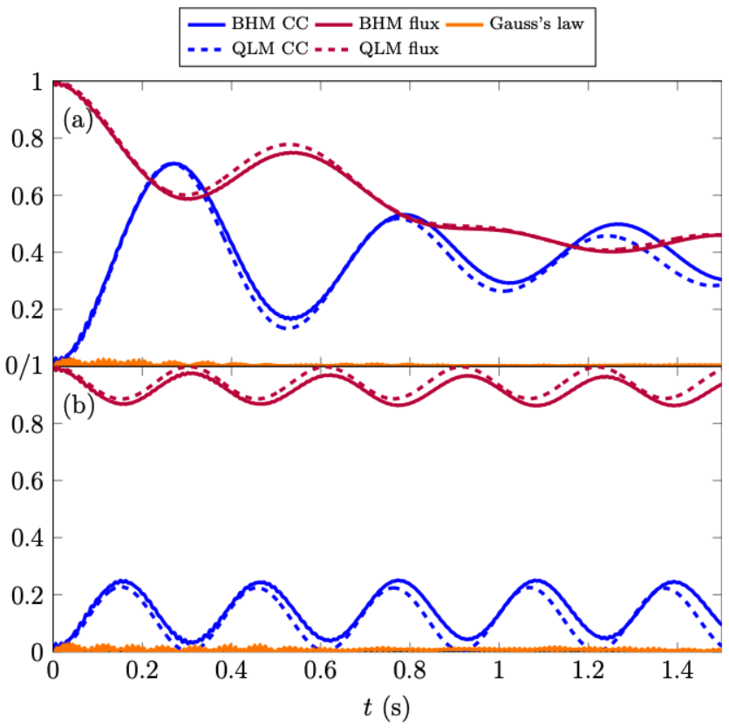
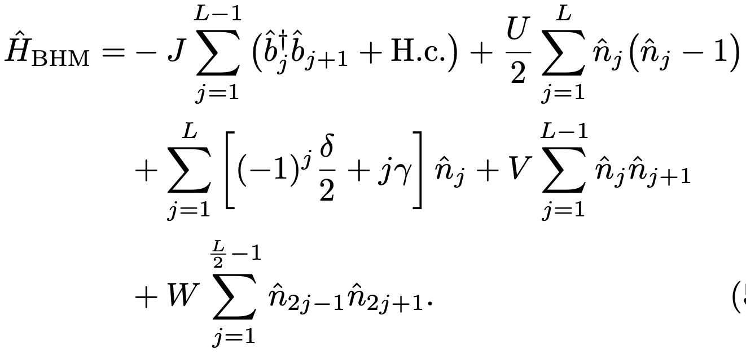
Going to Higher Representations of the Electric Field
Osborne et al., JCH, arXiv:2305.06368

Slide 15
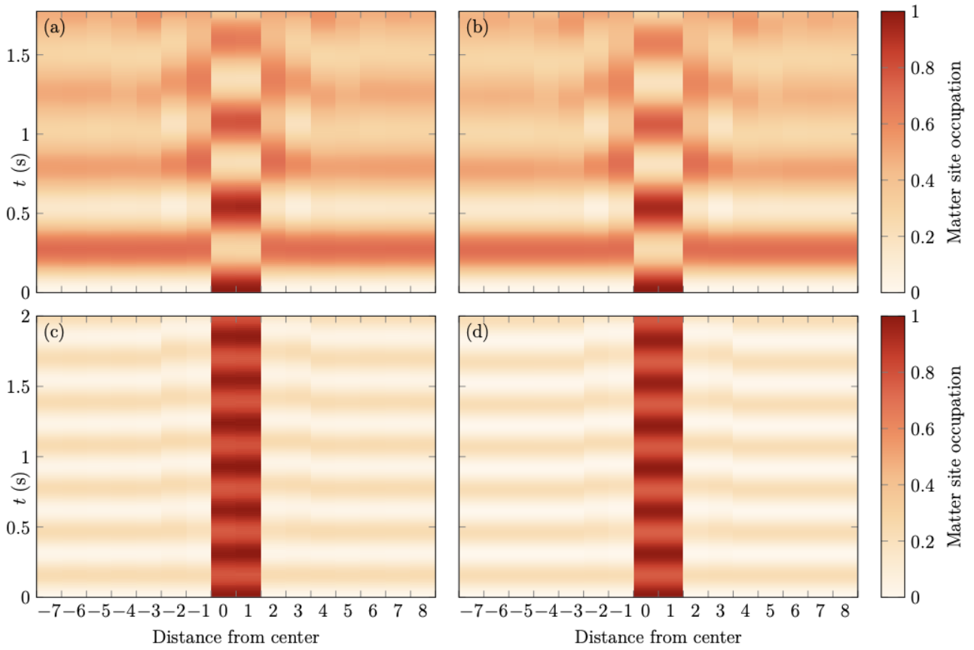
Going to Higher Representations of the Electric Field
BHM
QLM
Vanishing gauge coupling
Strong gauge coupling
Osborne et al., JCH, arXiv:2305.06368

Slide 16
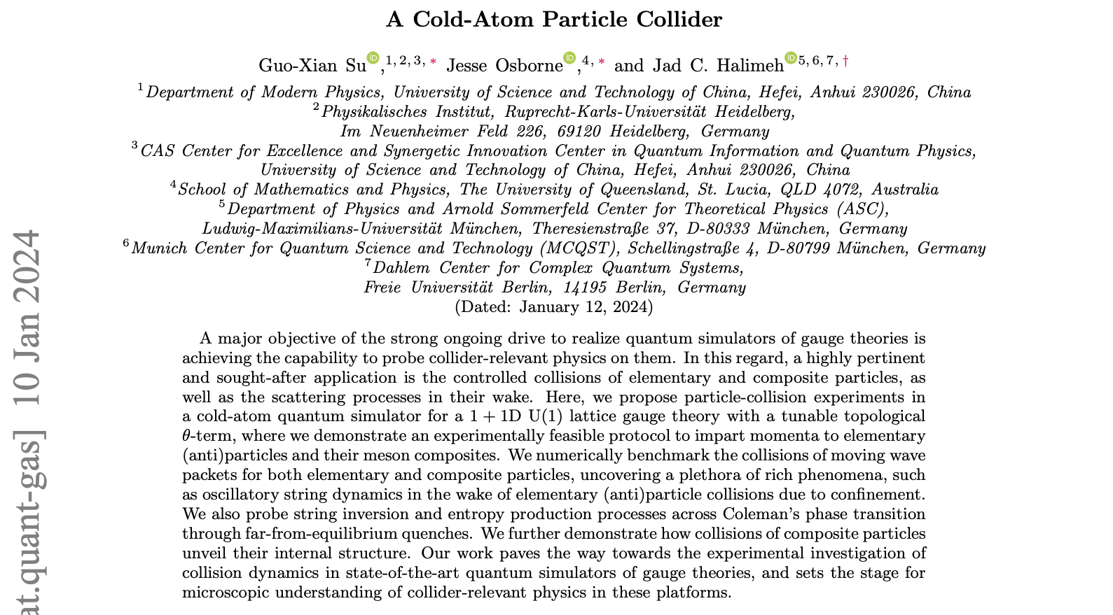
Probing Particle Collisions on a Quantum Simulator
Su, Osborne, JCH, arXiv:2401.05489

Slide 17

























...
...
$$Deconfined$$
$$χ=0$$
1
1
0.4
0.4
$$\left|\left\langle \hat{Q}\right\rangle \right|$$
$$\left\langle \hat{Q}\right\rangle$$
$$\left\langle \hat{E}\right\rangle$$
0
$$t (s)$$
0.2
$$t (s)$$
0.2
0
20
$$j_{M}$$
40
0
0.2
0.4
0
-1
0
10
20
30
10
20
30
$$t (s)$$
$$j_{M}$$
$$j_{G}$$
$$Confined$$
$$χ=0.035κ$$
1
1
Particle
1
1
Antiparticle
$$\left|\left\langle \hat{Q}\right\rangle \right|$$
0
$$t (s)$$
$$\left\langle \hat{Q}\right\rangle$$
$$t (s)$$
$$\left\langle \hat{E}\right\rangle$$
0
0.5
0.5
20
40
0
0.4
0.8
0
10
20
30
-1
0
10
20
30
$$t (s)$$
$$j_{M}$$
$$j_{G}$$
Su, Osborne, JCH, arXiv:2401.05489

Slide 18
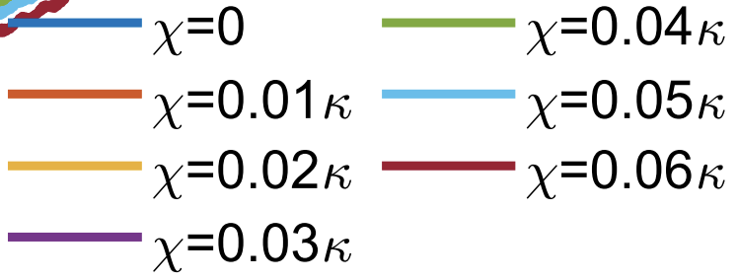
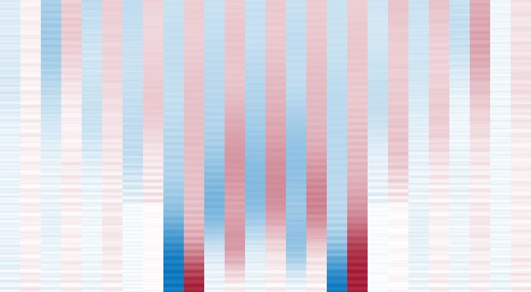
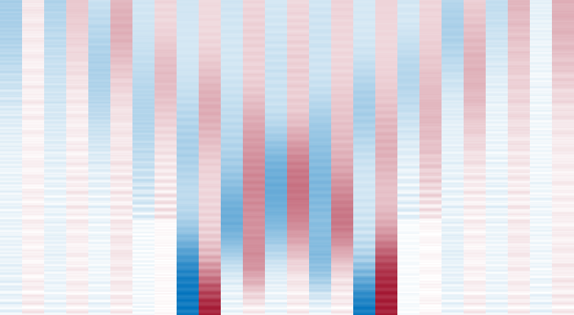
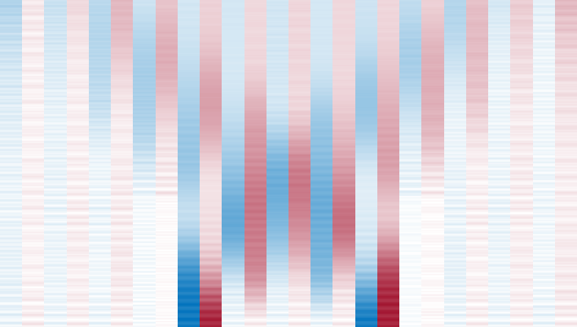


























...
...
$m=1.5κ$ (BHM)
0.5
$m=1.5κ$,
$$χ=0$$
$m=1.5κ$,
$$χ=0.02κ$$
1
$m=1.5κ$,
$$χ=0.04κ$$
1
1
Particle
Antiparticle
Electric flux
0.5
0.5
0.5
$${\left\langle \hat{E}\right\rangle }_{L/2,L/2+1}$$
$$\left|\left\langle \hat{Q}\right\rangle \right| \& \left(\left\langle \hat{E}\right\rangle +0.5\right)$$
0
0
0
0
0
0
10
10
10
20
400
20
400
20
200
400
$$j_{M(G)}$$
0
200
0.4
0
200
0.4
0
0.2
0.4
t (s)
0.2
t (s)
0.2
t (s)
1
-0.5
0.4
0
0.2
0.4
$$t (s)$$
$$\left\langle \hat{Q}\right\rangle$$
$$t (s)$$
0.2
0
5
10
15
20
25
5
10
15
20
25
5
10
15
20
25
-1
0
$$j_{M}$$
$$j_{M}$$
$$j_{M}$$
0.4
$$t (s)$$
$$\left\langle \hat{E}\right\rangle$$
$${\overline{\left\langle \hat{E}\right\rangle }}_{L/2,L/2+1}$$
0.2
0
5
10
15
20
25
5
10
15
20
25
5
10
15
20
25
-0.2
$$j_{G}$$
$$j_{G}$$
$$j_{G}$$
3
0.4
0
0.02
0.04
0.06
$$t (s)$$
$$S$$
$$χ/κ$$
0.2
0
10
20
30
40
50
10
20
30
40
50
10
20
30
40
50
0
$$j$$
$$j$$
$$j$$
Su, Osborne, JCH, arXiv:2401.05489

Slide 19
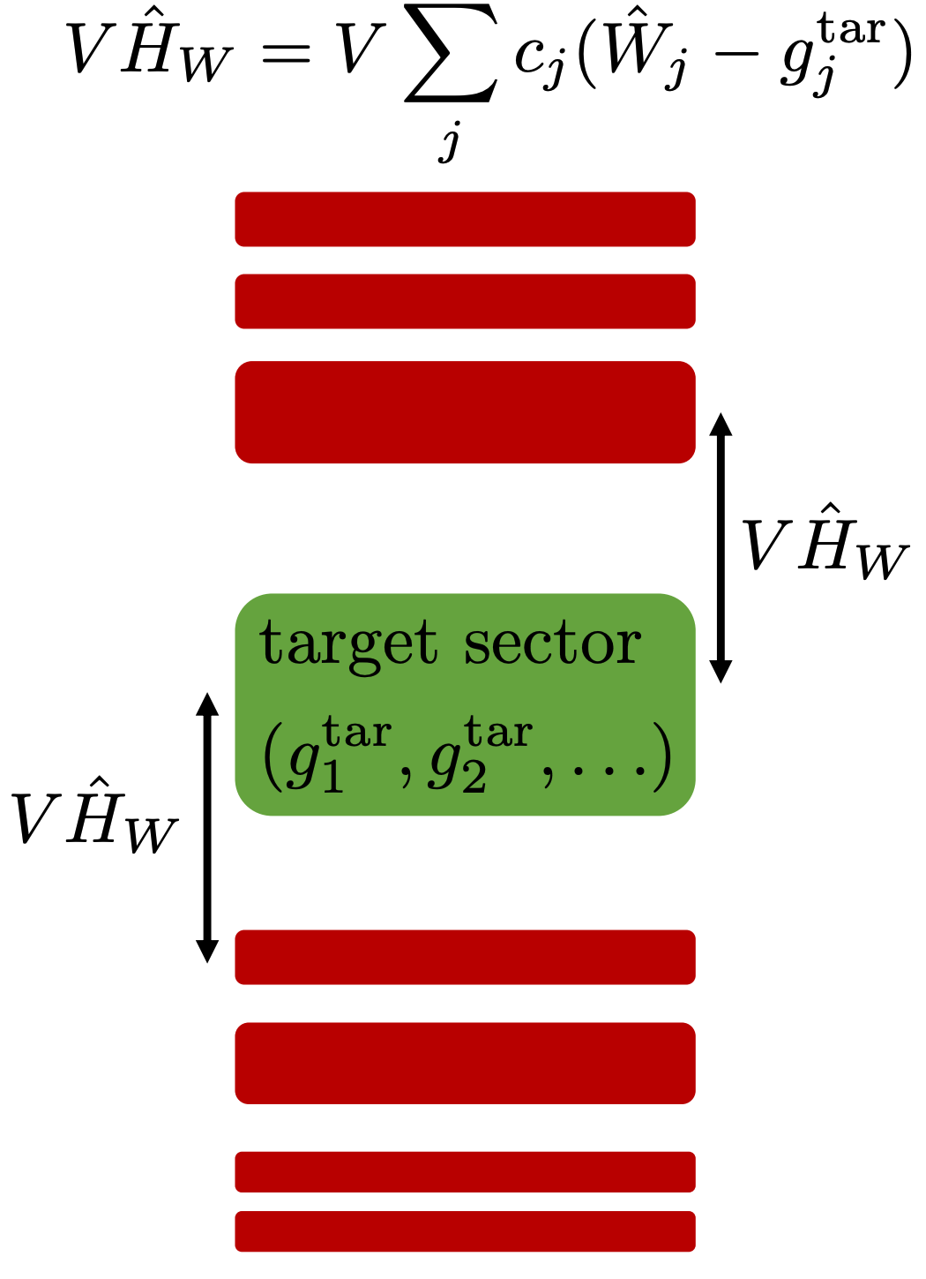
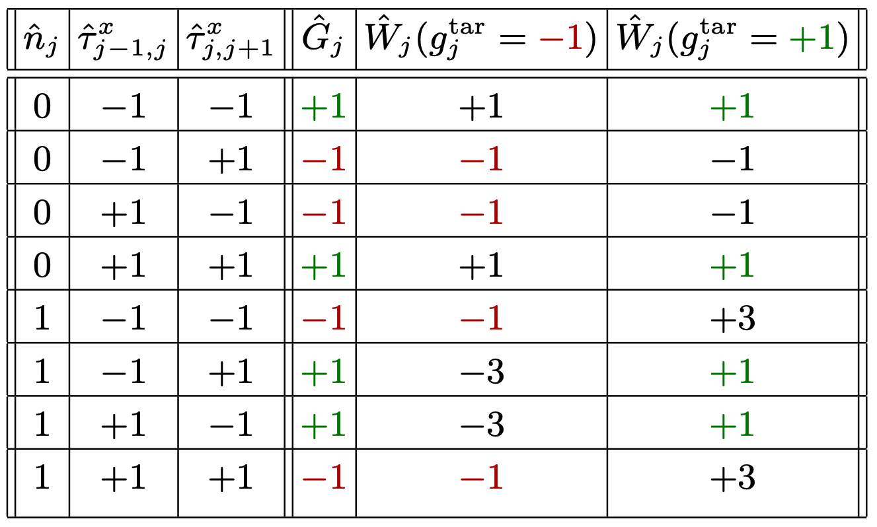
Local pseudogenerator
Schweizer et al., Nat. Phys. 15, 1168-1173 (2019)
JCH and Hauke, Phys. Rev. Lett. 125, 030503 (2020)
JCH et al., Phys. Rev. Research 4, 033120 (2022)

Slide 20
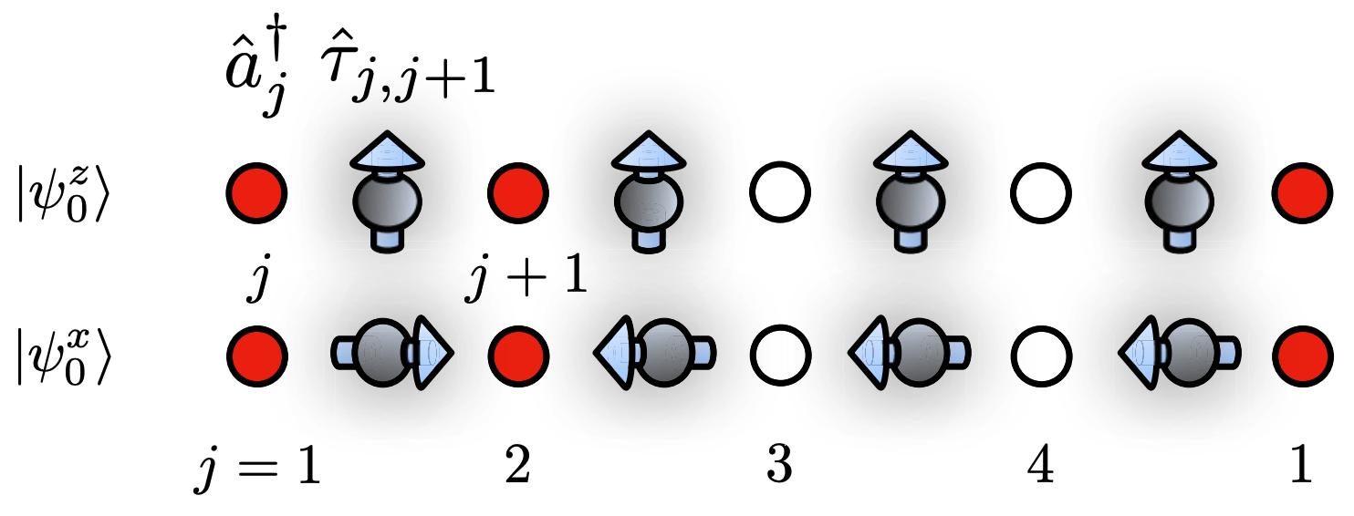
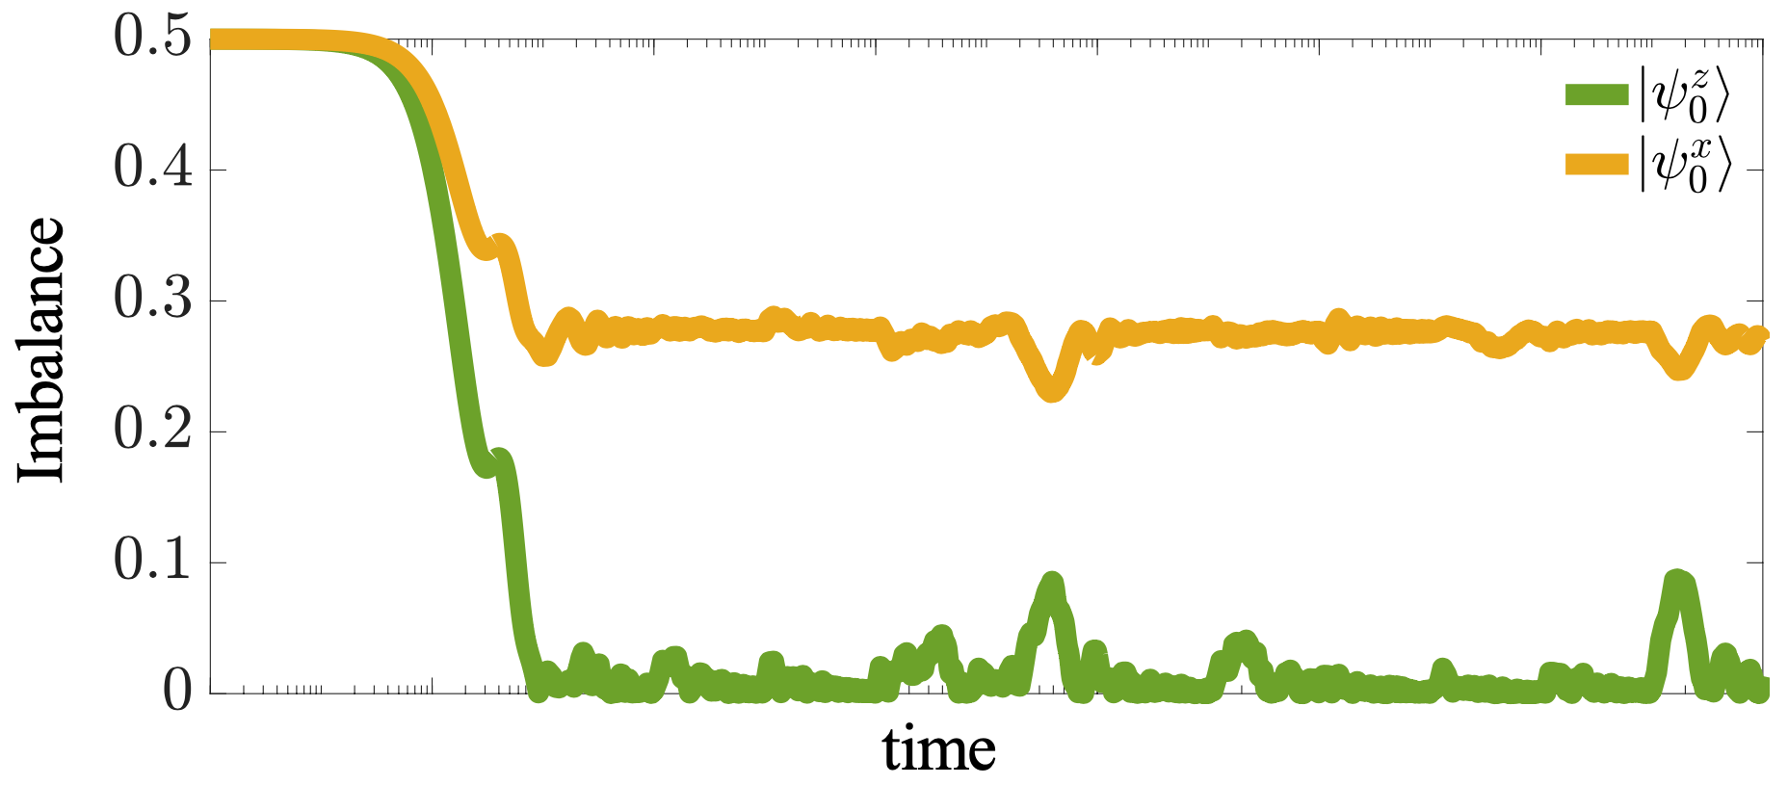
Disorder-free localization
Smith, Knolle, Kovrizhin, Moessner, Phys. Rev. Lett. 118, 266601 (2017)
Brenes, Dalmonte, Heyl, Scardicchio, Phys. Rev. Lett. 120, 030601 (2018)

Slide 21
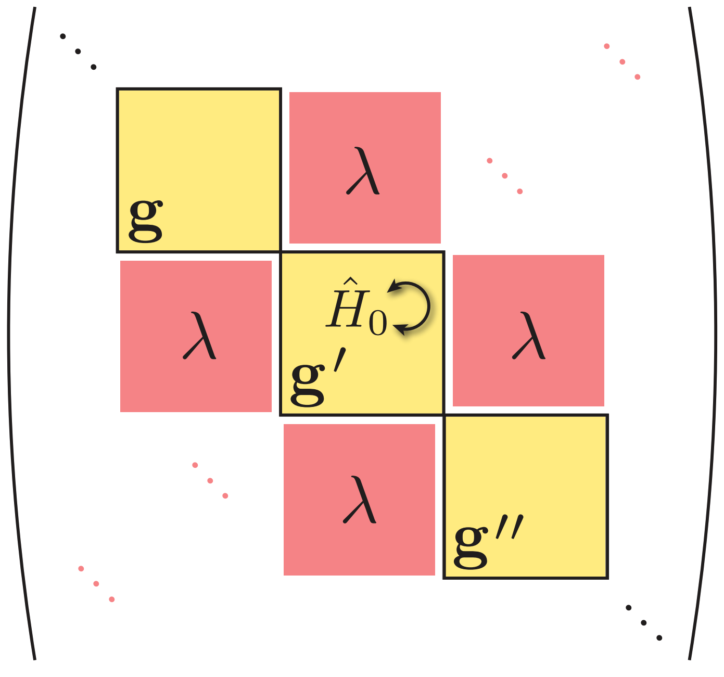
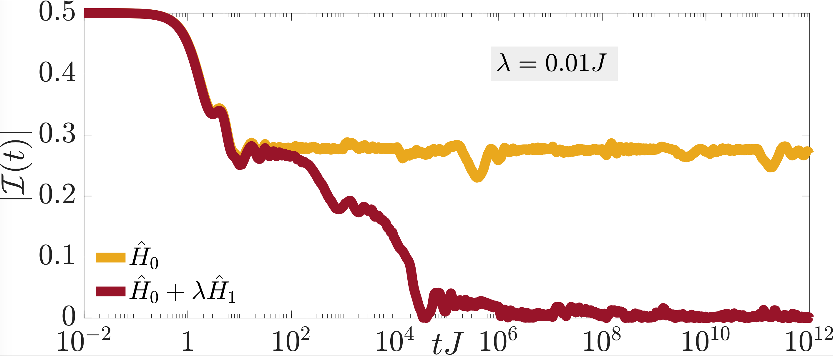
Disorder-free localization
JCH, Zhao, Hauke, Knolle, arXiv:2111.02427
JCH et al., PRX Quantum 3, 020345 (2022)

Slide 22
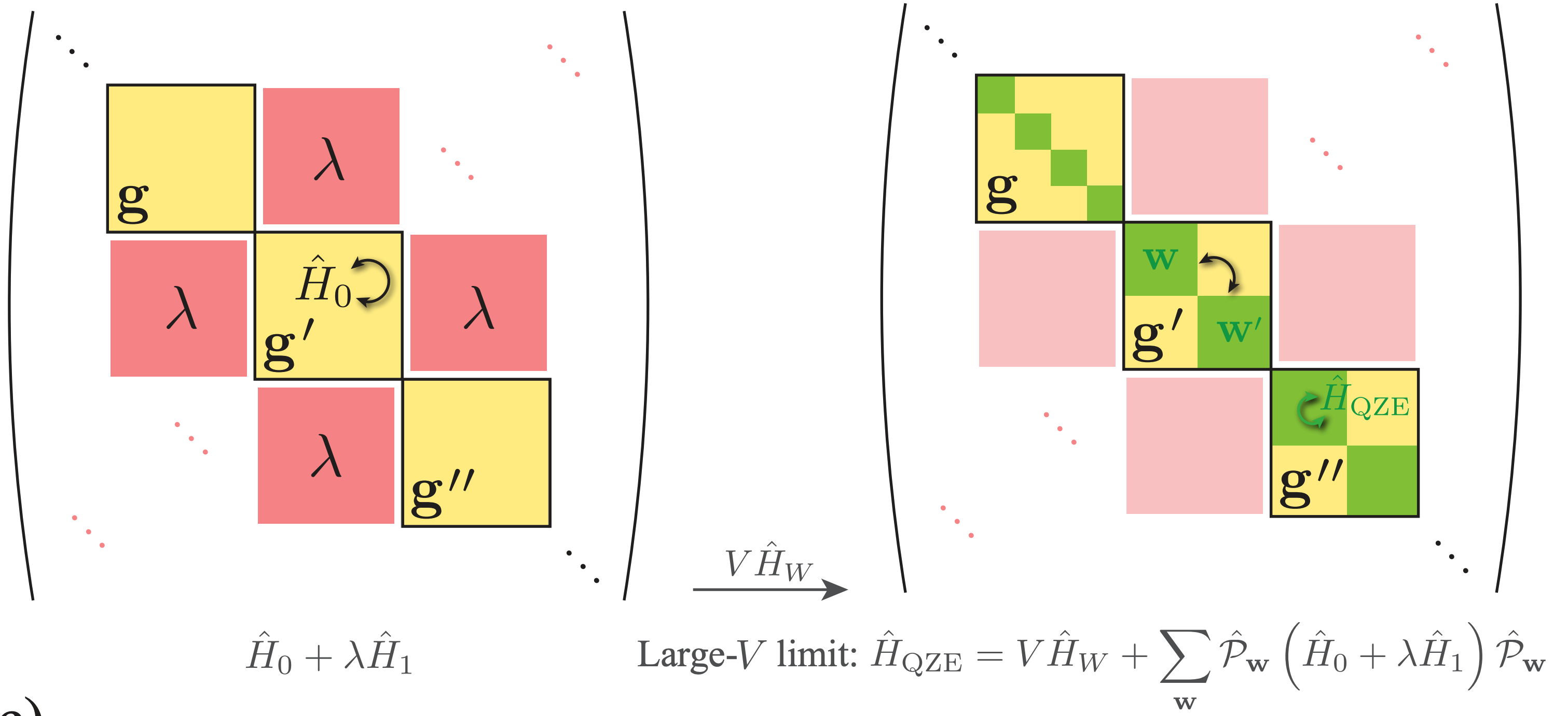
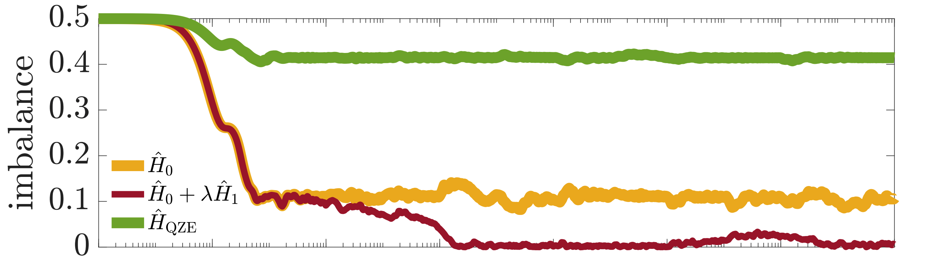
Disorder-free localization
JCH, Zhao, Hauke, Knolle, arXiv:2111.02427
JCH et al., PRX Quantum 3, 020345 (2022)

Slide 23
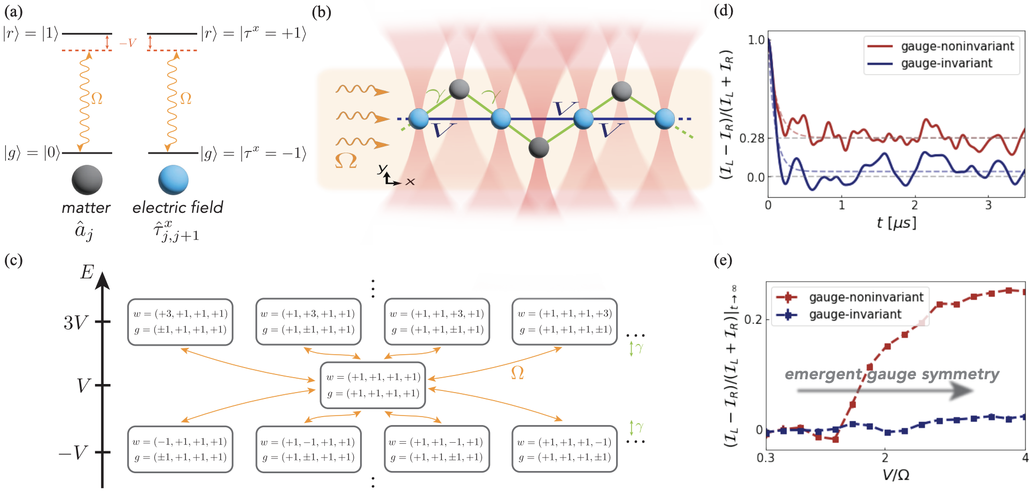
Disorder-free localization: Rydberg-atom experimental proposal
JCH et al., PRX Quantum 3, 020345 (2022)

Slide 24
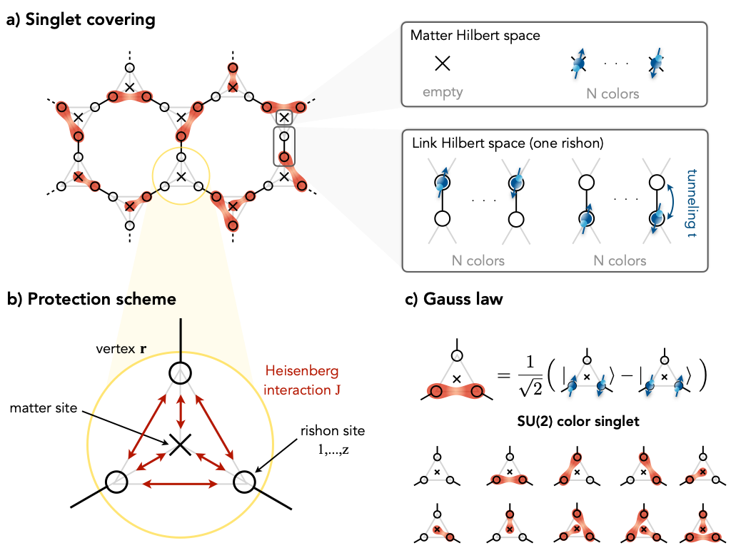
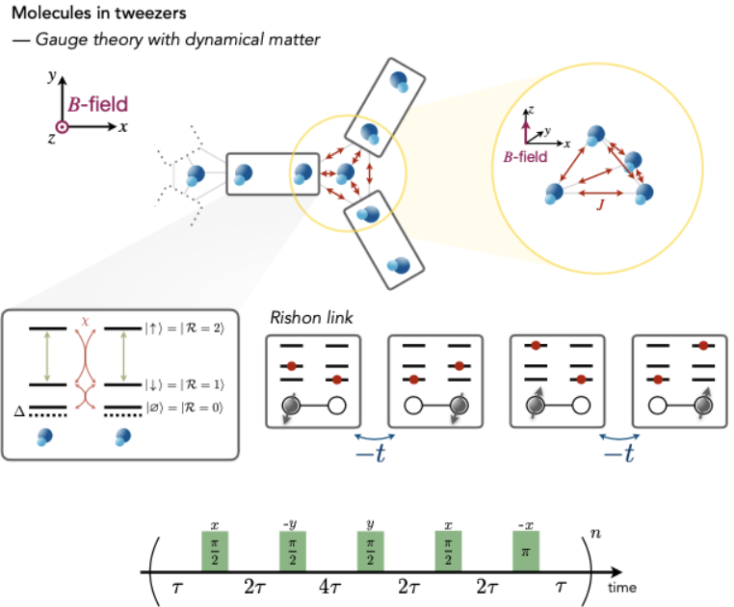
Going to Non-Abelian Gauge Groups
JCH, Lang, Hauke, New J. Phys. 24, 033015 (2022)
JCH*, Homeier*, et al., arXiv:2305.06373

Slide 25
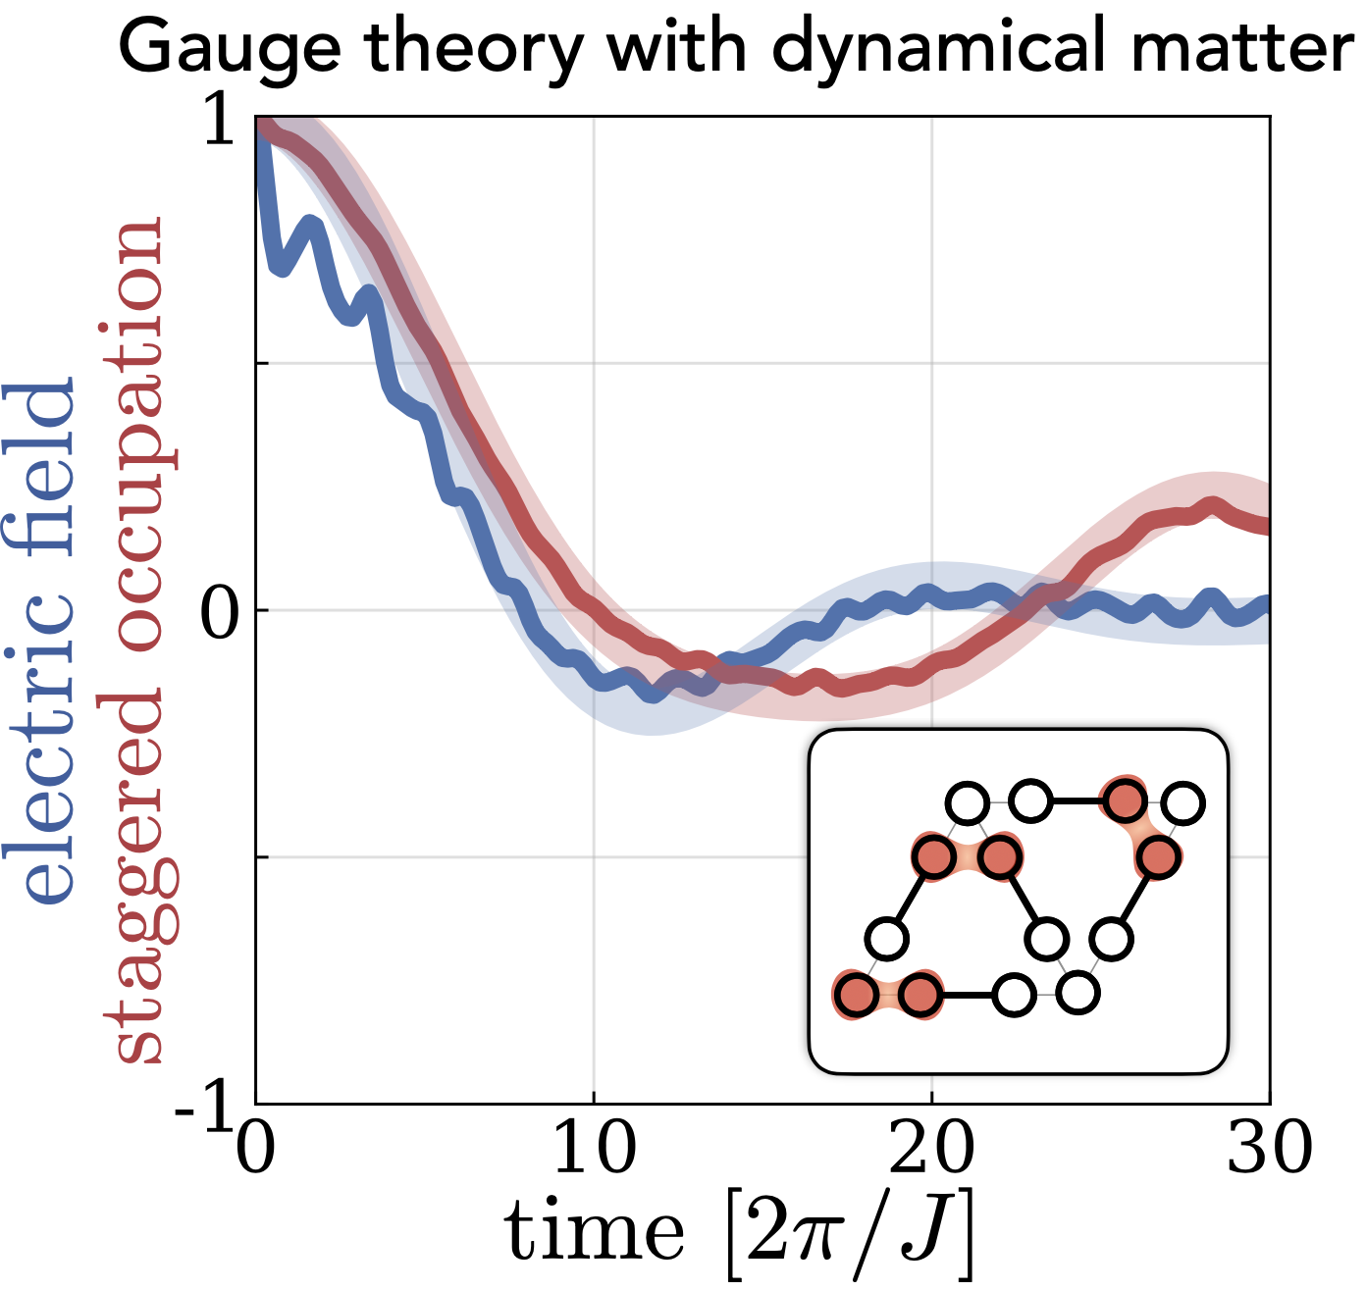
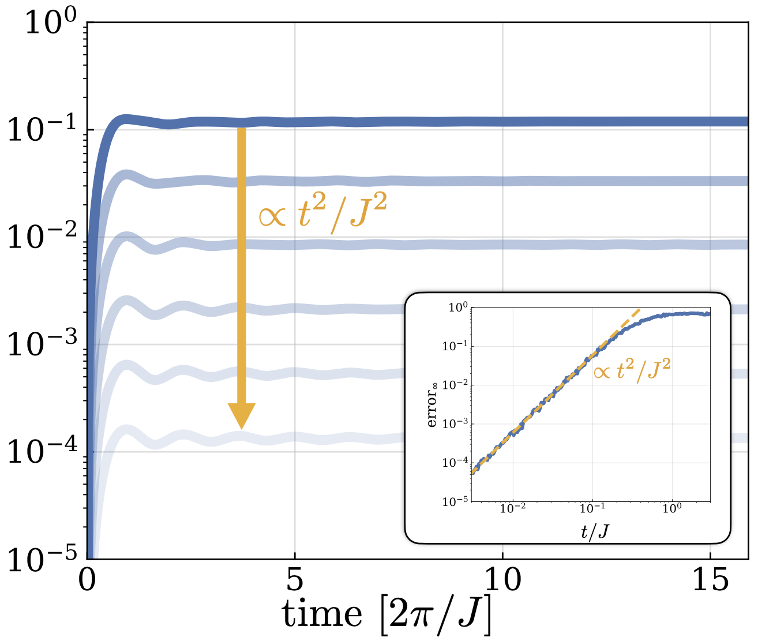
Going to Non-Abelian Gauge Groups
JCH, Lang, Hauke, New J. Phys. 24, 033015 (2022)
JCH*, Homeier*, et al., arXiv:2305.06373

Slide 26
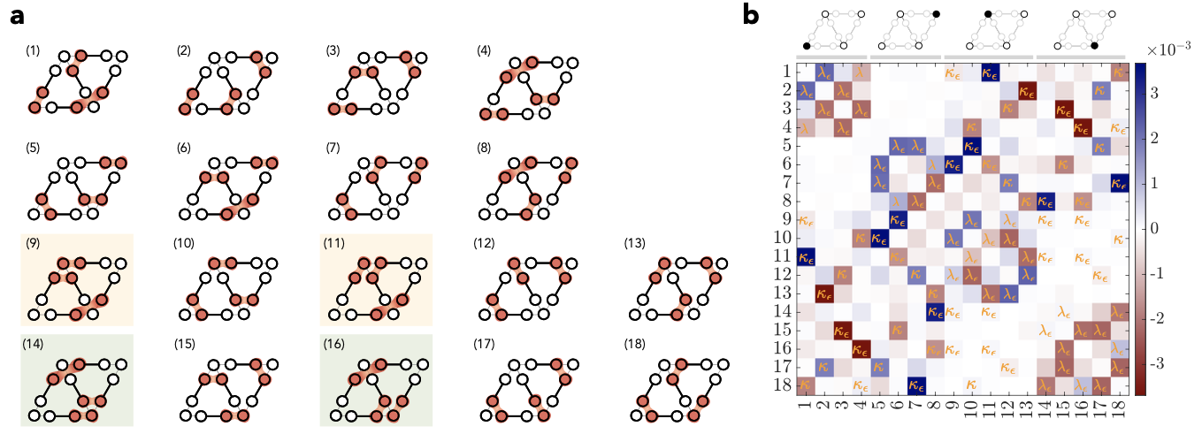
Going to Non-Abelian Gauge Groups
JCH, Lang, Hauke, New J. Phys. 24, 033015 (2022)
JCH*, Homeier*, et al., arXiv:2305.06373

Slide 27
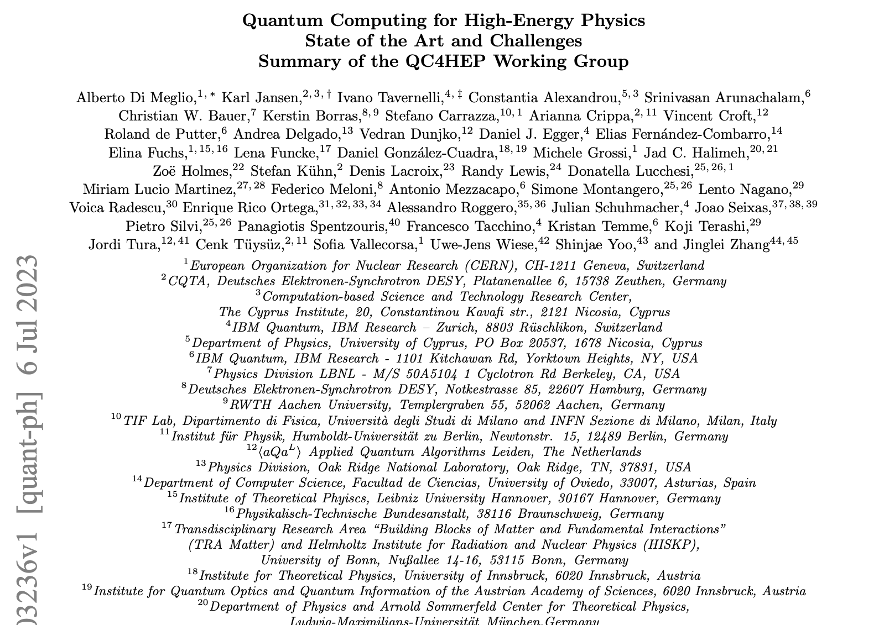
Roadmap Paper (arXiv:2307.03236)

Slide 28
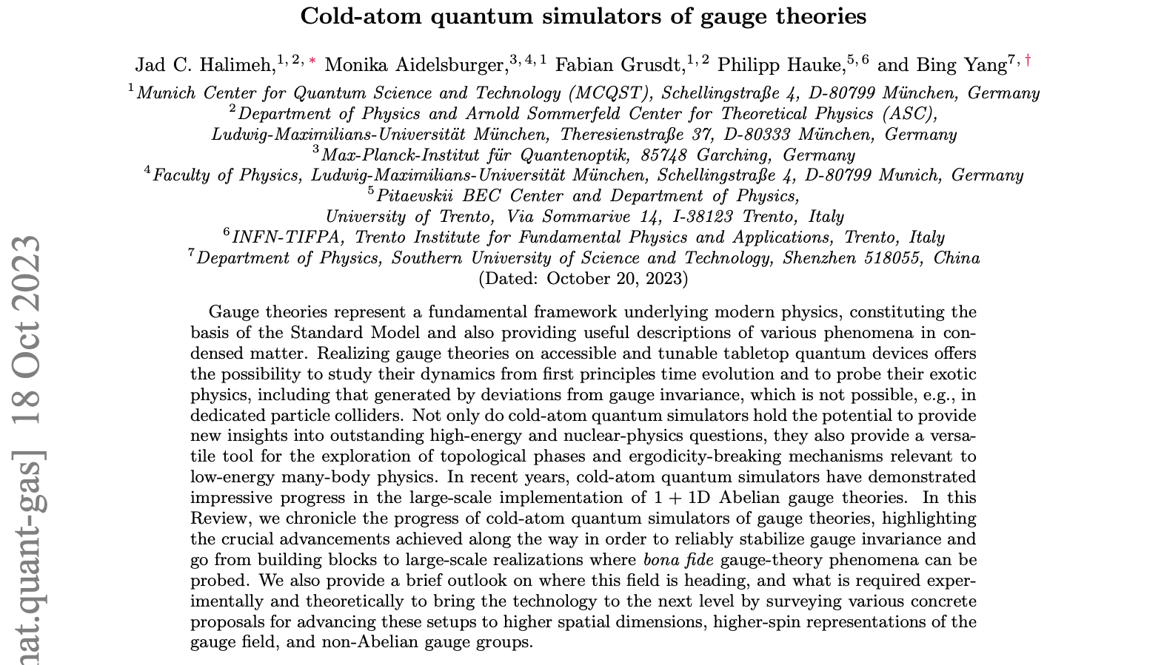
Review Paper (arXiv:2310.12201)

Slide 29
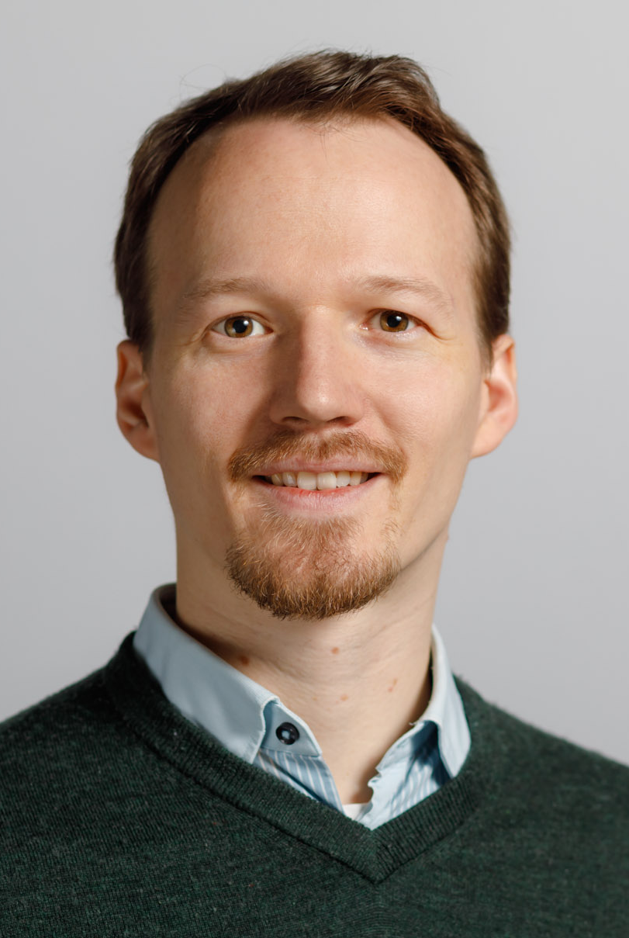













Acknowledgments
Philipp Hauke
Fabian Grusdt
Johannes Knolle
Zlatko Papić
My own research group in Munich started on November 1st, 2023
PhD positions available
GAUGE THEORIES IN COLD ATOMS
EXOTIC DYNAMICS
Monika Aidelsburger
Bing Yang
Zhen-Sheng Yuan
Jian-Wei Pan
THANK YOU!
EXPERIMENT

Slide 30


Future plans
Desaules, et al., JCH, arXiv:2301.07717

Slide 31
Quantum Zeno effect: continuous coupling
Taylor to make gauge superselection sectors!
JCH, Lang, Mildenberger, Jiang, Hauke, PRX Quantum 2, 040311 (2021)

