Slide 1

Generalized fRG Solver for Strongly Correlated Systems
David K. Campbell and Nahom Yirga
ERG 2022, July 28, 2022

Slide 2
Outline
Goal: general fRG-motivated approach to strongly correlated electron systems in
1-,2-, and 3-dimensions involving e-e and e-ph interactions
Brief Historical Review and motivation of fRG:
  Conventional RG (“g-ology”), failure of “g-ology” in 1D EHM, going beyond “g-ology”, our old “multiscale” fRG results on BOW in 1D EHM (tUV model)
Our Algorithmic developments in fRG
  Momentum decoupling, Frequency decoupling, Band decoupling, Decoupling of incoming and outgoing modes in the vertex, Inclusion of phonon modes within the decoupled picture
Selected Applications
  Models for the cuprate SC: one-, two-, and three-band models for cuprates, phonon modes in cuprates
  Models for infinite layer Nicketlates
Future Directions and Outlook
Key reviews
  C. Bagnuls and C. Bervillier, Phys. Rep. 348 91 (2001)
  W. Metzner, M. Salmhofer, C. Honerlkamp, V. Meden, and K. Schönhammer, RMP 84 299 (2012)

Slide 3
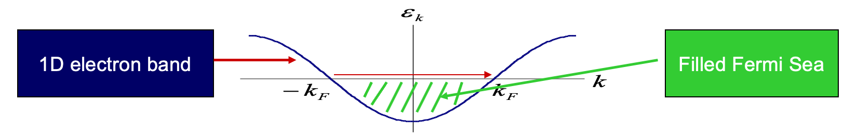
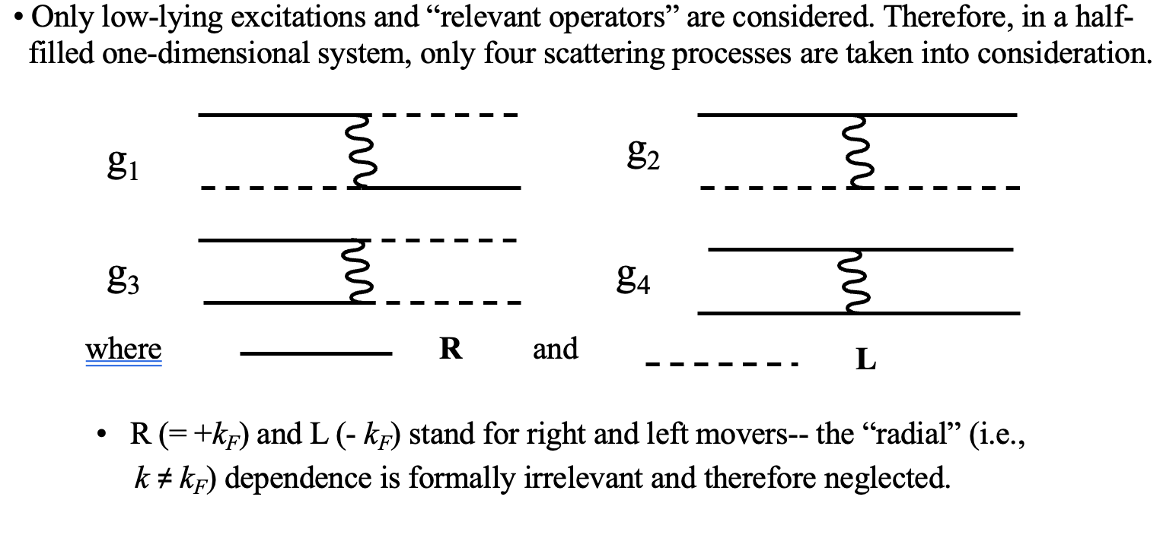
Brief Historical Review: Conventional RG
Recall conventional RG (”g-ology”) (Emery, Solyom,..
But: Failure of “g-ology” in 1D EHM (= tUV) model motivates fRG—next
slides give history and our new results

Slide 4
1D EHM: Conventional Wisdom—strong coupling
The one-dimensional extended Hubbard model
In the classical (or “strong coupling”) limit (large U/t and V/t), there are two obvious possible
broken symmetry phases at half-filling, charge density wave (CDW) and spin density
wave (SDW).
The phase boundary is U=2V (simple counting argument).
CDW
2V
SDW
Same holds true for finite t—boundary line perhaps slightly shifted but only two phases
U

Slide 5
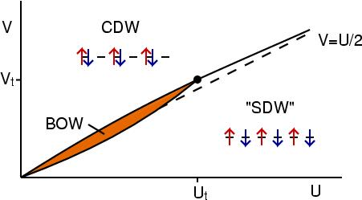
CW Shattered: “BOW*” Phase in 1D EHM
In 1999, Nakamura suggested the existence of an intermediate “bond order wave” (BOW) phase (dimerized, modulated kinetic energy density) based on level crossing spectroscopy method for small system sizes (M. Nakamura, JPSJ 1999, PRB 2000).
CDW: spin & charge gaps
BOW: spin & charge gaps
SDW: only charge gap
* “BOW” also called “BCDW”
BOW order parameter:
Two “cartoon” views:
!! Existence of BOW confirmed by “SSE” QMC !! (Sengupta, Sandvik, DKC, PRB 2002)

Slide 6
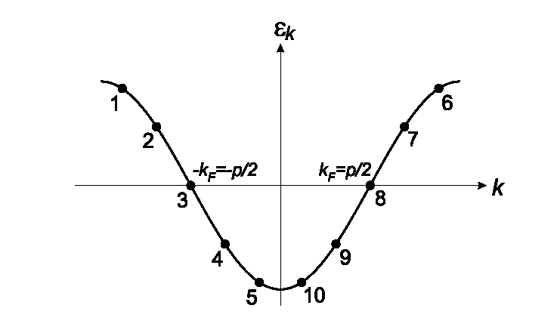
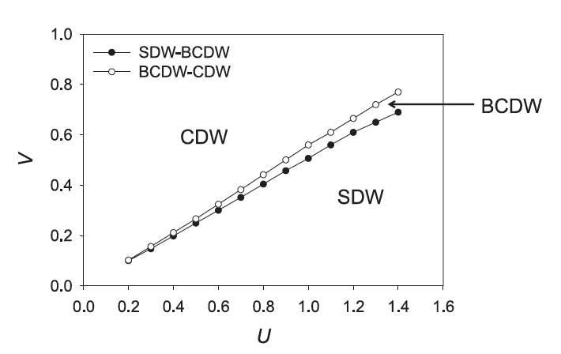
How to capture BOW in 1D EHM in RG?
Accidental degeneracy requires inclusion of nominally irrelevant operators coupled to relevant
operators by generalizing g-ology to a functional RG (=fRG) with many scattering processes.
(Recall “patch RG,” Zanchi and Schulz, PRB 2000).
k₁
k₃
k₂
k₄=k₁+k₂-k₃
where, k₁, k₂ and k₃ can be anywhere in the Brillouin zone.
Discretization scheme for N = 10 radial divisions in momentum: no frequency dependence
Old fRG Results: K-M Tam, S-W Tsai, DKC PRL 96 036408 (2006)
.

Slide 7
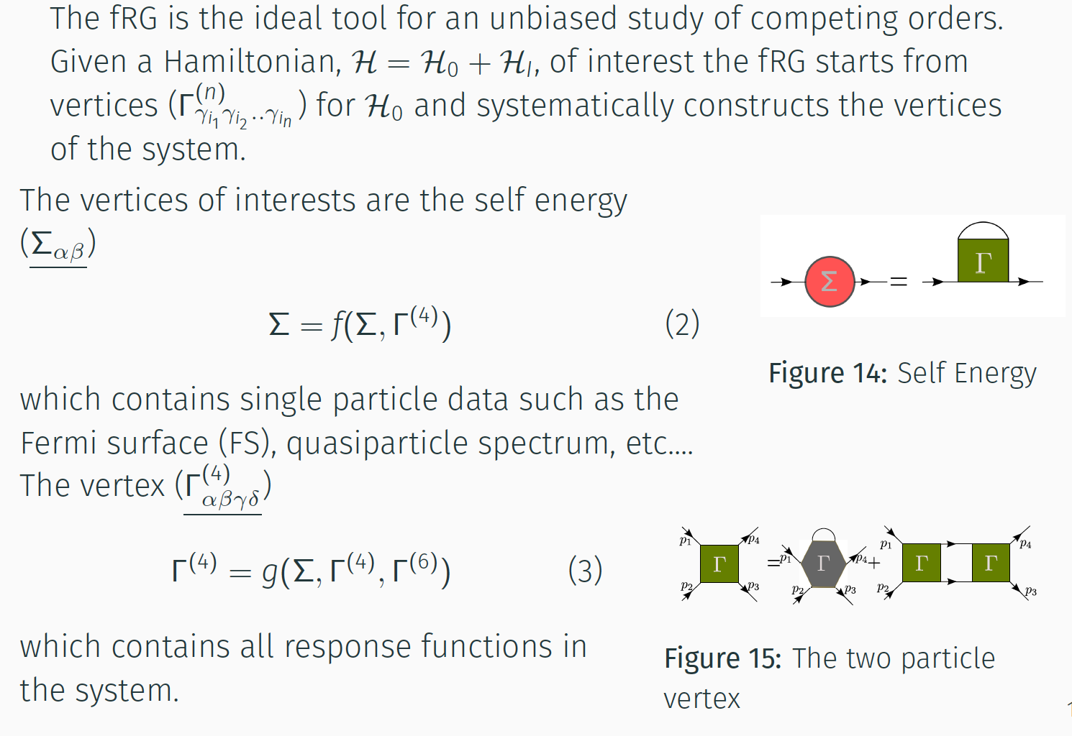
Algorithmic Developments: Our New fRG Method

Slide 8
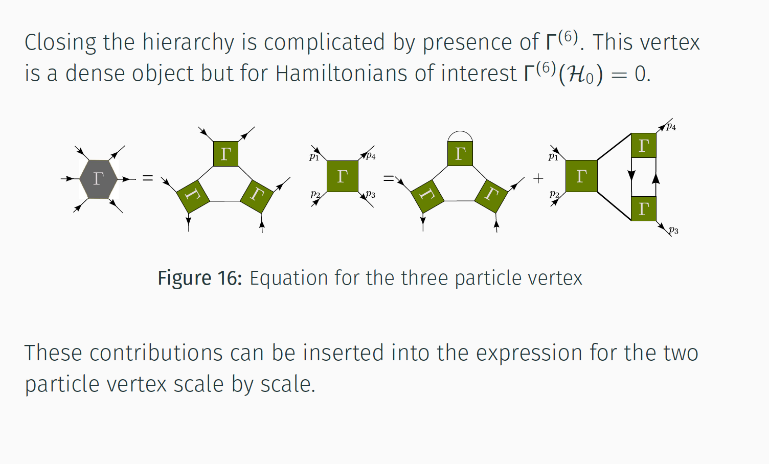
Closing the Hierarchy
Notes:
Is the second term onhe RHS of second equation the two loop contribution ??

Slide 9
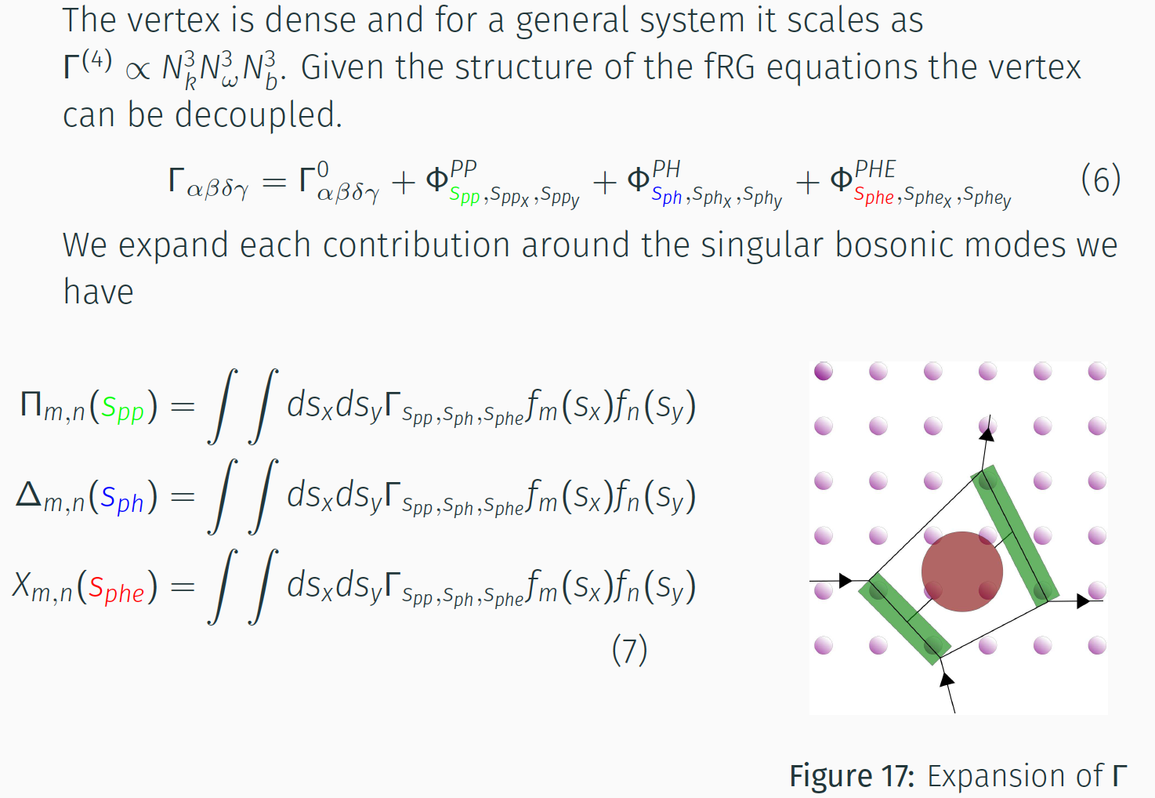
The (decoupled) fRG
Notes:
Pp= particle – particle
Ph = particle –hole
PHE = particle hole exchange
Four sites in red in cartoon are the core—could be Π or Δ or X—and the two green rectangles are the basis function f_{m} and f_{n}
What are the integrals over Sx and Sy—these are scales??

Slide 10
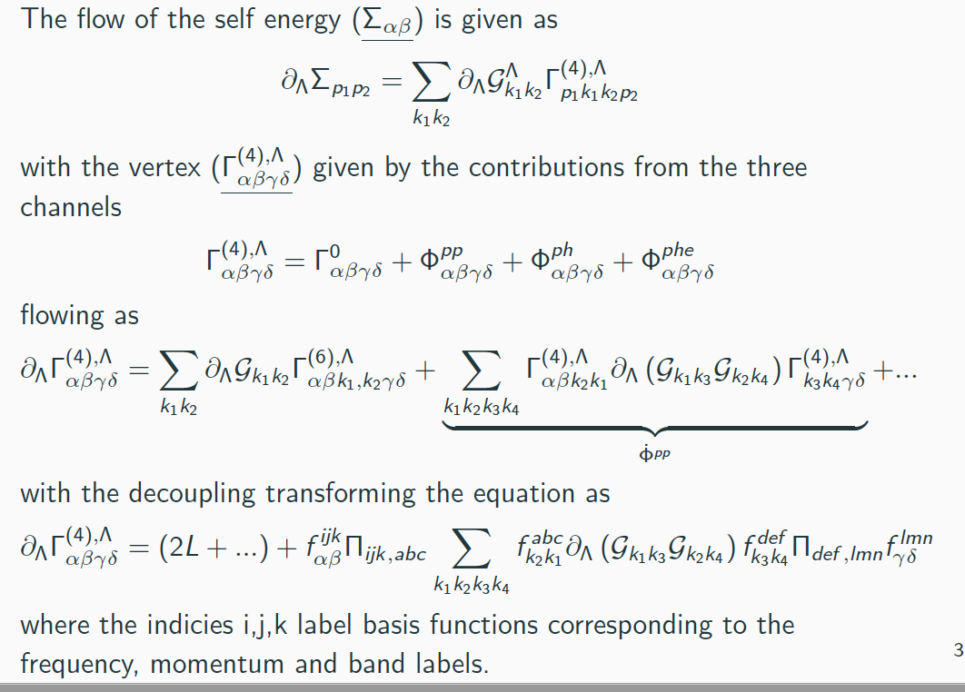
The actual flow equations for Σ and Γ
Notes:
Pp= particle – particle
Ph = particle –hole
PHE = particle hole exchange
Four sites in red in cartoon are the core—could be Π or Δ or X—and the two green rectangles are the basis function f_{m} and f_{n}
What are the integrals over Sx and Sy—these are scales??

Slide 11
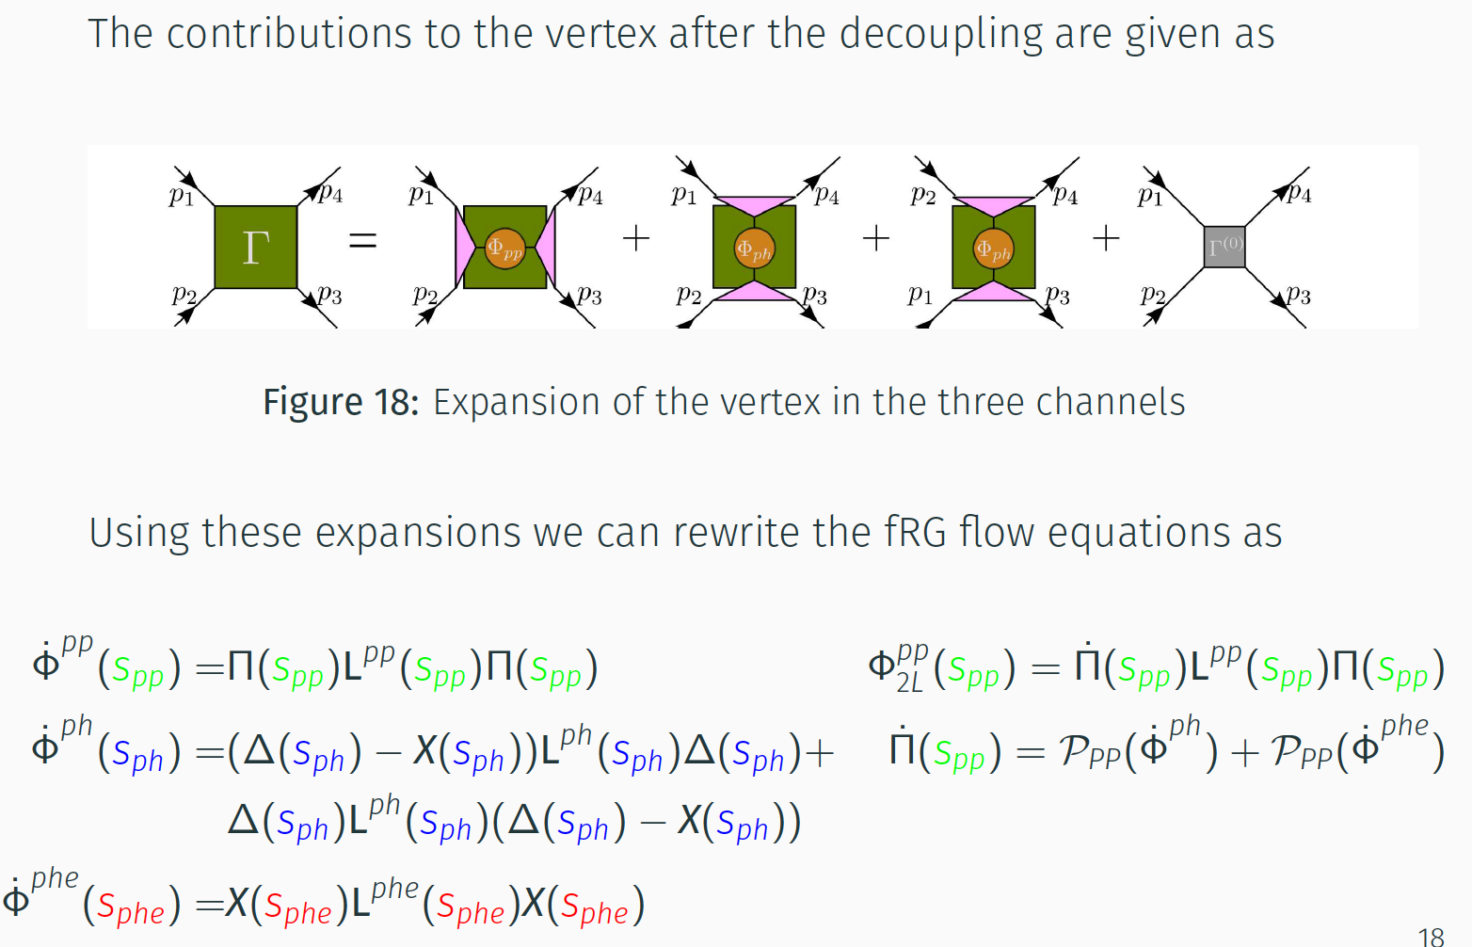
The (decoupled) fRG for Γ in the three channels
Familiar s, t, and u channels from HEP
Dots over functions mean scale derivatives => flow
Notes:
This has mistake—the third decomposition on RHS should be PHI_phe
The one loop flows are on left. The two loop equation is gotten by substituting from 1 loop flow back into 1 loop flow
The expression on right bottom is part d of figure on previous slide

Slide 12
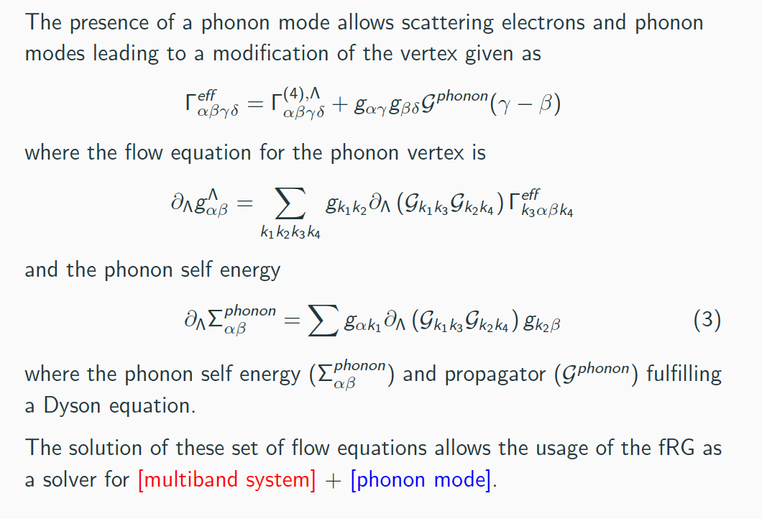
Inclusion of Phonons in our fRG
Notes:
Pp= particle – particle
Ph = particle –hole
PHE = particle hole exchange
Four sites in red in cartoon are the core—could be Π or Δ or X—and the two green rectangles are the basis function f_{m} and f_{n}
What are the integrals over Sx and Sy—these are scales??

Slide 13
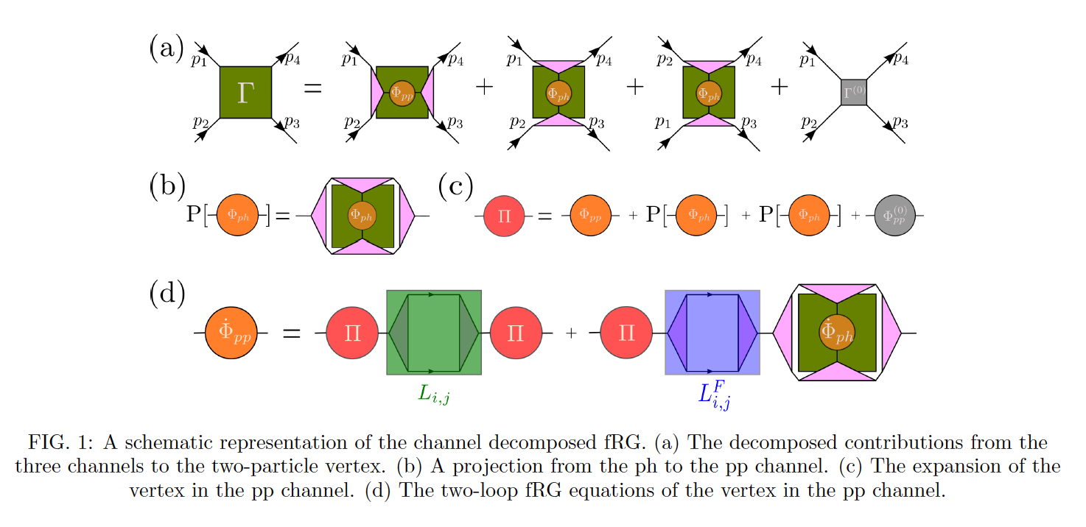
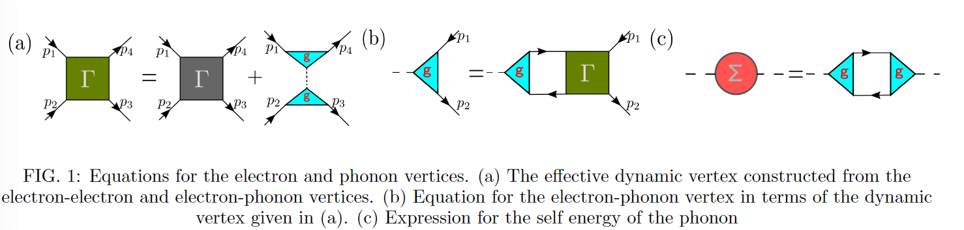
The (decoupled) fRG in pictures
N. Yirga and DKC, PRB103 235165 (2021) and N. K. Yirga, K. M. Tam, and DKC , arXiv:2206.03981 (submitted to PRB)
Notes:
Note the Phi-dot in the final term in d)
Need to say what P means
Stress that momenta in principle are four continuous vectors (k0,k1,k2,k3)—energy and momentum—we will discretize them later for calculation

Slide 14
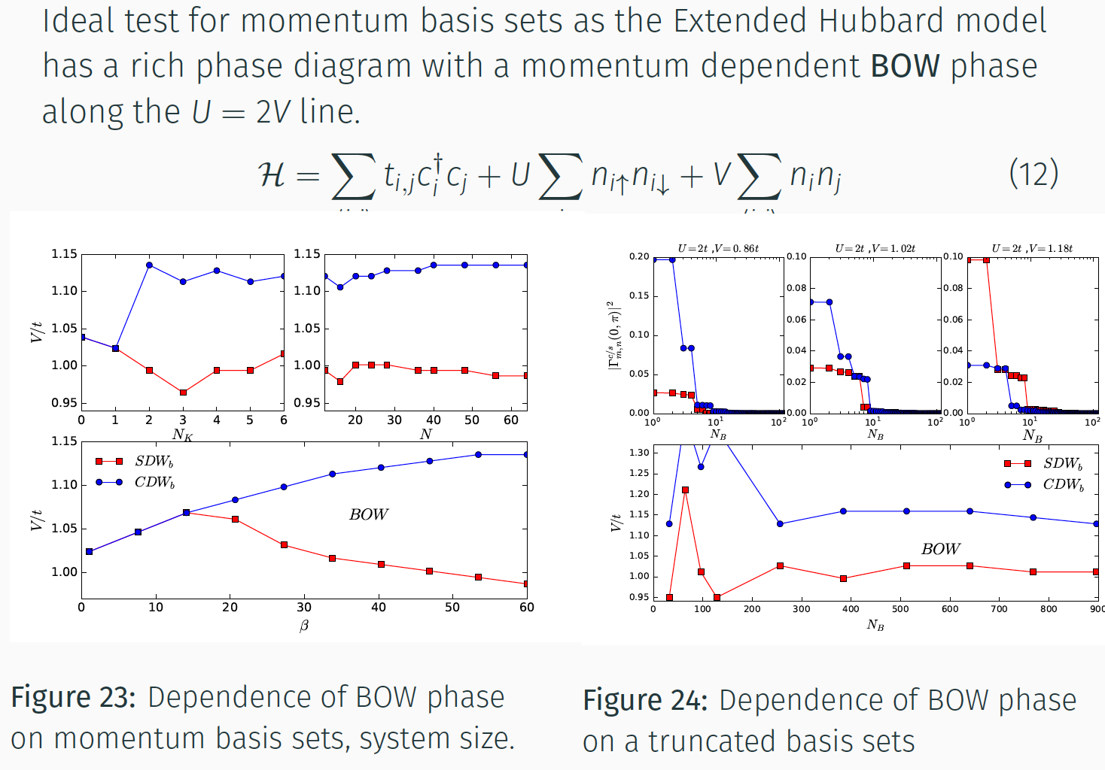
Familiar Example: The 1D EHM (tUV) model
Revisit old results to confirm method works
U= 2t in graphs
Shows limited number of basis functions needed so can truncate
N. Yirga and DKC, PRB103 235165 (2021)
Notes:
Nk – number of discrete momenta kept
N = system size
Beta = inverse temperature ~ imaginary frequency
The whole point of the right panel is that it shows we can truncate the channels to a small number—that the higher channels don
‘t contribute that much also us to neglect them.

Slide 15
Comparing old and new fRG in EHM
U<2V
U<2V
U>2V
U>2V
OLD RESULTS: K-M Tam, S-W Tsai, DKC PRL 96 036408 (2006)
Calculations at 1-loop and zero frequency (static) limit
BCDW-BOW around line U=2V
BOW phase extends to weak coupling
Results are consistent with QMC studies (P. Sengupta et al. PRB
2002, Sandvik et al. PRL 2004) and DMRG studies (Zhang, 2004)
in region of validity.
Vanishing of BOW at strong coupling is beyond the reliable range of the fRG calculations.
NEW RESULTS: N. Yirga and DKC, PRB103 235165 (2021)
Calculations are at 2-loop and finite frequency
With new fRG BOW is captured in both finite size
systems (blue) and Cluster Average (CA, purple) systems
BOW phase vanishes at large U and V
Can calculate features such as full correltator and double
occupancy which are inaccessible in old method
Details in reference above

Slide 16
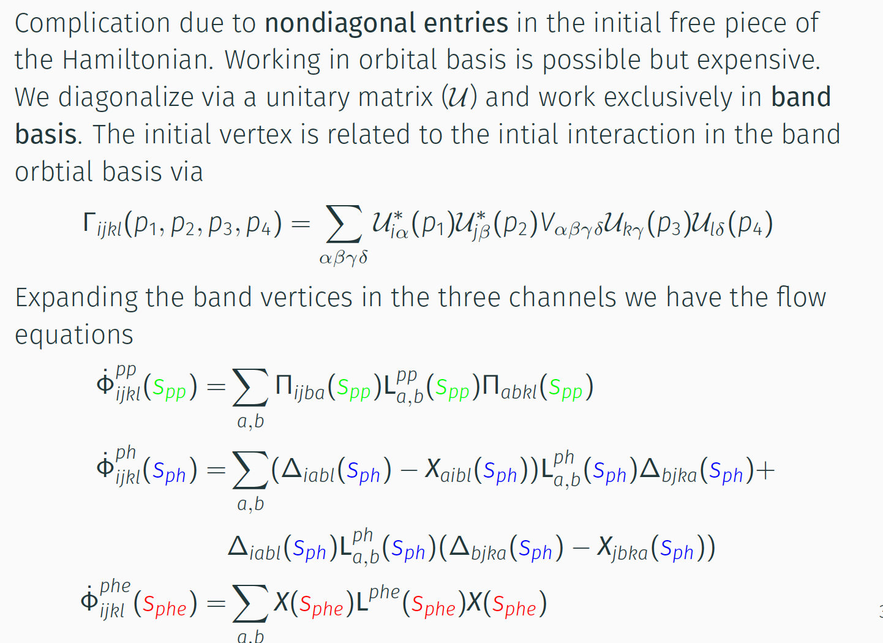
fRG flow for Multiband Hamiltonians

Slide 17
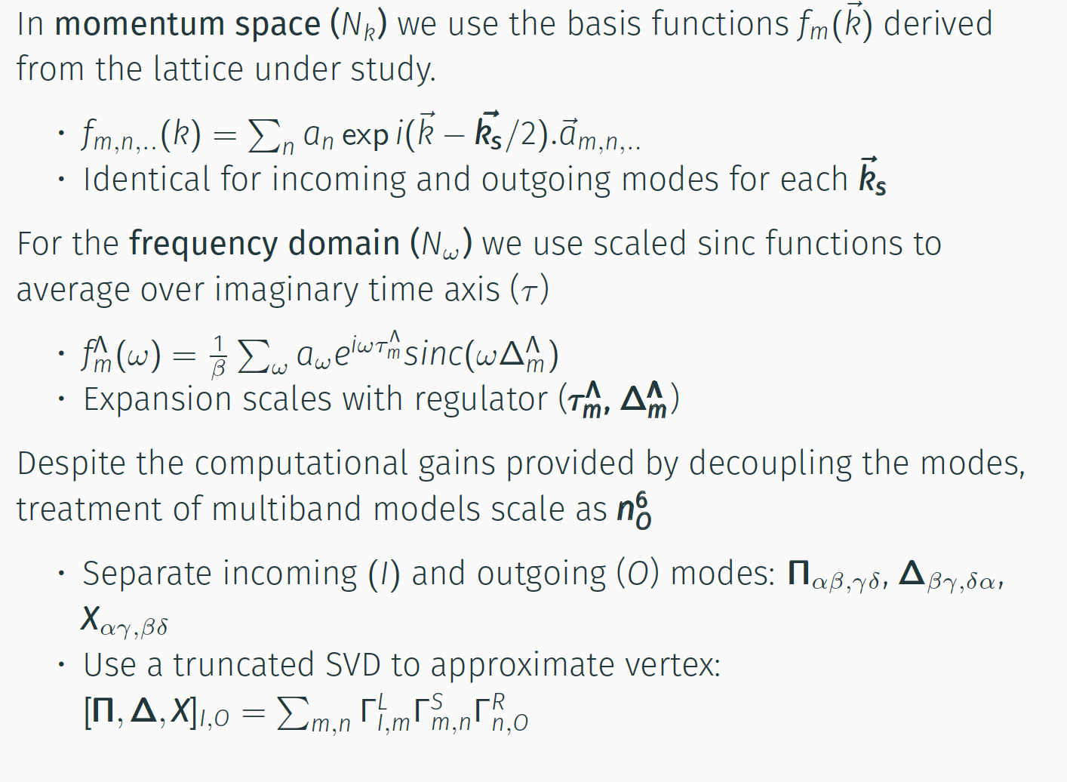
Expansion of the fRG equations
sinc (x) = sinπx/πx
Notes:
Sinc function unnormalized is sinx/x
Normalized in sinπx/πx
Both are defined as 1 ata x=0
Zeroes of normalized sinc function are at nonzero integer values of x

Slide 18
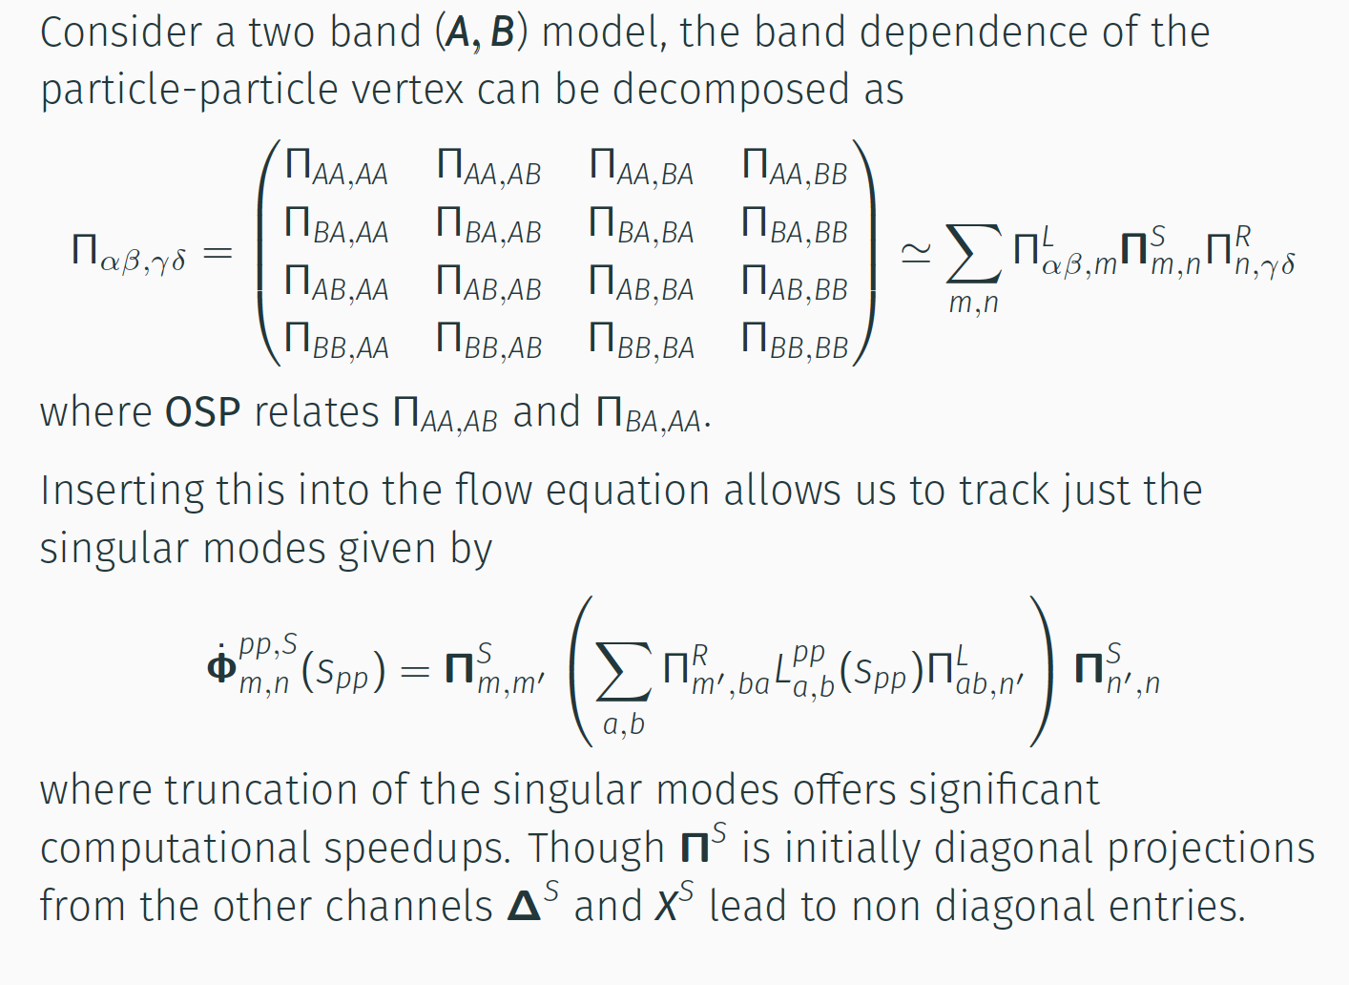
Singular Value Decomposition of the Vertex

Slide 19
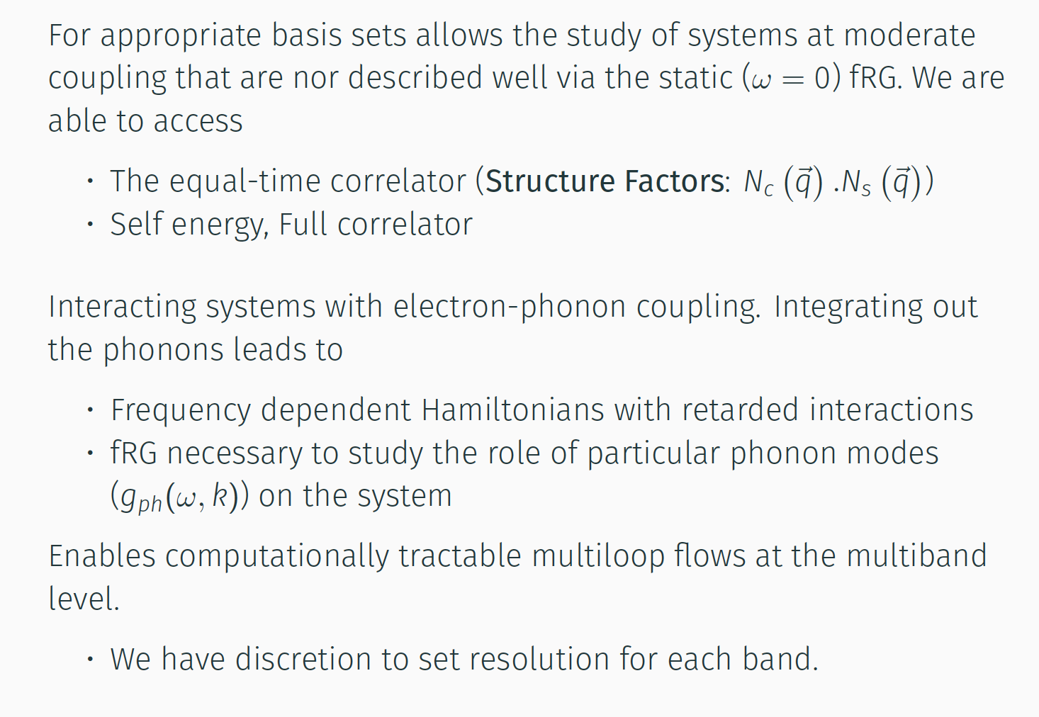
When and why do we need the decoupled fRG ?

Slide 20
Applications of our fRG Method
We have studied 2-D models for Cuprate compounds at the one-, two-, and three-band level and studied the impact of coupling photon modes (A1g and B1g) to system.
We extended these studies to 2D models for the Pnictides (FeASe,…) and chalcoginides (FeSe,..) which require modeling at least the two-band level.
Most recently we have extended studies to the Nickelates which require 3-D models to account for out-of-plane hopping and hybridization with a conduction band.
Needless to say, cannot discuss all these in 25-minute talk => focus on the one- and two-band models Cuprates

Slide 21
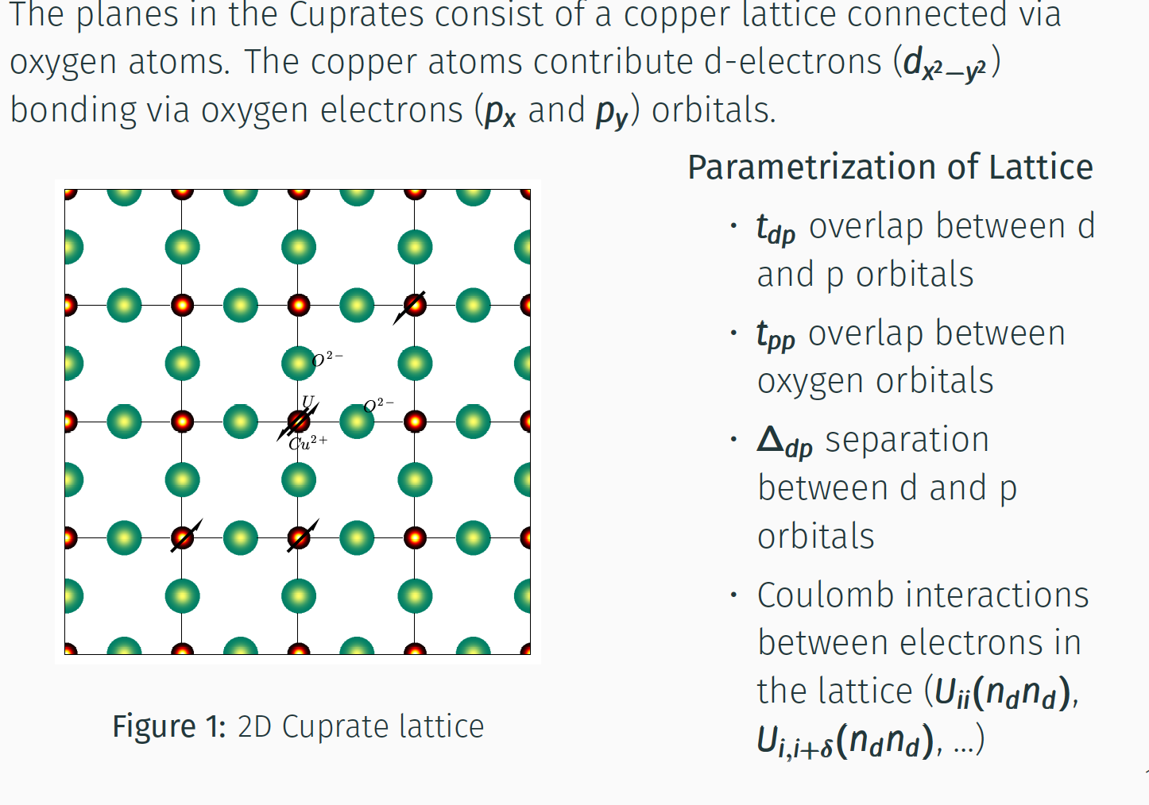
Models for Cuprate Compounds

Slide 22
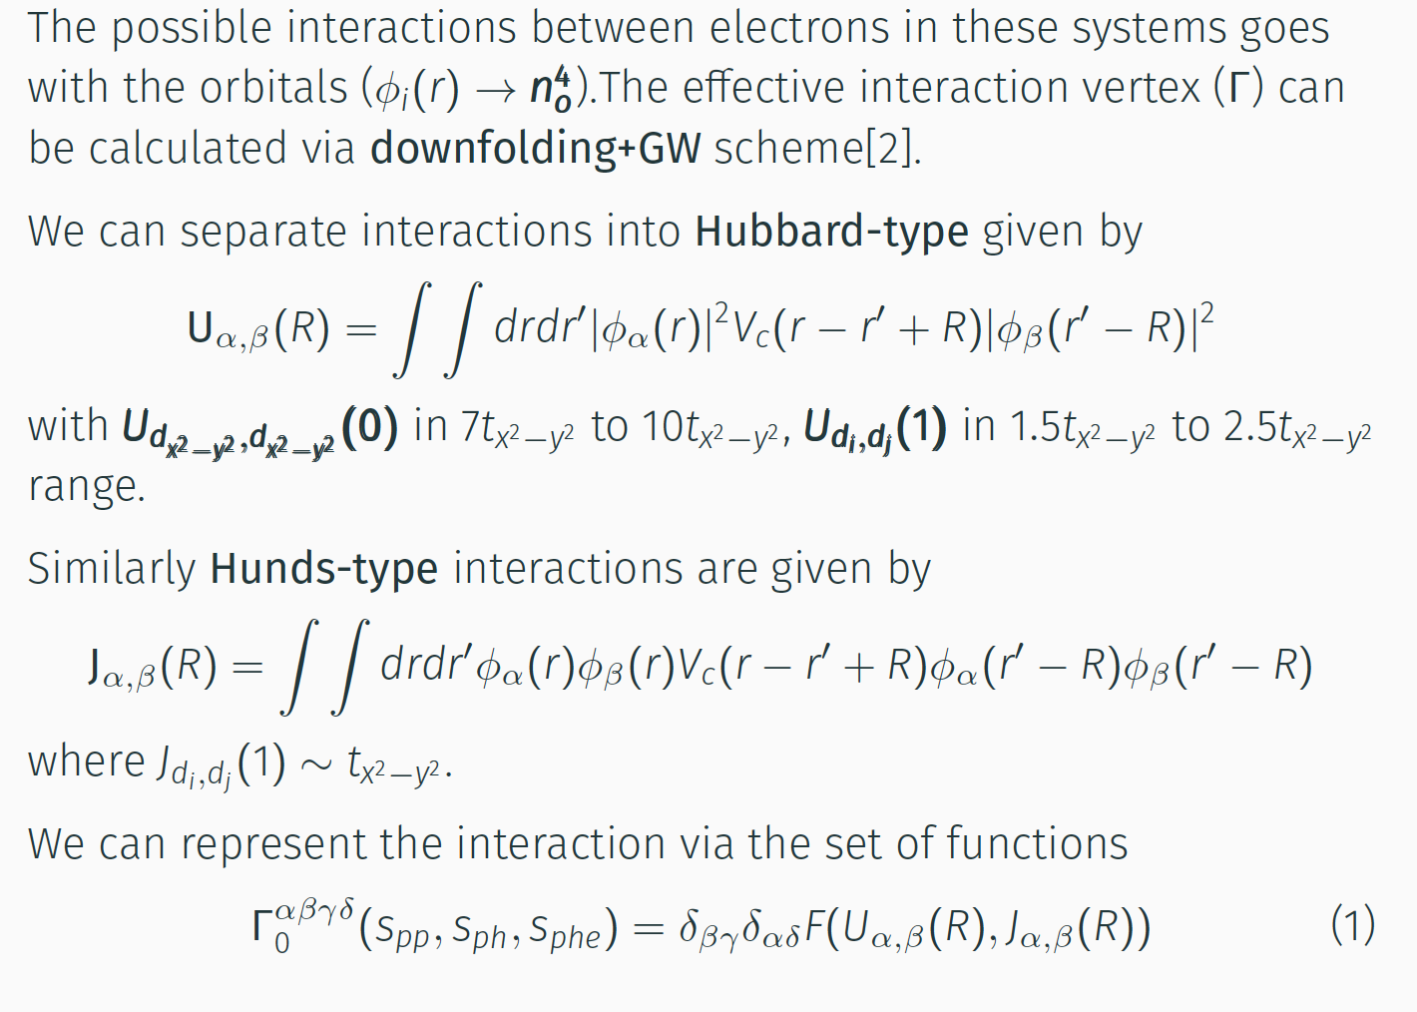
Interaction vertices in Cuprate Compounds

Slide 23
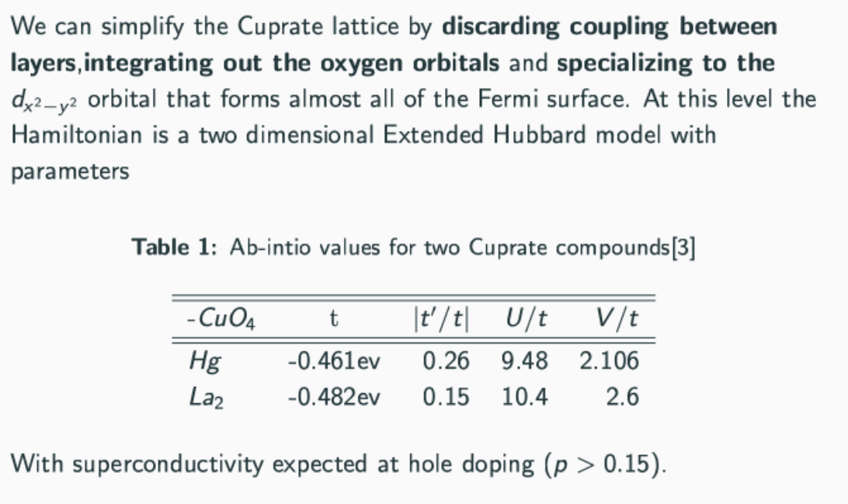
One-band model for Cuprates: 2D tUV (!)
Values from (3) M Hirayama et al, PRB 98:134501 (2018)

Slide 24
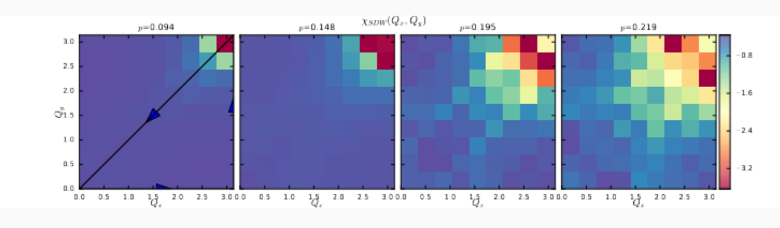
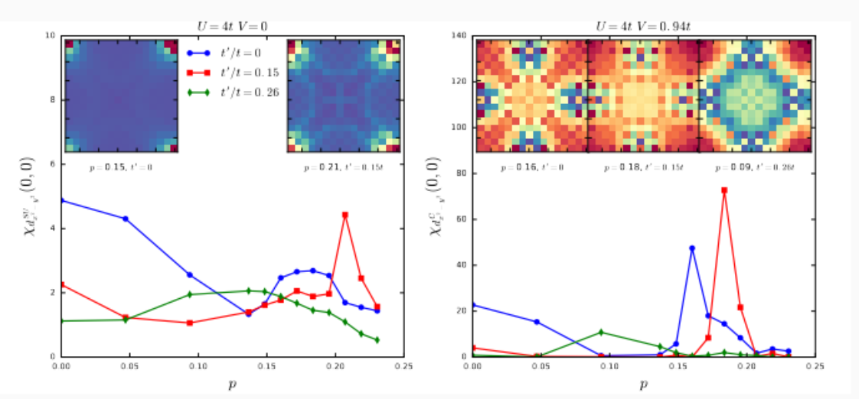
One-band model for Cuprates: 2D tUV (!)
Incommensurate spin fluctuations arise from doping: Note scale (0 to π)
As V is increased, response changes from d-type SC (left panel) to d-type C (right panel).
As t’ increases peak location changes for both SC and C responses.
d-type SC (V=0 left) and Charge (V~U/4 right) responses vs doping: Note scale on inserts (-π to π )
Notes:
Top figure shows incommensurate spin fluctuations developing as a function of hole doping at V-0 and U = 4 in the 2-loop fRG the x-y momenta go from 0 to pi only.
The bottom figure shows on the left the SC response at V=0 for different nn hoppings shown in red, blue, green. On the right we turn on V-.94t (~ ¼ U) is the d-type charge response which is analog of the s-wave CDW in the 1D tUV. The s-wave CDW in 2D comes in at still higher V.

Slide 25
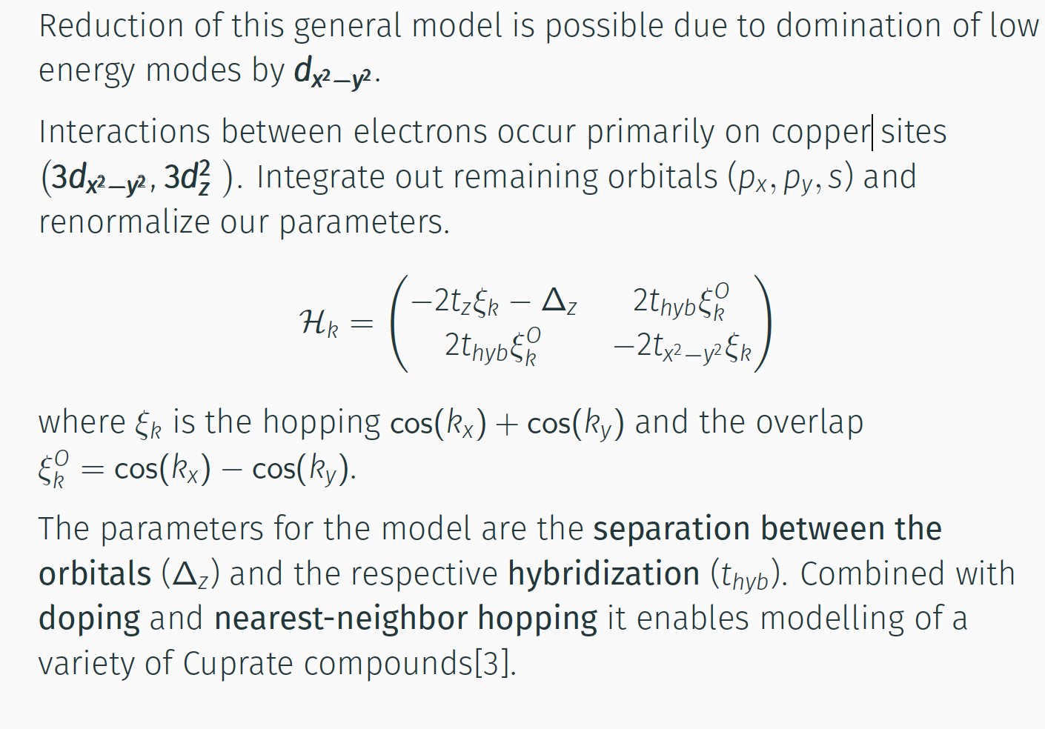
The two-band model for Cuprates
Values from (3) M Hirayama et al, PRB 98:134501 (2018)

Slide 26
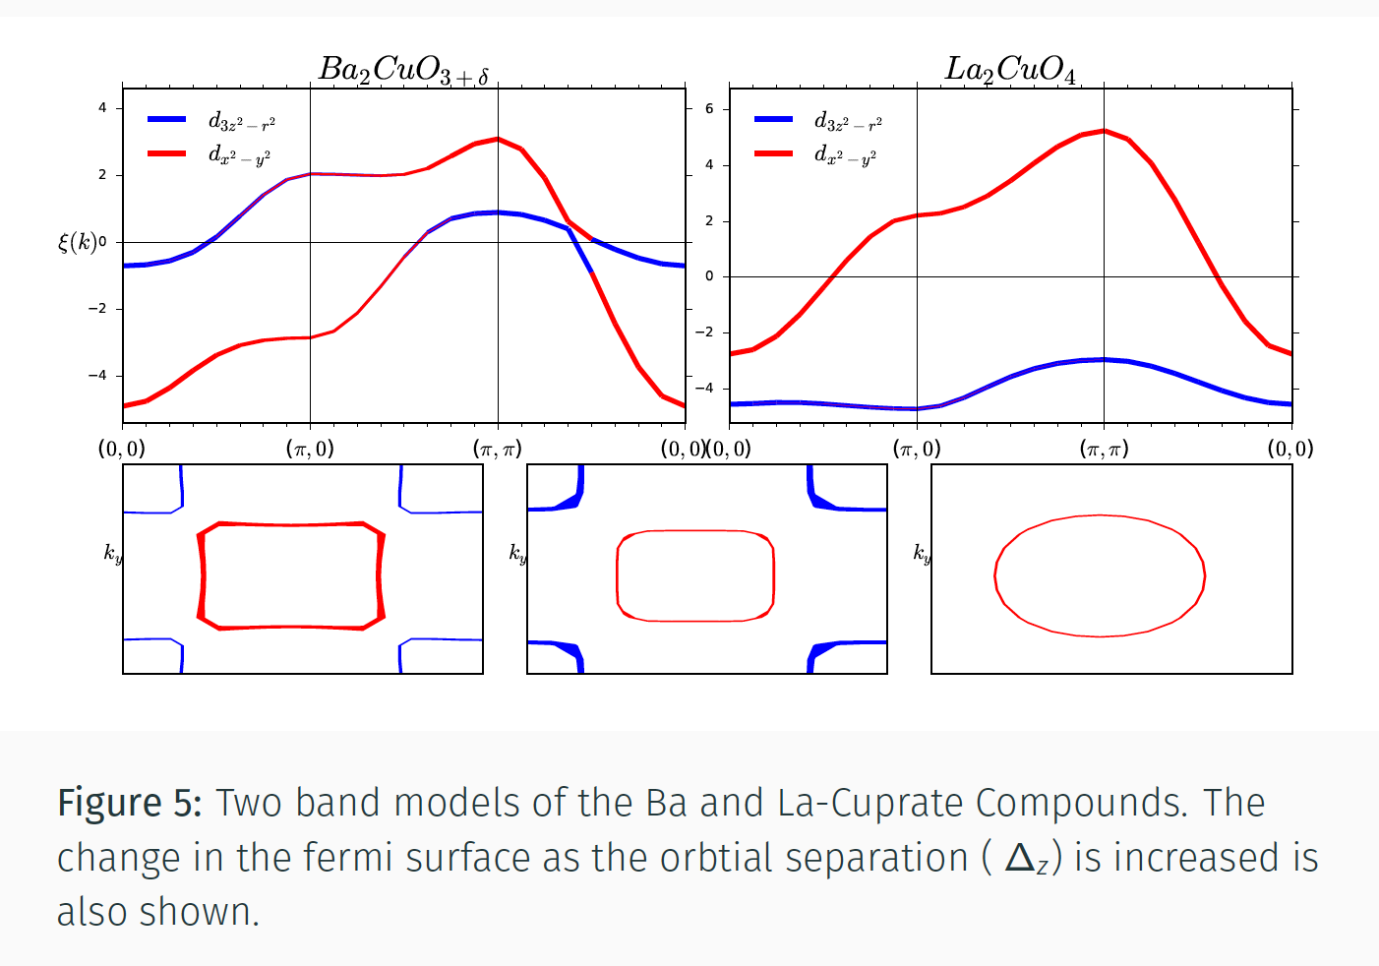
Two-band structure of Cuprate compounds
NB: Blue = 3d_{z2} Red = 3d_{x2-y2}
Note at large Δ_{z} model approaches one band

Slide 27
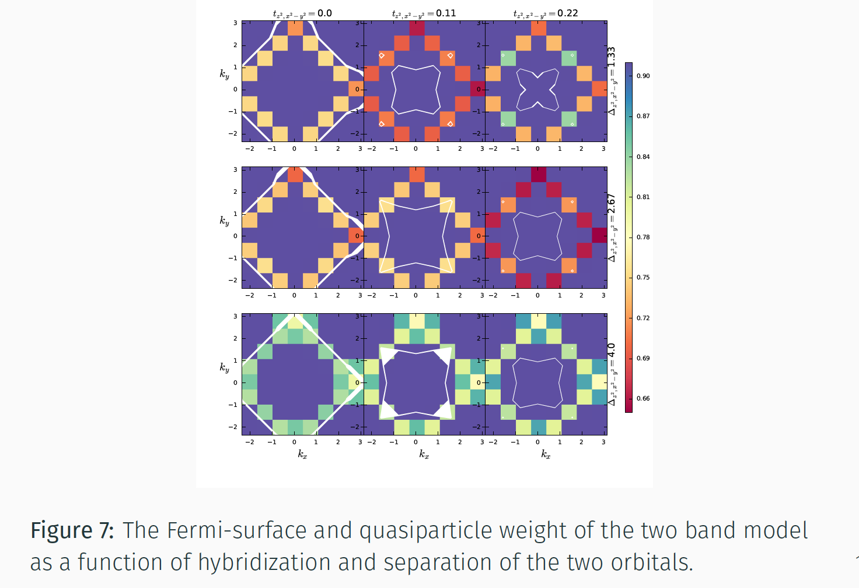
Quasiparticle weight of the two-band Model
White lines are Fermi surface which changes as t_{hyb} and Δ_{z} change
Moving to the right increases the hybridization t_{hyb} between z² and x²-y² orbitals and moving down increases separation between two orbitals Δ_{z}
Notes:
Move to right increase the hybridization thyb between z2 and x2-y2 and moving down increases separation between two orbitals Dz
Expansion of the model beyond the dominant low energy modes of dx2-y2 is possible.
Interactions between electrons occurring on the copper sites involve the 3d,c2_y2, 3d: orbitals. Integrate out the remaining orbitals (Px Py s) and renormalizing our parameters.
where {k is the hopping cos( kx ) + cos( ky ) and the overlap
􀀁f = cos( kx ) - cos(ky ).
The parameters for the model are the separation between the orbitals (f).z ) and the respective hybridization (thyb)- Combined with doping and nearest-neighbor hopping it enables modelling of a variety of
Cu prate com pou nds[4].

Slide 28
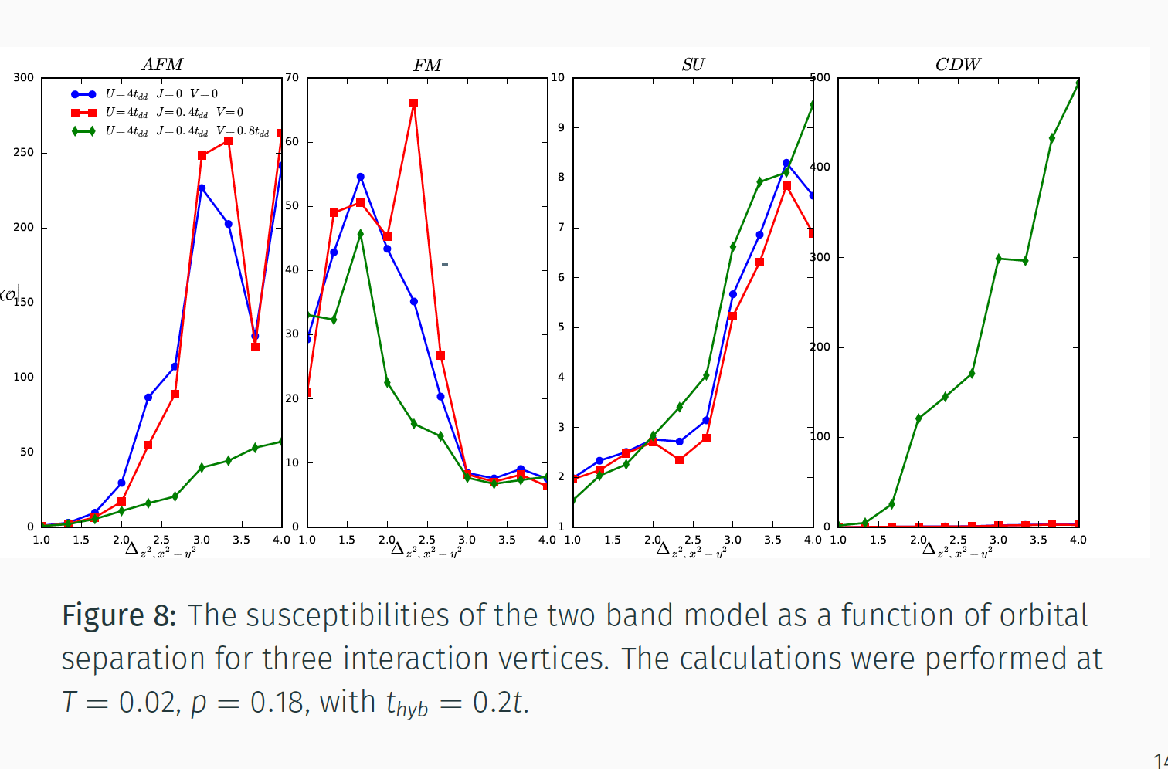
Ordering in the two band Cuprate Model
This shows how the four responses—AFM, FM, SC, and CDW—change as the separation Δ_{z} is increased with different values (colors) of Hund’s rule coupling J and extended Hubbard interaction V.
Naïve critical line in 2D is U=4V
Notes:
This shows how the four responses—AFM, FM, SC, and CDW—changes as the separation Dz is increased with different values (colors) of Hunds rule coupling J and extended Hubbard interaction =V. Note that for large V and Δz the CDW response is very strong.

Slide 29
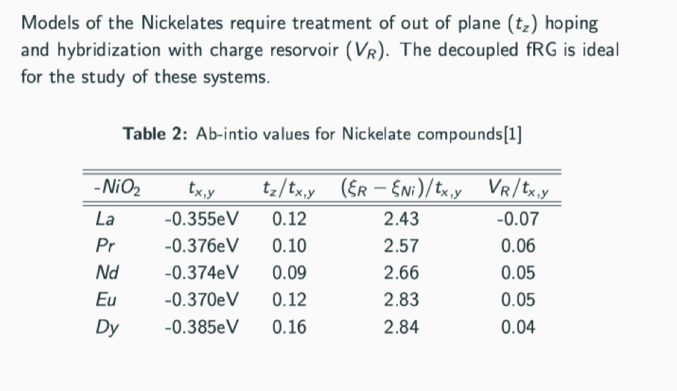
Ab initio results for Nickelates
Values from (1) = E. Been et al, PRX 11(1):011050 (2021)
Notes:
This shows how the four responses—AFM, FM, SC, and CDW—changes as the separation Dz is increased with different values (colors) of Hunds rule coupling J and extended Hubbard interaction =V.
Values from (1) = E. Been et al, PRX 11(1):011050 (2021)

Slide 30
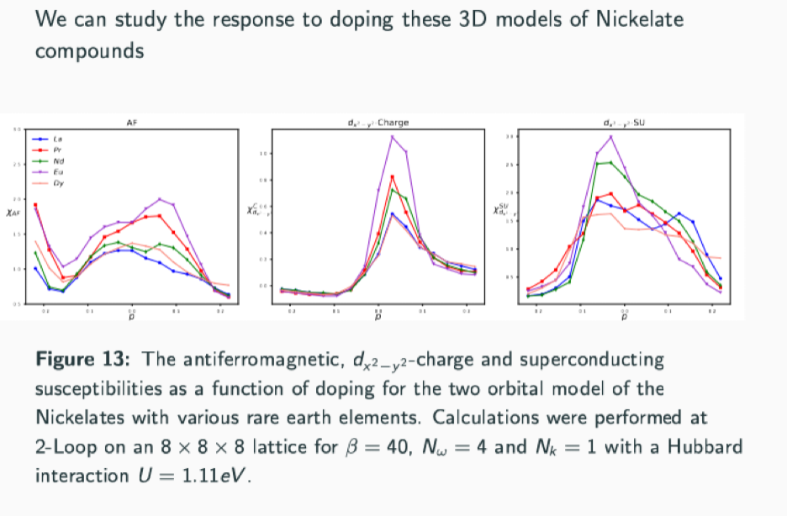
fRG results for Nickelates
This shows how the three responses—AFM, d-wave SC, and d-wave CDW—change as the doping away from ½ filling is increased. The d-CDW peaks above half filling, d-SC peaks below half filling. AFM is weakened relative to Cuprates by out of plane hopping and is subdominant.
Notes:
This shows how the three responses—AFM, d-wave SC, and d-wave CDW—changes as the doping away from ½ filling is increased. Charge peaks above half filling, SC peaks below half filling. AFM is weakened relative to Cuprates by out of plane hopping and is subdominant.

Slide 31
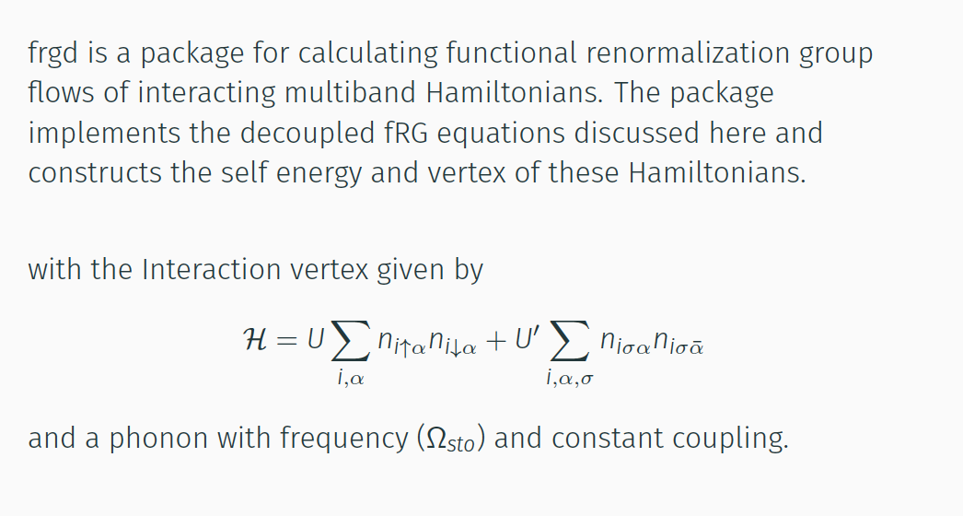
Shameless advertisement for Package “fRGd"
fRGd package soon to be posted on github site !

Slide 32
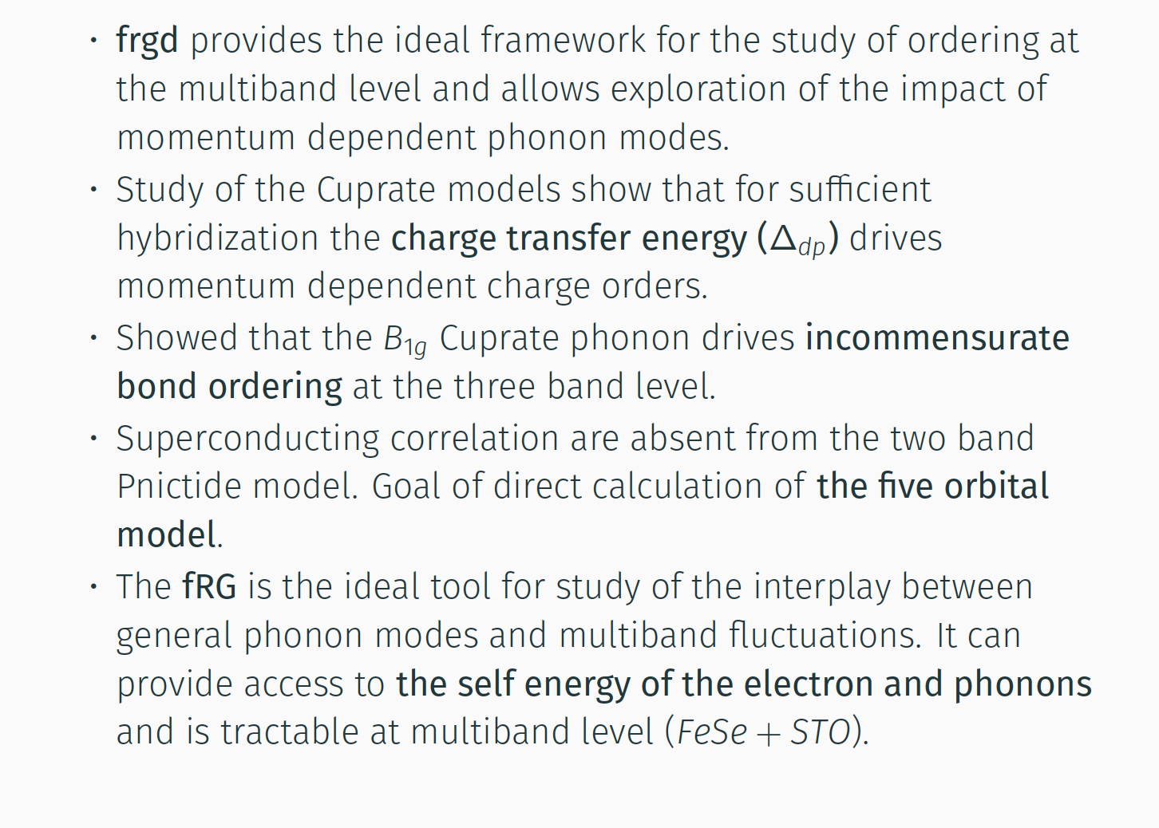
Features of fRGd package
fRGd package soon to be posted on github site !

Slide 33
Conclusions
We have decoupled the fRG equations in momentum, frequency, and band domains which offers significant computational savings and leads to stable flows.
We have verified that our approach reproduces previously known results and provides further details of the BOW in the 1D EHM (= tUV) model.
We have used our decoupled fRG equations to study the Cuprates and the Nickelates at the single- and two-band levels.
We have doped the Cuprate and Nickelate model systems and established that charge and superconducting orders occur in these systems.
We are currently studying multiband and three-dimensional systems and will publish these soon.
We will package our method on github as “fRGd” so that it can be used by the community.

Slide 34



Selected Relevant References
“Functional Renormalization Group Analysis of the half-filled one-dimensional extended Hubbard model，” K．M. Tam，S-W Tsai，DKC, Phys. Rev. Lett. 96, 036408 (2006).
Nahom K. Yirga and DKC, “Frequency Dependent Functional Renormalization Group for Interacting Fermionic Systems,” Phys. Rev. B 103 235165 (2021).
“Phonon Induced Instabilities in Correlated Electron Hamiltonians” N. K. Yirga, K. M. Tam, and DKC , arXiv:2206.03981 (submitted to PRB)
DANKE SCHÖN
Nahom Shan-Wen Ka-Ming

Slide 35
Extra Slides for backup

Slide 36
Conclusions
MFRG takes into account both e-e and e-ph interactions among electrons of all
momenta and energy and includes phonon retardation. The RG flows become
functional (matrix, for discretized momentum and energy) equations.
Formally irrelevant operators are included because they couple to formally
relevant operators at finite scales and these effects may be crucial to correct for
accidental broken symmetries.
In the half-filled 1D EHM, MFRG captures existence of BOW phase (missed by
standard g-ology) because of the inclusion of all couplings.
In the 1D Holstein-Hubbard model, MFRG confirms that only CDW and SDW
phases exist at half-filling and shows that previous predictions of SC were not
valid because Luttinger Liquid relations can fail in presence of retardation and
most divergent couplings may be at finite frequencies
Applications to other problems in 1, 2, and 3D where the MFRG has produced
new, or confirmed earlier, results. Applications to systems with arbitrary Fermi
surfaces are possible.

Slide 37
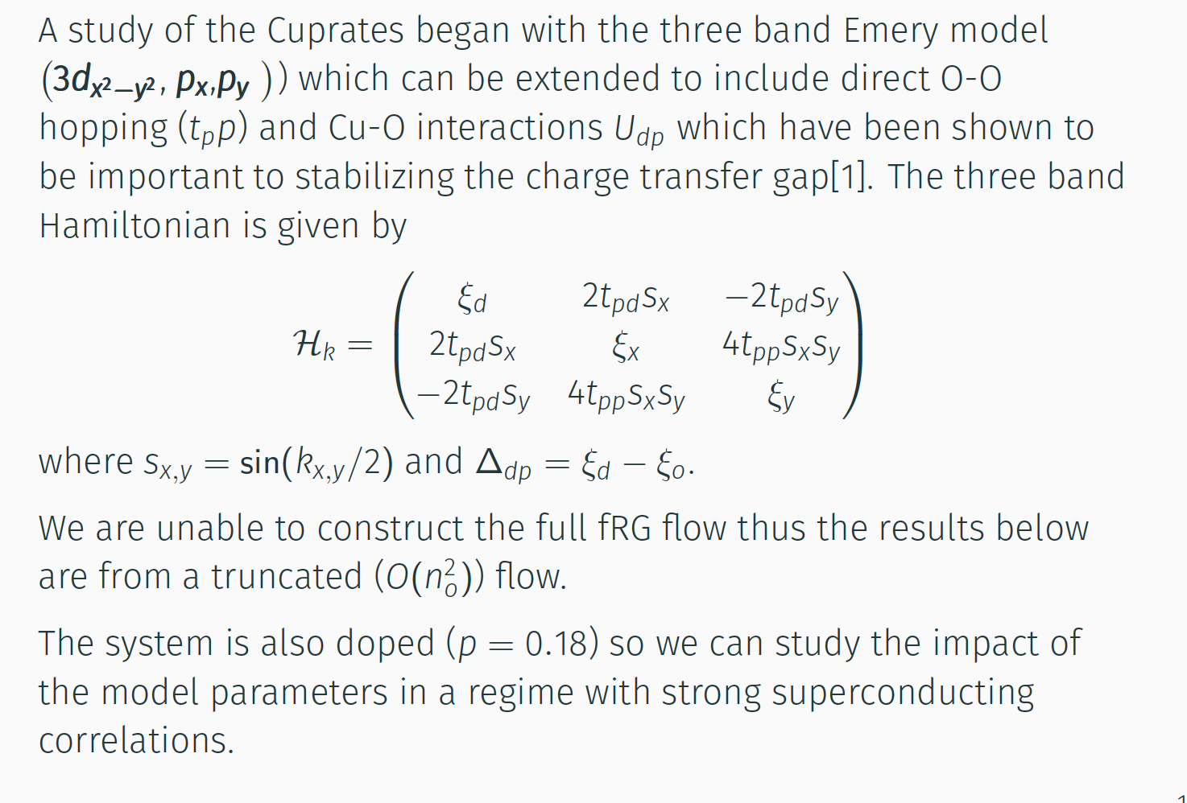
The three band Model for Cuprates

Slide 38
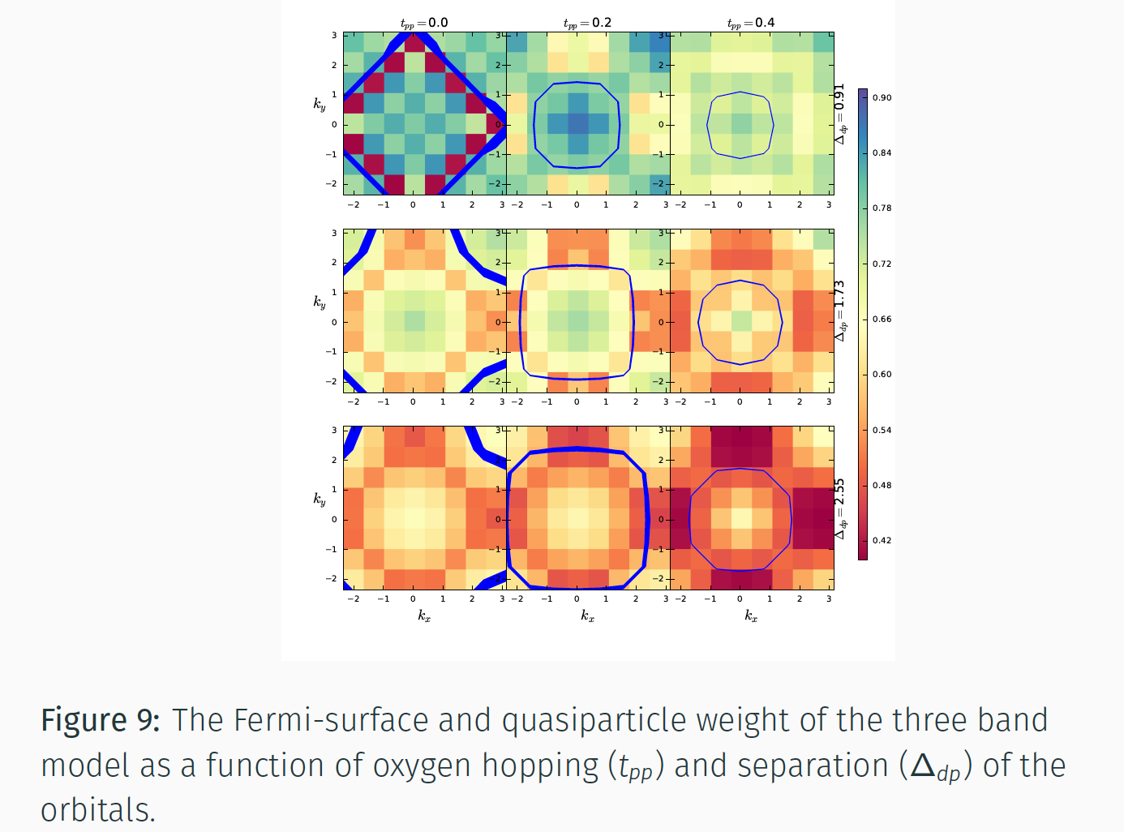
Quasiparticle weight of the three band Model

Slide 39
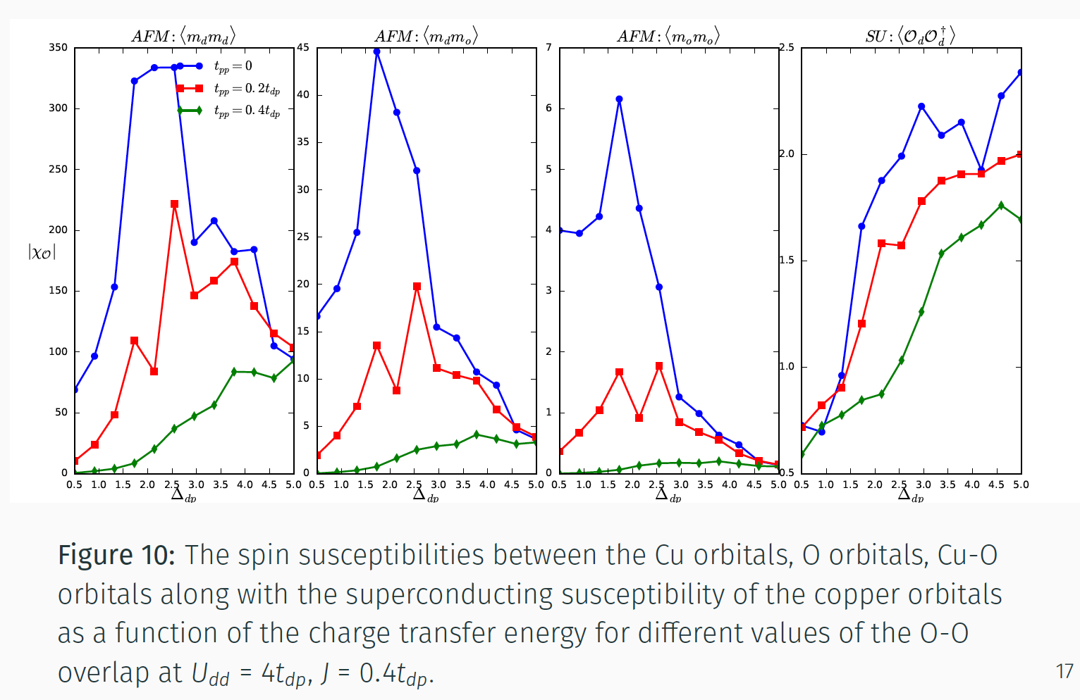
Susceptibilities of three band Model

Slide 40
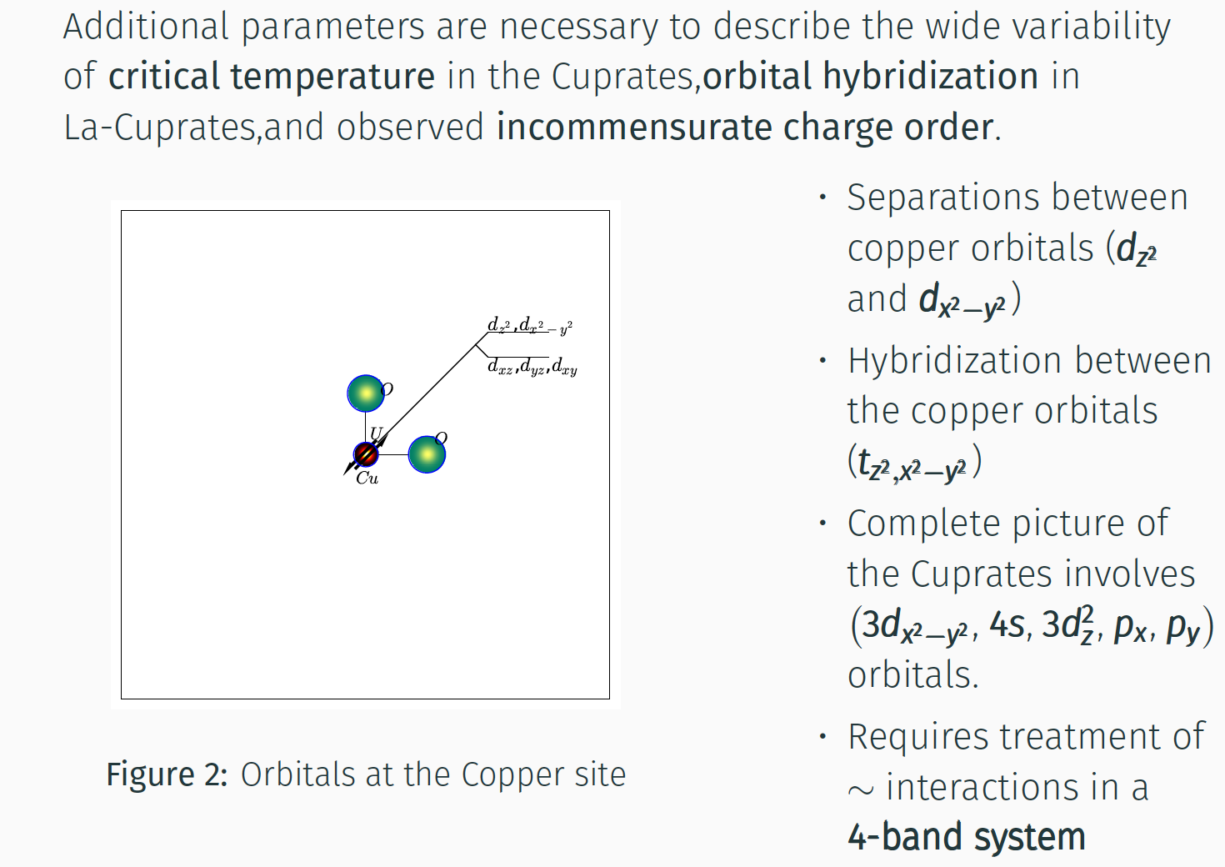
Models for Cuprate Compounds

Slide 41
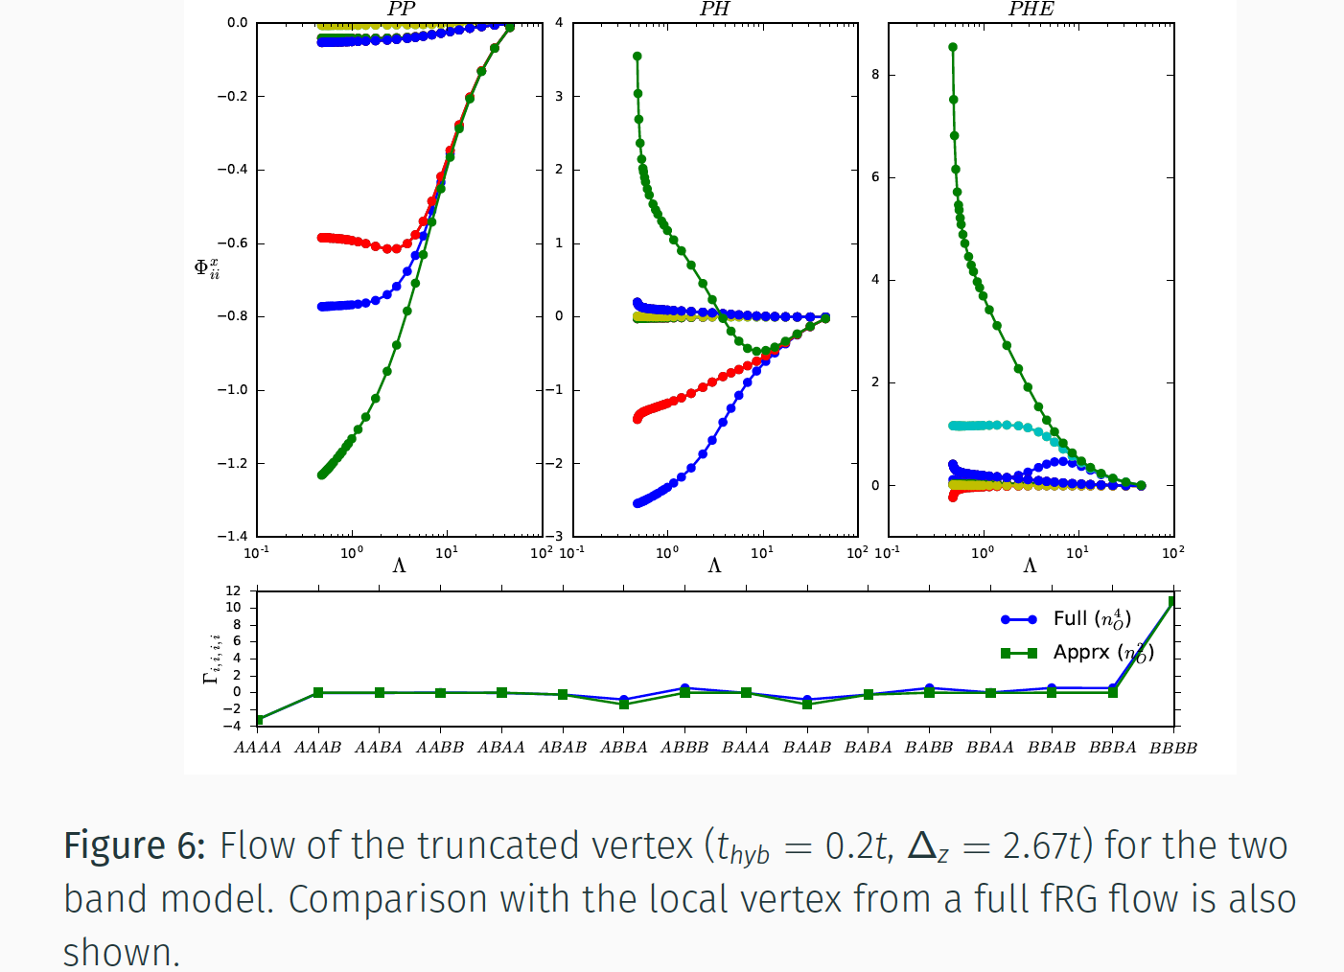
Flow of the truncated vertex in two band Model

Slide 42
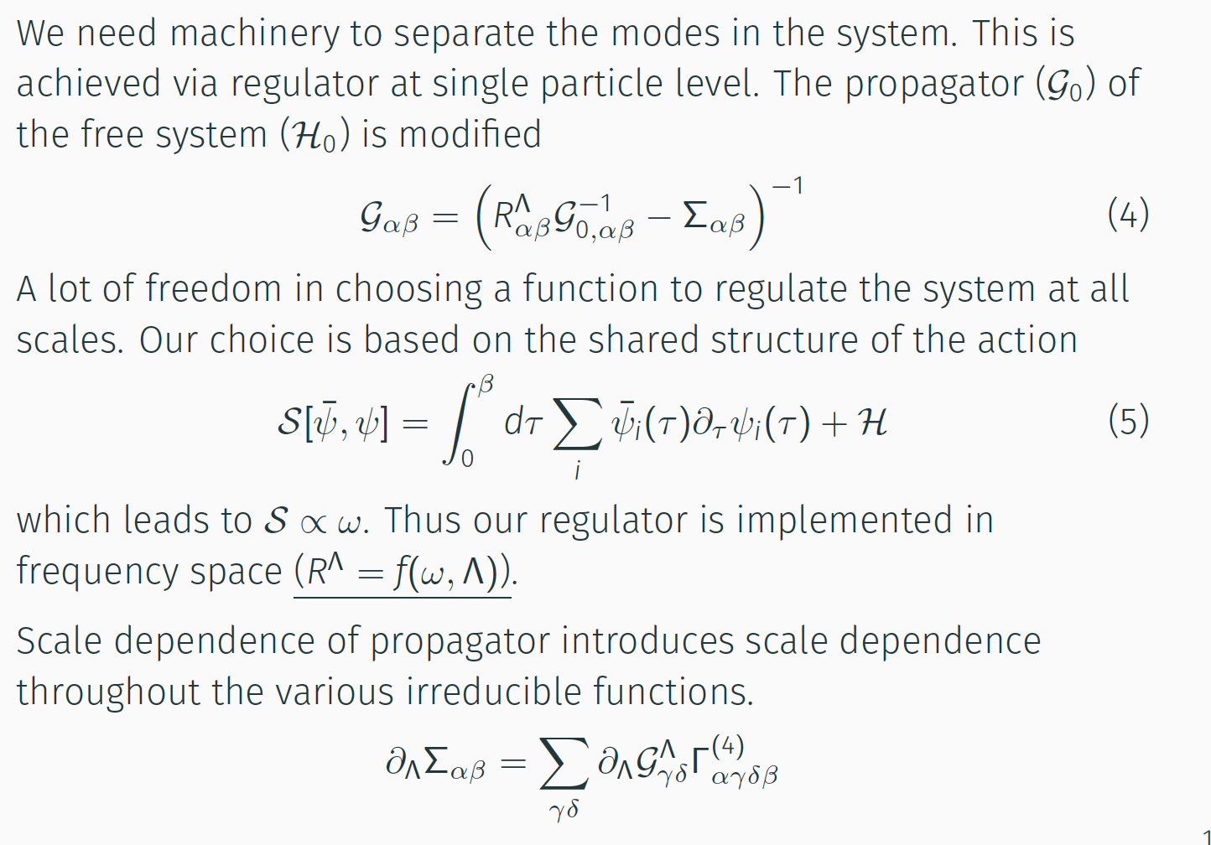
Scale Dependent Propagator

Slide 43
Accidental symmetry in 1D EHM
For half-filled EHM, the bare values of the g’s are:
g₁ = g₃ = U-2V and g₂ = g₄ = U+2V
When U=2V, g₁ = g₃ = 0 initially, and these values do not flow under the RG,
so that they remain zero. This is an “accidental” symmetry and leads to the direct
SDW-CDW transition, with a Luttinger liquid phase right at the transition line.
There is no BOW phase within this approximation in standard g-ology
But at finite values of the RG flow, irrelevant operators are not zero and can couple to
relevant operators, as long as momentum and energy are conserved: can the
irrelevant operators break the accidental symmetry and allow the BOW to emerge?
Key insight from Tsuchiizu and Furusaki (PRL 2002, PRB 2004): ad hoc procedure
integrating out part of band (“higher order” perturbation theory) gives for U-2V
g₁ = - g₃ = - aV²/t
If these are used as the bare values, the standard RG flow will give a BOW phase.

Slide 44
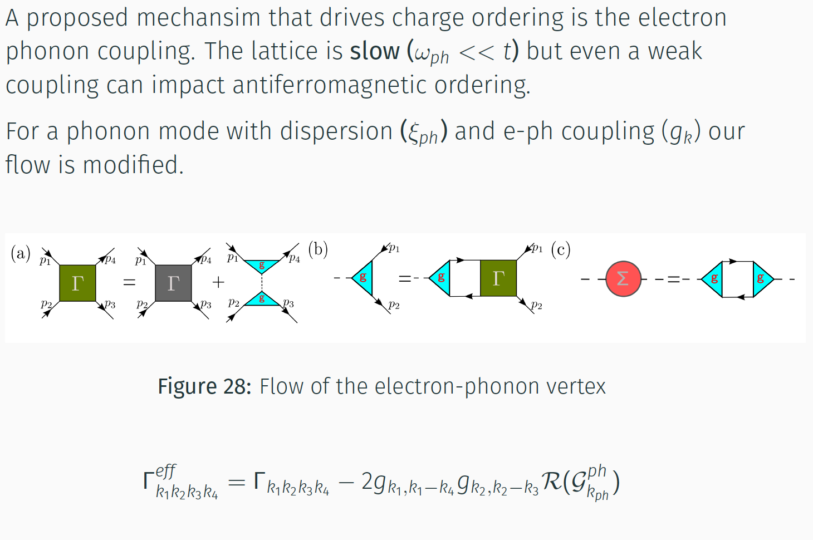
Impact of e-ph Couplings on Ordered Systems

Slide 45
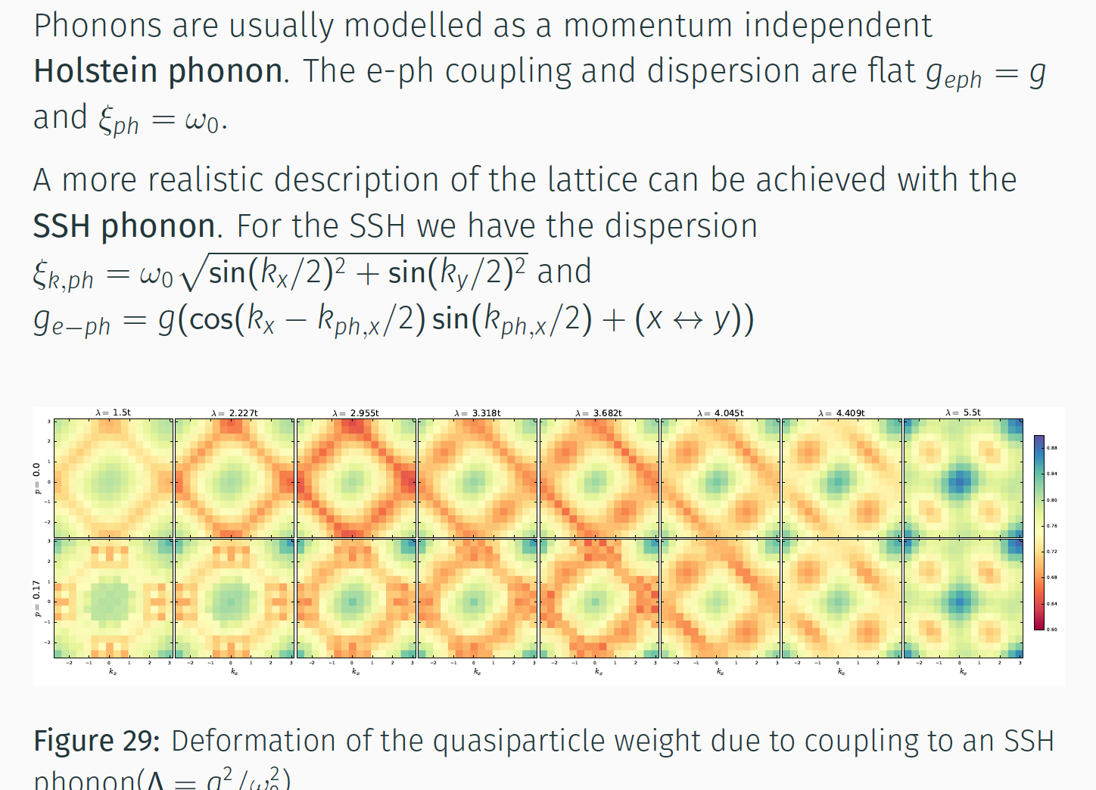
General Phonon Modes

Slide 46
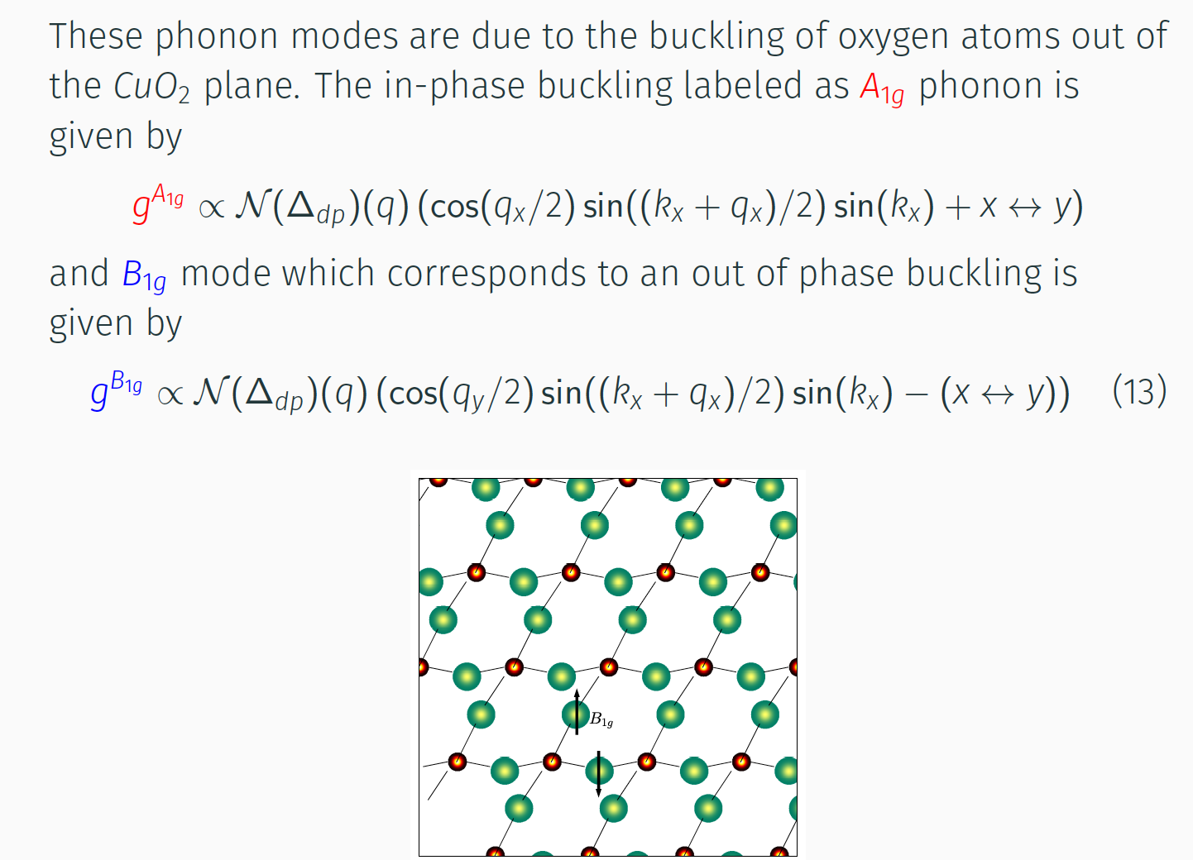
The Cuprate A_{1g} and B_{1g} Phonon Modes

