Slide 1
Nonequilibrium Physics by the Functional Renormalization Group
Dante M. Kennes
RWTH Aachen University
and
Max Planck Institute for the Structure and Dynamics of Matter
Berlin, July 28th 2022

Slide 2
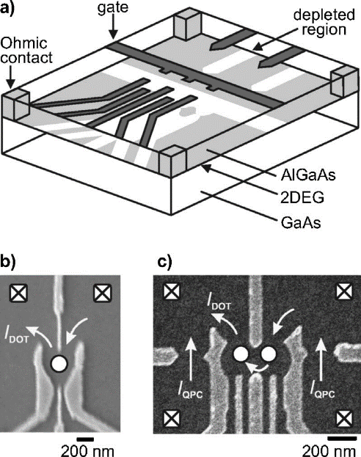
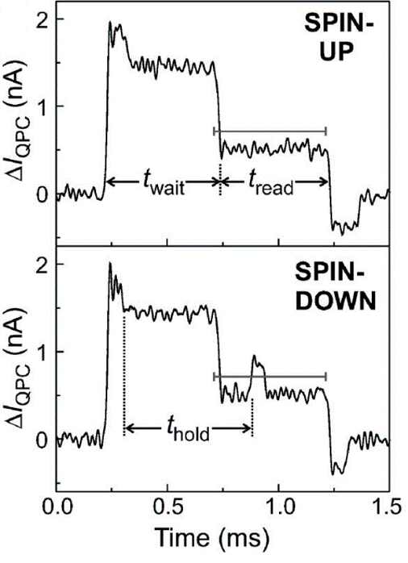
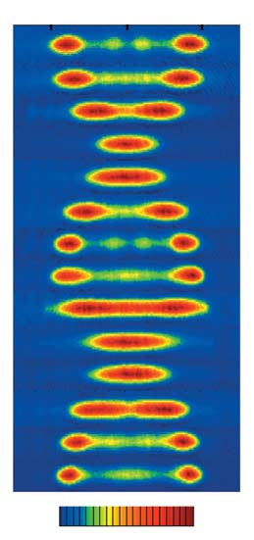
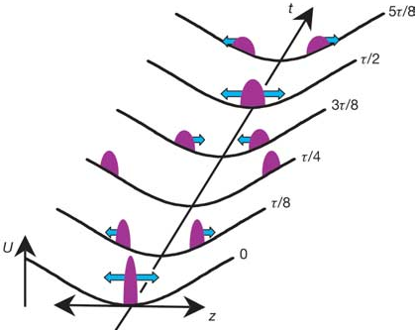
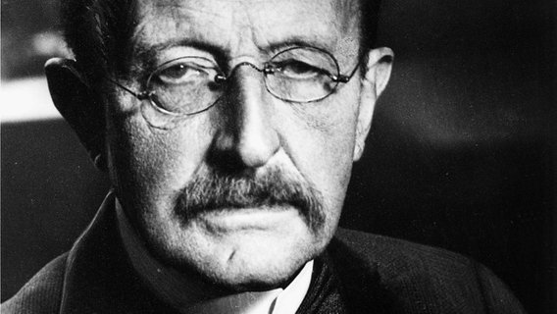
Motivation: Understanding Nonequilibirum Dynamics
Quantum dots
Cold gases
t
Hanson, et al. (2007)
Kinoshita, et al. (2006)
Quantum computing: “The NISQ era unfolds“
- John Preskill: arXiv:2106.10522
“insight must precede application“
- Max Planck

Slide 3
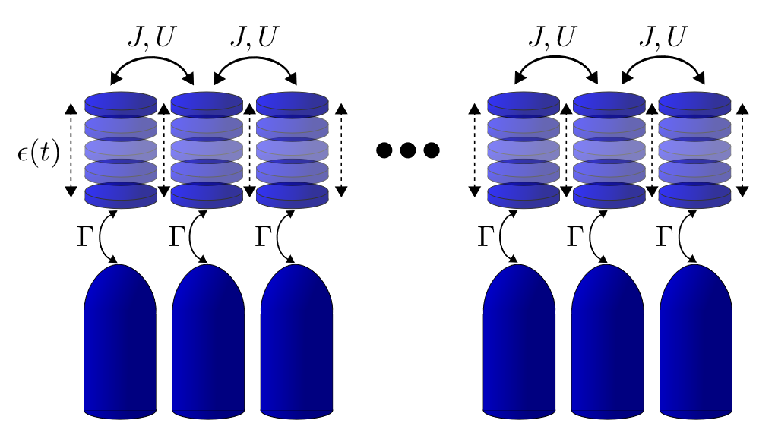
Stage: Which kind of models are we interested in?
Tight-binding model Hamiltonians:

Slide 4
Methodolgy: Nonequilibirum by Green’s Functions and Diagramatics
start with equilibrium:
aim at nonequilibrium: mixed propagation
Keldysh: rewrite as forward propagation on backfolded contour

Slide 5
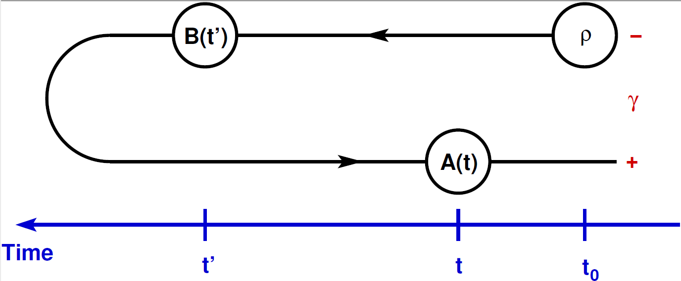
Methodolgy: Nonequilibirum by Green’s Functions and Diagramatics

Slide 6
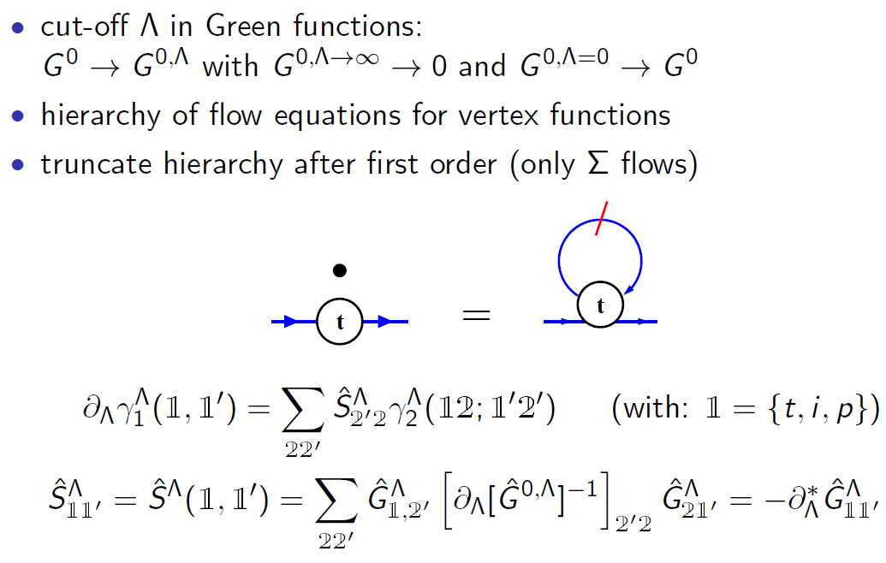
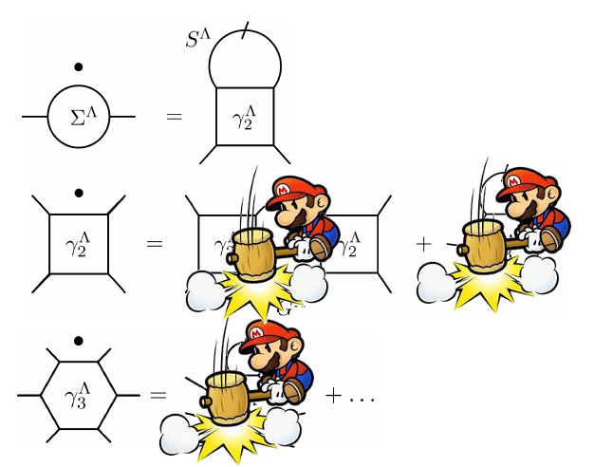
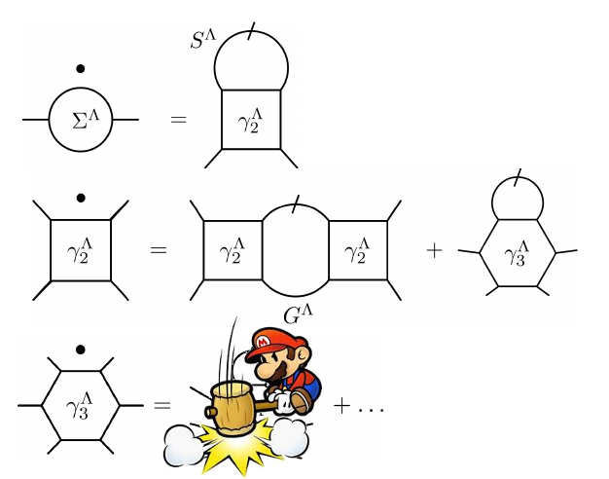
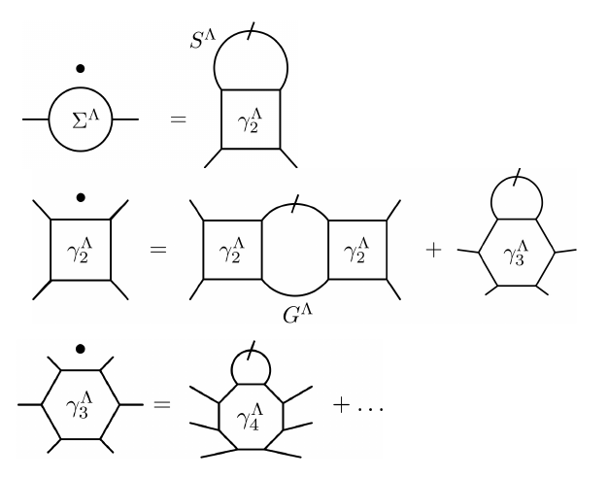
Methodolgy: Functional RG in Keldysh Space
two-particle interaction: FRG

Slide 7
Methodolgy: Functional RG a Flexible Approach to Nonequilibrium

Slide 8
Benchmark: Interacting Resonant Level Model
Why FRG?
Perturbation Theory:
Functional RG:
Schlottmann ´80-´82, Borda´07,Karrasch ´10

Slide 9
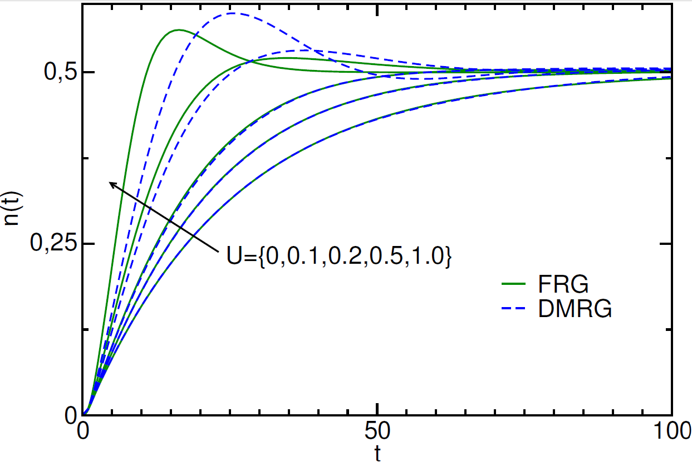
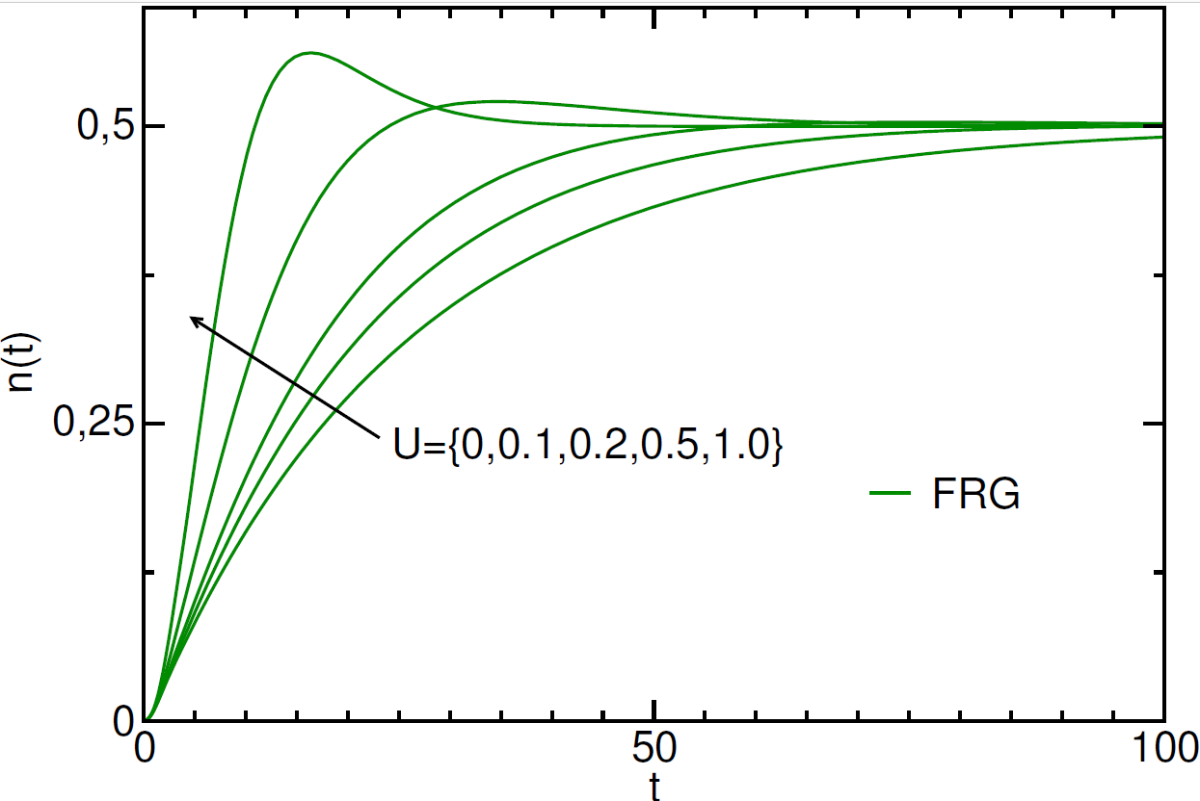
Benchmark: Interacting Resonant Level Model Dynamics

Slide 10
Periodic driving?
Floquet theory

Slide 11
Periodic driving?
Phys. Rev. Lett. 116, 026801 (2016)
Phys Rev B 94, 245116 (2016)
set up FRG in Floquet space

Slide 12
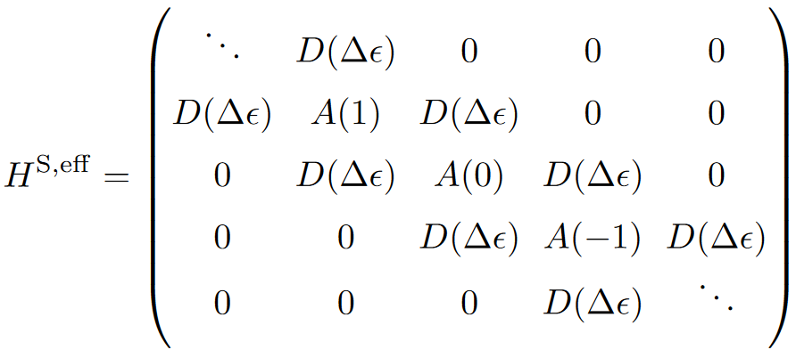
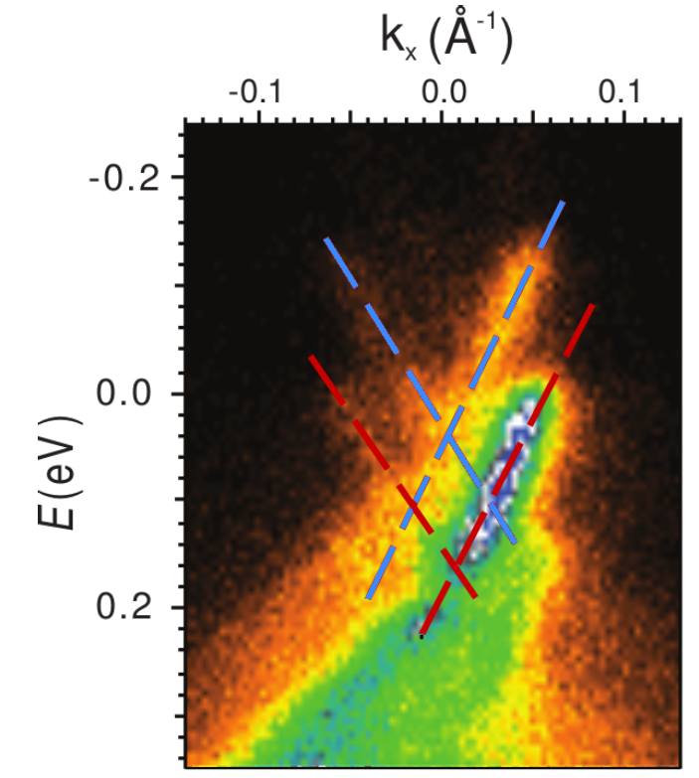
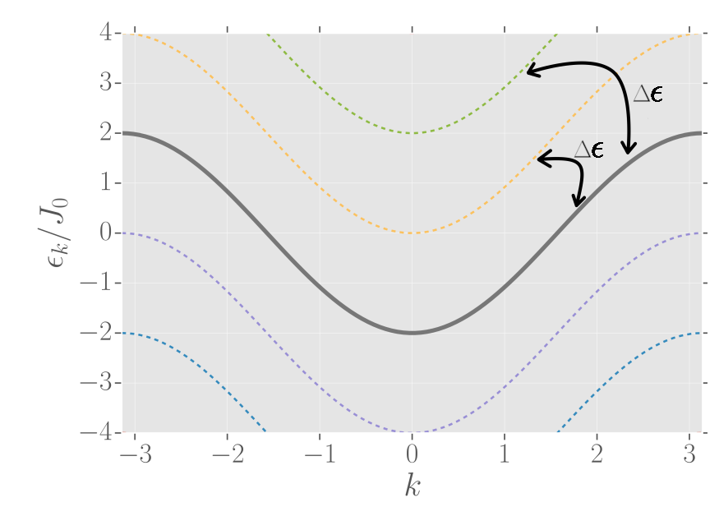
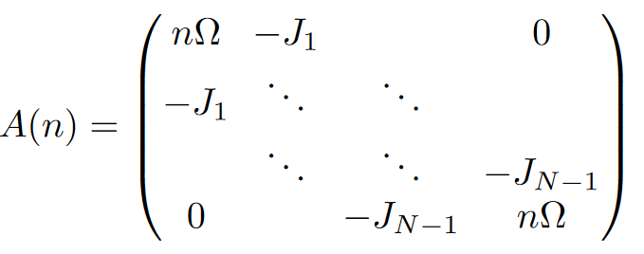
Periodically driven chain
arXiv:1801.02866
Floquet Sidebands!
Wang, et al. (2013)

Slide 13
Periodically driven chain
arXiv:1801.02866
Why FRG ?
In equilibrium: Luttinger Liquid with interaction dependent power laws:
e.g. transport through impurities or (boundary) density of states

Slide 14
Order of Vertex Truncation?
vs.
RG enhanced mean field
can resum powerlaws
numerically easy
no inelastic scattering (heating?)
RG enhanced RPA with inter-channel feedback
numerically cumbersome (2-particle vertex)
incl. inelastic scattering (heating?)
Instabilities signaling phase transitions

Slide 15
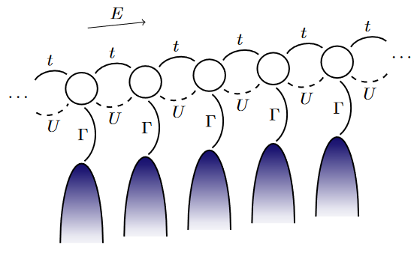
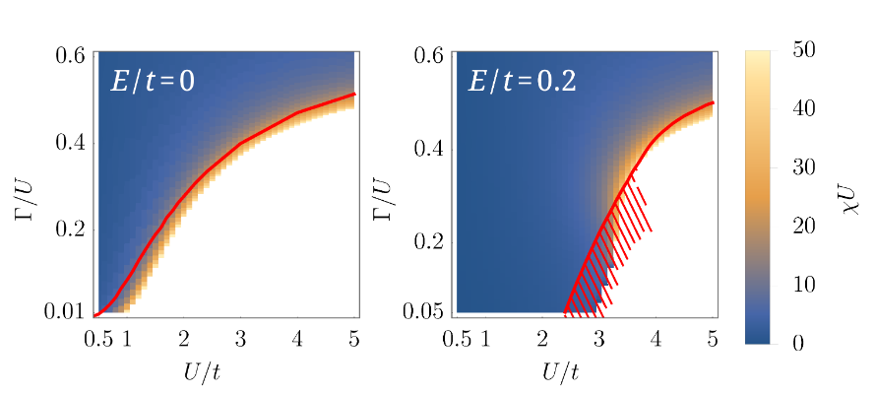
Phys. Rev. Lett. 125, 147601 (2020)
New J. Phys. 22, 083039 (2020)
arXiv:2205.00919
Statically Biased Chain
Berezinskii-
Kosterlitz-Thouless

Slide 16
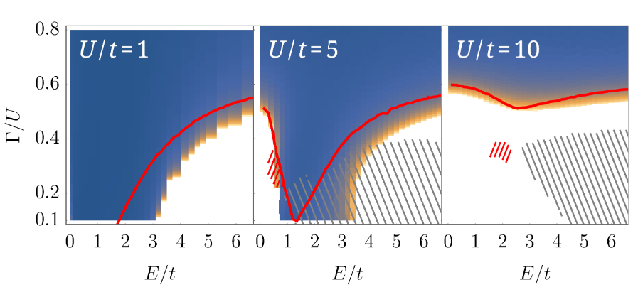
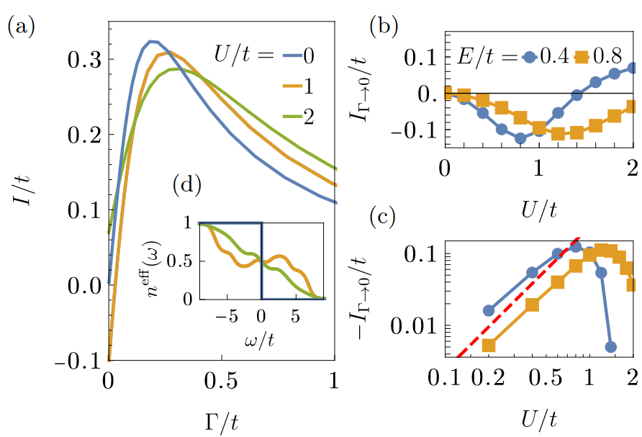
Phys. Rev. Lett. 125, 147601 (2020)
New J. Phys. 22, 083039 (2020)
arXiv:2205.00919
Statically Biased Chain

Slide 17
Take home messages
Nonequilibrium quantum many-body physics is a timely subject
FRG is a versatile tool to approach this problem
There is a enormeous potential for developments

